Slide 1






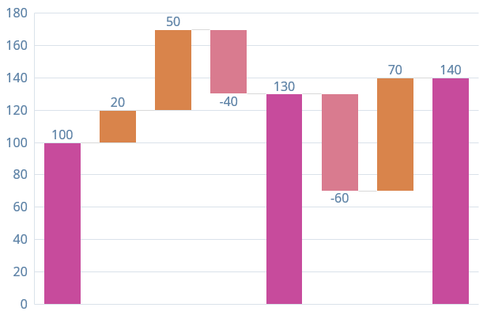
Title
Best Poster
1B
Program
Number
Author Name
Institution / University Name
Department, City, Country
author.name@institution.edu
www.research-website.com
Introduction
Methodology
Research background and motivation for the study
1
2
3
4
Key challenges in the current field of investigation
Objectives and scope of the presented work
Data Collection
Processing
Analysis
Validation
Novel contributions and expected outcomes
Gather and prepare experimental data from multiple sources
Apply preprocessing and filtering techniques
Perform statistical and computational analysis
Verify results and validate findings
Structure and organization of this presentation
Results
Data Comparison
Significant improvement observed in experimental group
Statistical significance achieved (p < 0.05)
Performance increased by 35% compared to baseline
The histogram
Discussion
The circle diagram
Key Finding 1
The experimental results demonstrate a significant improvement in performance metrics compared to baseline methods, with statistical significance at p < 0.05 level
Key Finding 2
Novel approach shows robust performance across different experimental conditions, validating the theoretical framework proposed in the methodology section
Key Finding 3
Analysis reveals important implications for future research directions and potential applications in related domains of investigation
Conclusion
The histogram
Key Finding 1
The experimental results demonstrate a significant improvement in performance metrics compared to baseline methods, with statistical significance at p < 0.05 level
Key Finding 2
Novel approach shows robust performance across different experimental conditions, validating the theoretical framework proposed in the methodology section
Key Finding 3
Analysis reveals important implications for future research directions and potential applications in related domains of investigation
This work was supported by the Russian Science Foundation under research project No.

