Slide 1


1 T MRI and biophotonics methods: synergy of approaches in biomedical research
Zherdeva Victoria
A.N. Bach Biochemistry Institute, RC of Biotechnology RAS
Moscow, Russian Federation
Saratov Fall Meeting
SFM'26

Slide 2
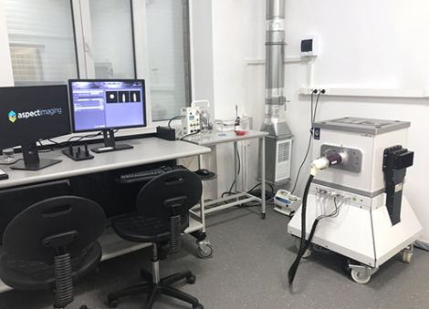
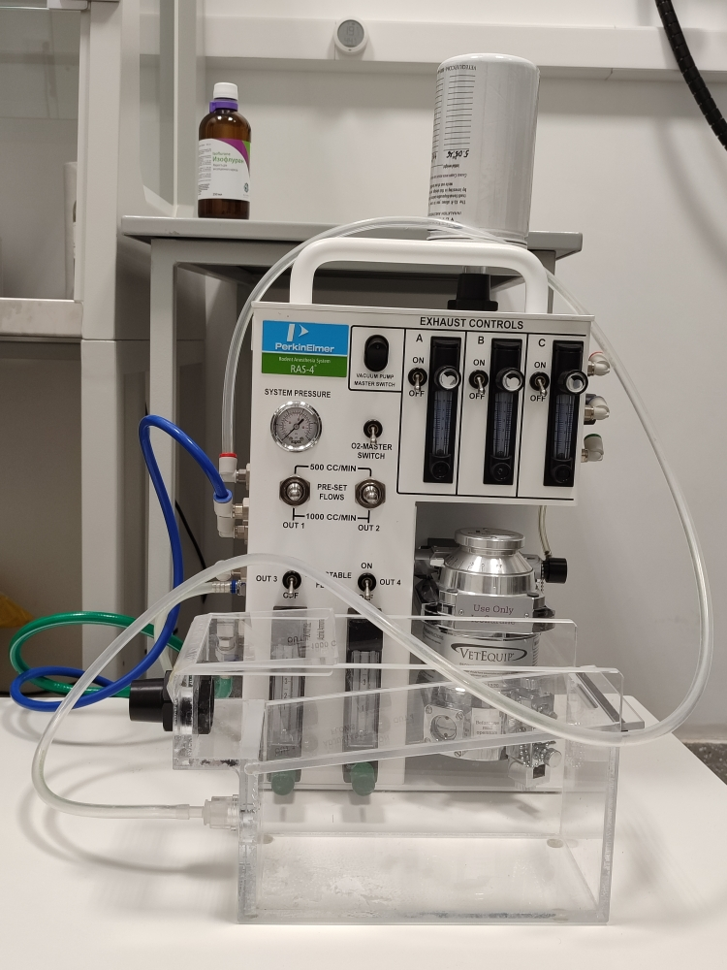
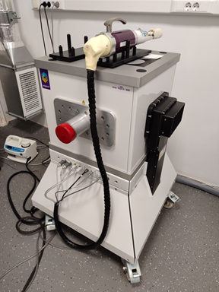
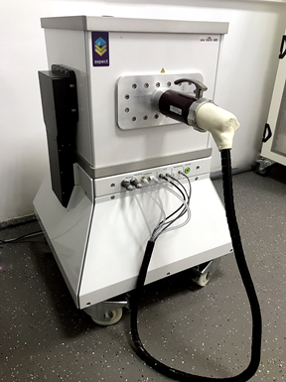
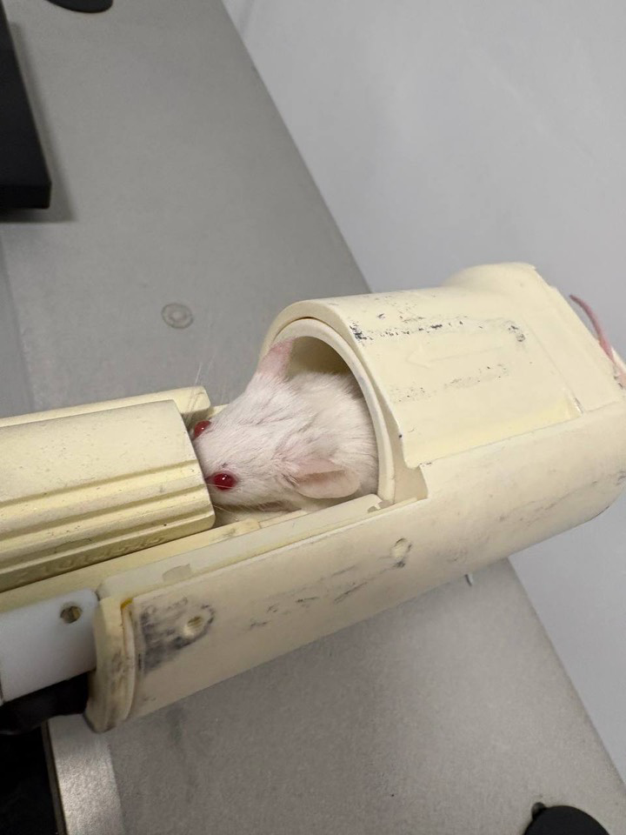
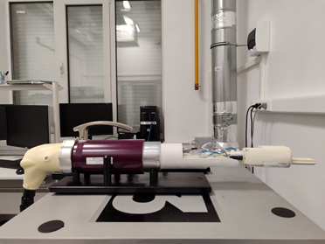
1T M3 MRI (Aspect imaging, Israel )
compact/non-cryogenic/ permanent magnet/easy to explotate in labrooms
the M3 1 T system- only for small lab animals (mice)
Equipped with 2 coil (Body and Head) installed into the handling system (=2 handling system)
Water heated bed for mice for maintaining the physiological processes
Breath monitoring
Combined to a Gas Anesthesia system(isoflurane +oxygen)
Notes:
This system was installed in our lab in 2020 and has since become a key piece of equipment. The system is based on a highly compact, non‑corrosive permanent magnet, which makes it very easy to operate.
We use the 1 T small‑animal MRI scanner exclusively for studies with small animals. It is equipped with a body coil and a head coil. The handling system includes water cooling to maintain stable physical conditions, and the setup is integrated with physiological monitoring and anesthesia delivery.
The system uses ultra‑strong gradient components. The bore diameter is either 50 or 160 mm, making it suitable specifically for mouse imaging. The gradient strength is several times higher than in clinical scanners, and the gradient switching rate is also very high, enabling fast transitions to maximum strength.

Slide 3
1 T M3 MRI
Because small animals require significantly higher spatial resolution than humans, these systems use specialized, ultra-strong miniature hardware components:
Inner Bore Diameter (50 × 150 mm): This narrow, specialized opening is designed tight to the subject. It accommodates an integrated animal handling bed and dedicated radiofrequency (RF) coils for small rodents, ensuring maximum signal-to-noise ratio.
Gradient Strength (440 mT/m): This is roughly 5 to 10 times stronger than standard human clinical MRI scanners (which usually top out at 40–80 mT/m). It allows the system to map microscopic structures in tissues just fractions of a millimeter wide.
Slew Rate (1750 T/m/s at 60 A): This indicates how fast the gradient magnetic fields can switch to their maximum strength. A high slew rate allows for ultra-fast pulse sequences and reduces image distortion.
Notes:
Because small animals require significantly higher spatial resolution than humans, these systems use specialized, ultra-powerful, miniature hardware components. Here's what these technical numbers mean in practice: Internal hole diameter (50 x 150 mm): This narrow, specialized hole fits tightly to the object. It features a built-in animal processing platform and dedicated radio frequency (RF) coils for small rodents to ensure maximum signal-to-noise ratio. Gradient strength (440 mT/m): This is approximately 5–10 times stronger than standard human clinical MRI scanners (which typically have a maximum power of 40–80 mT/m). This allows the system to map microscopic structures in tissues that are just a fraction of a millimeter wide. TEL - Abstracts on the line Slew rate (1750 T/m/s at 60 A current): indicates how quickly gradient magnetic fields can switch to maximum strength. High slew rate allows for ultra-fast pulse trains and reduces image distortion.

Slide 4
#1 effect of tissue optical clearing: diamagnetic Optical clearing agents & fluorescent imaging of red fluorescent protein expression in-vivo study
Bogdanov,
SPIE,2020
Bogdanov,
SPIE,2023
Notes:
Optical clearing (OC) increases the depth of light penetration and improves the outcomes of optical imaging
measurements in situ and in vivo. In vivo OC protocols have to be biocompatible and should result in transient effects
with minimal long-term damage to the tissues. The effects of various OC compositions in vivo were previously studied
by using primarily optical imaging. Multimodality registration of optical and magnetic resonance imaging (MRI)
signals in the same voxels of live tissue could be useful for improving accuracy of optical image reconstruction

Slide 5
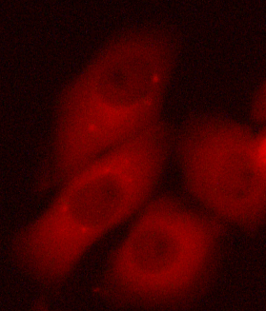
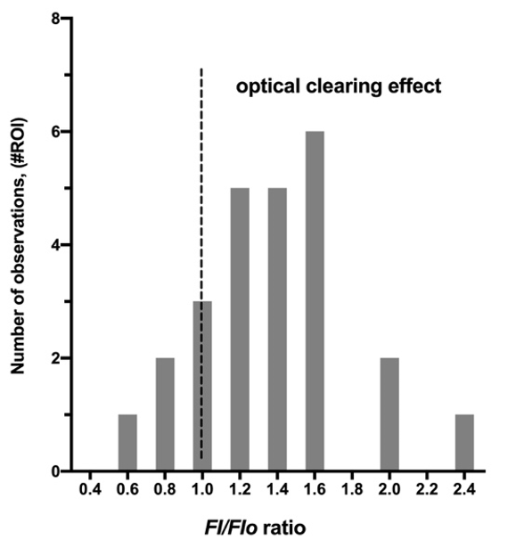
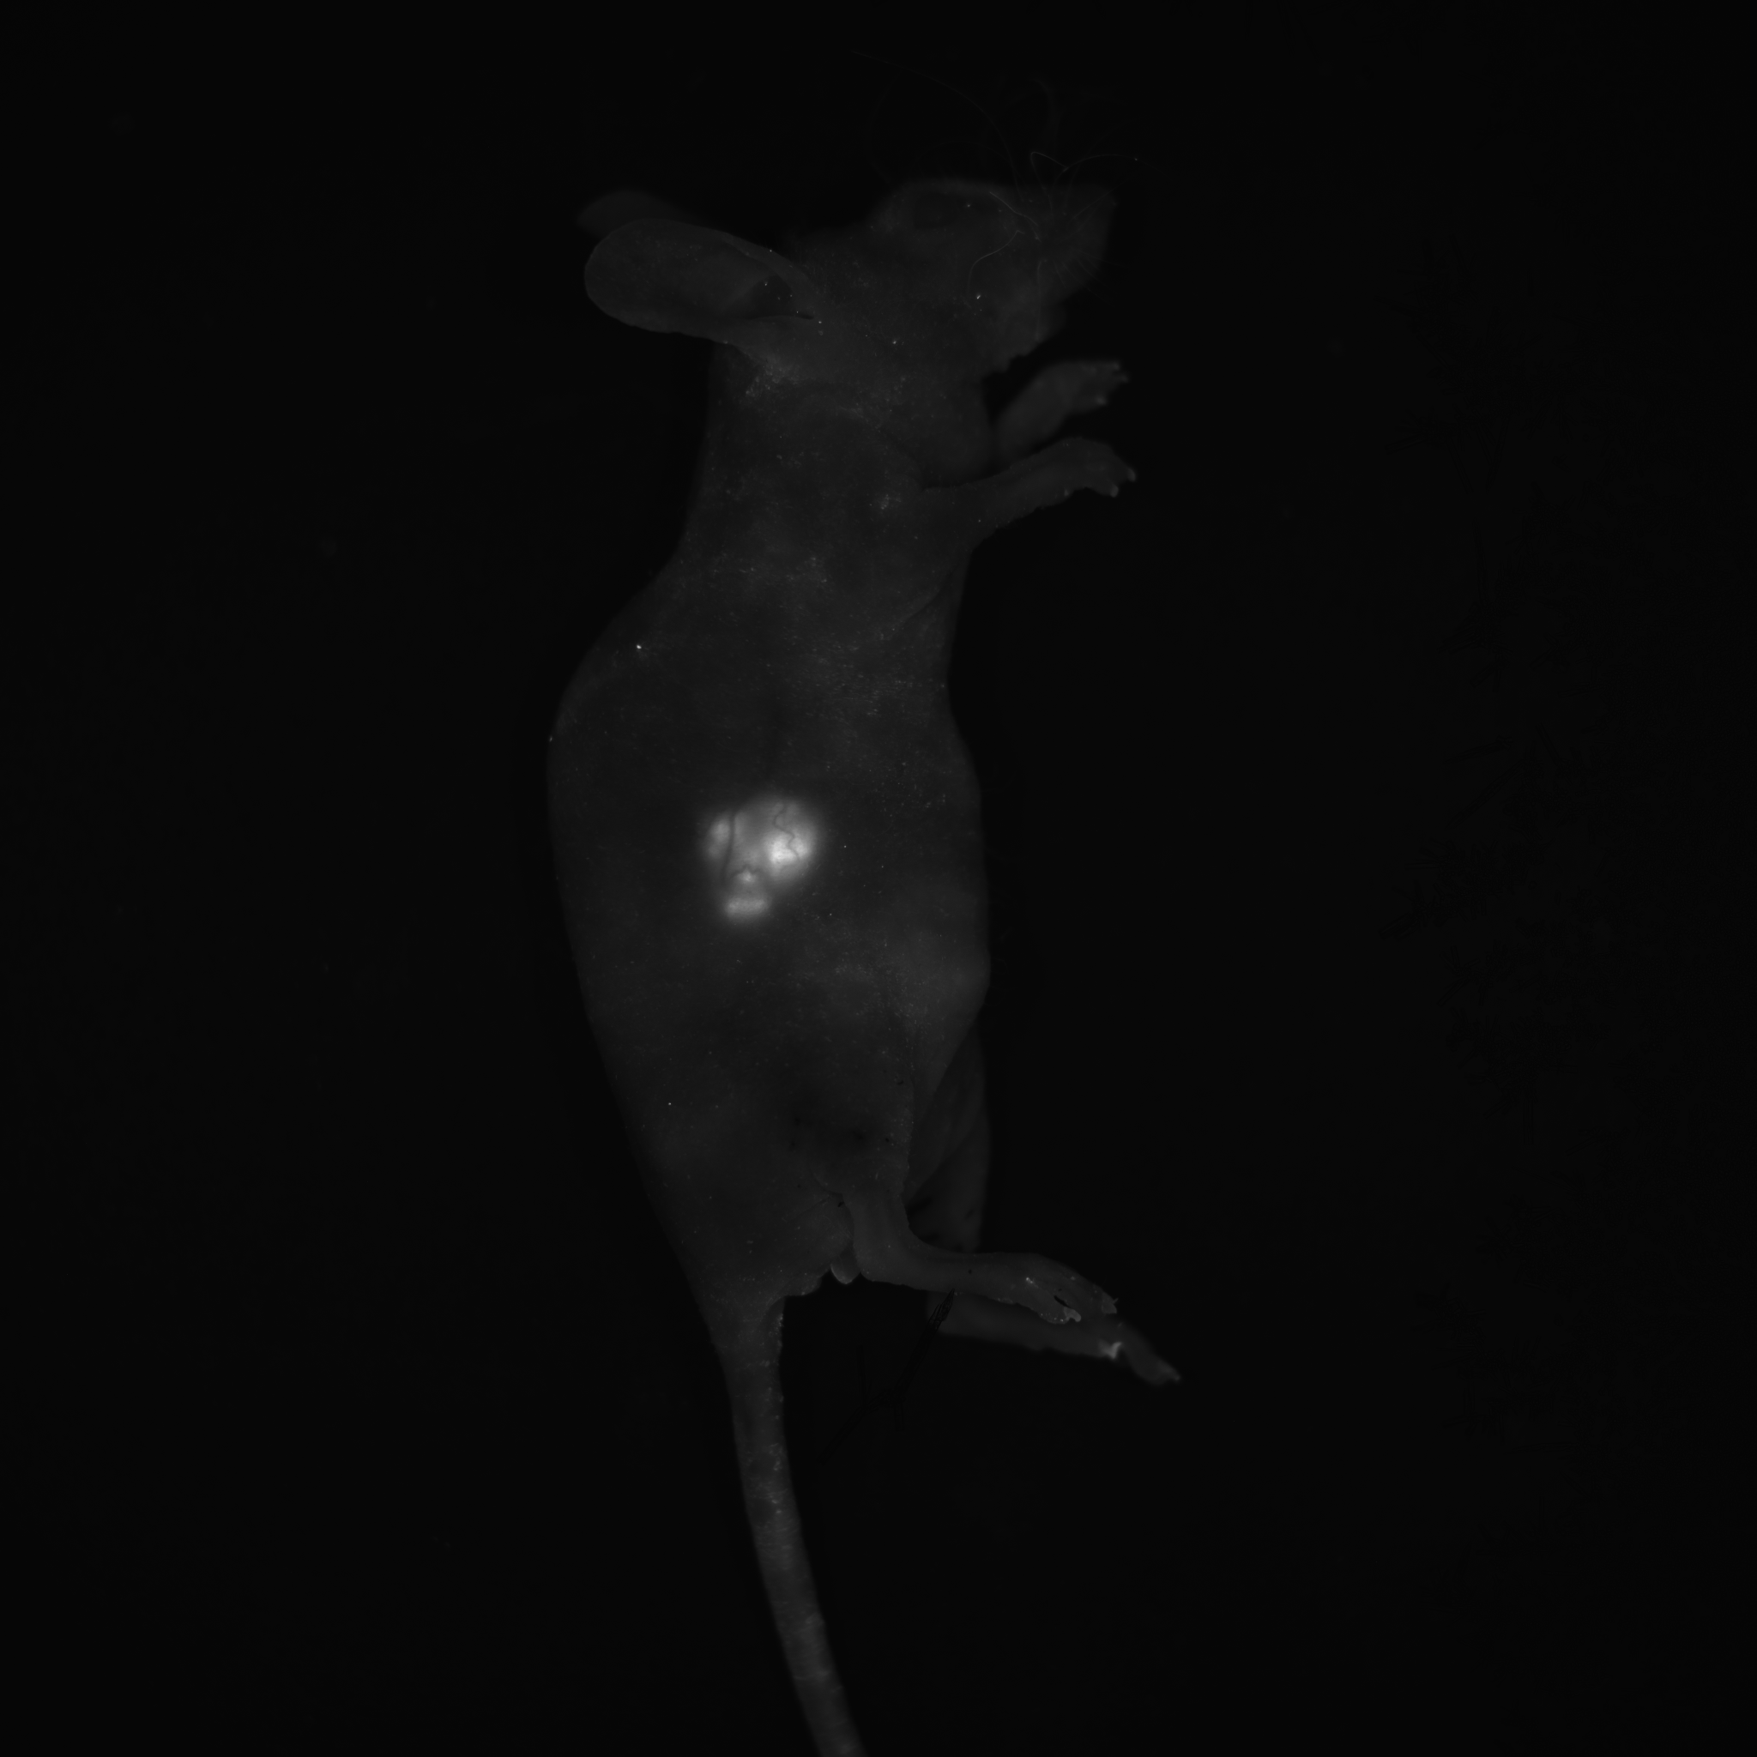
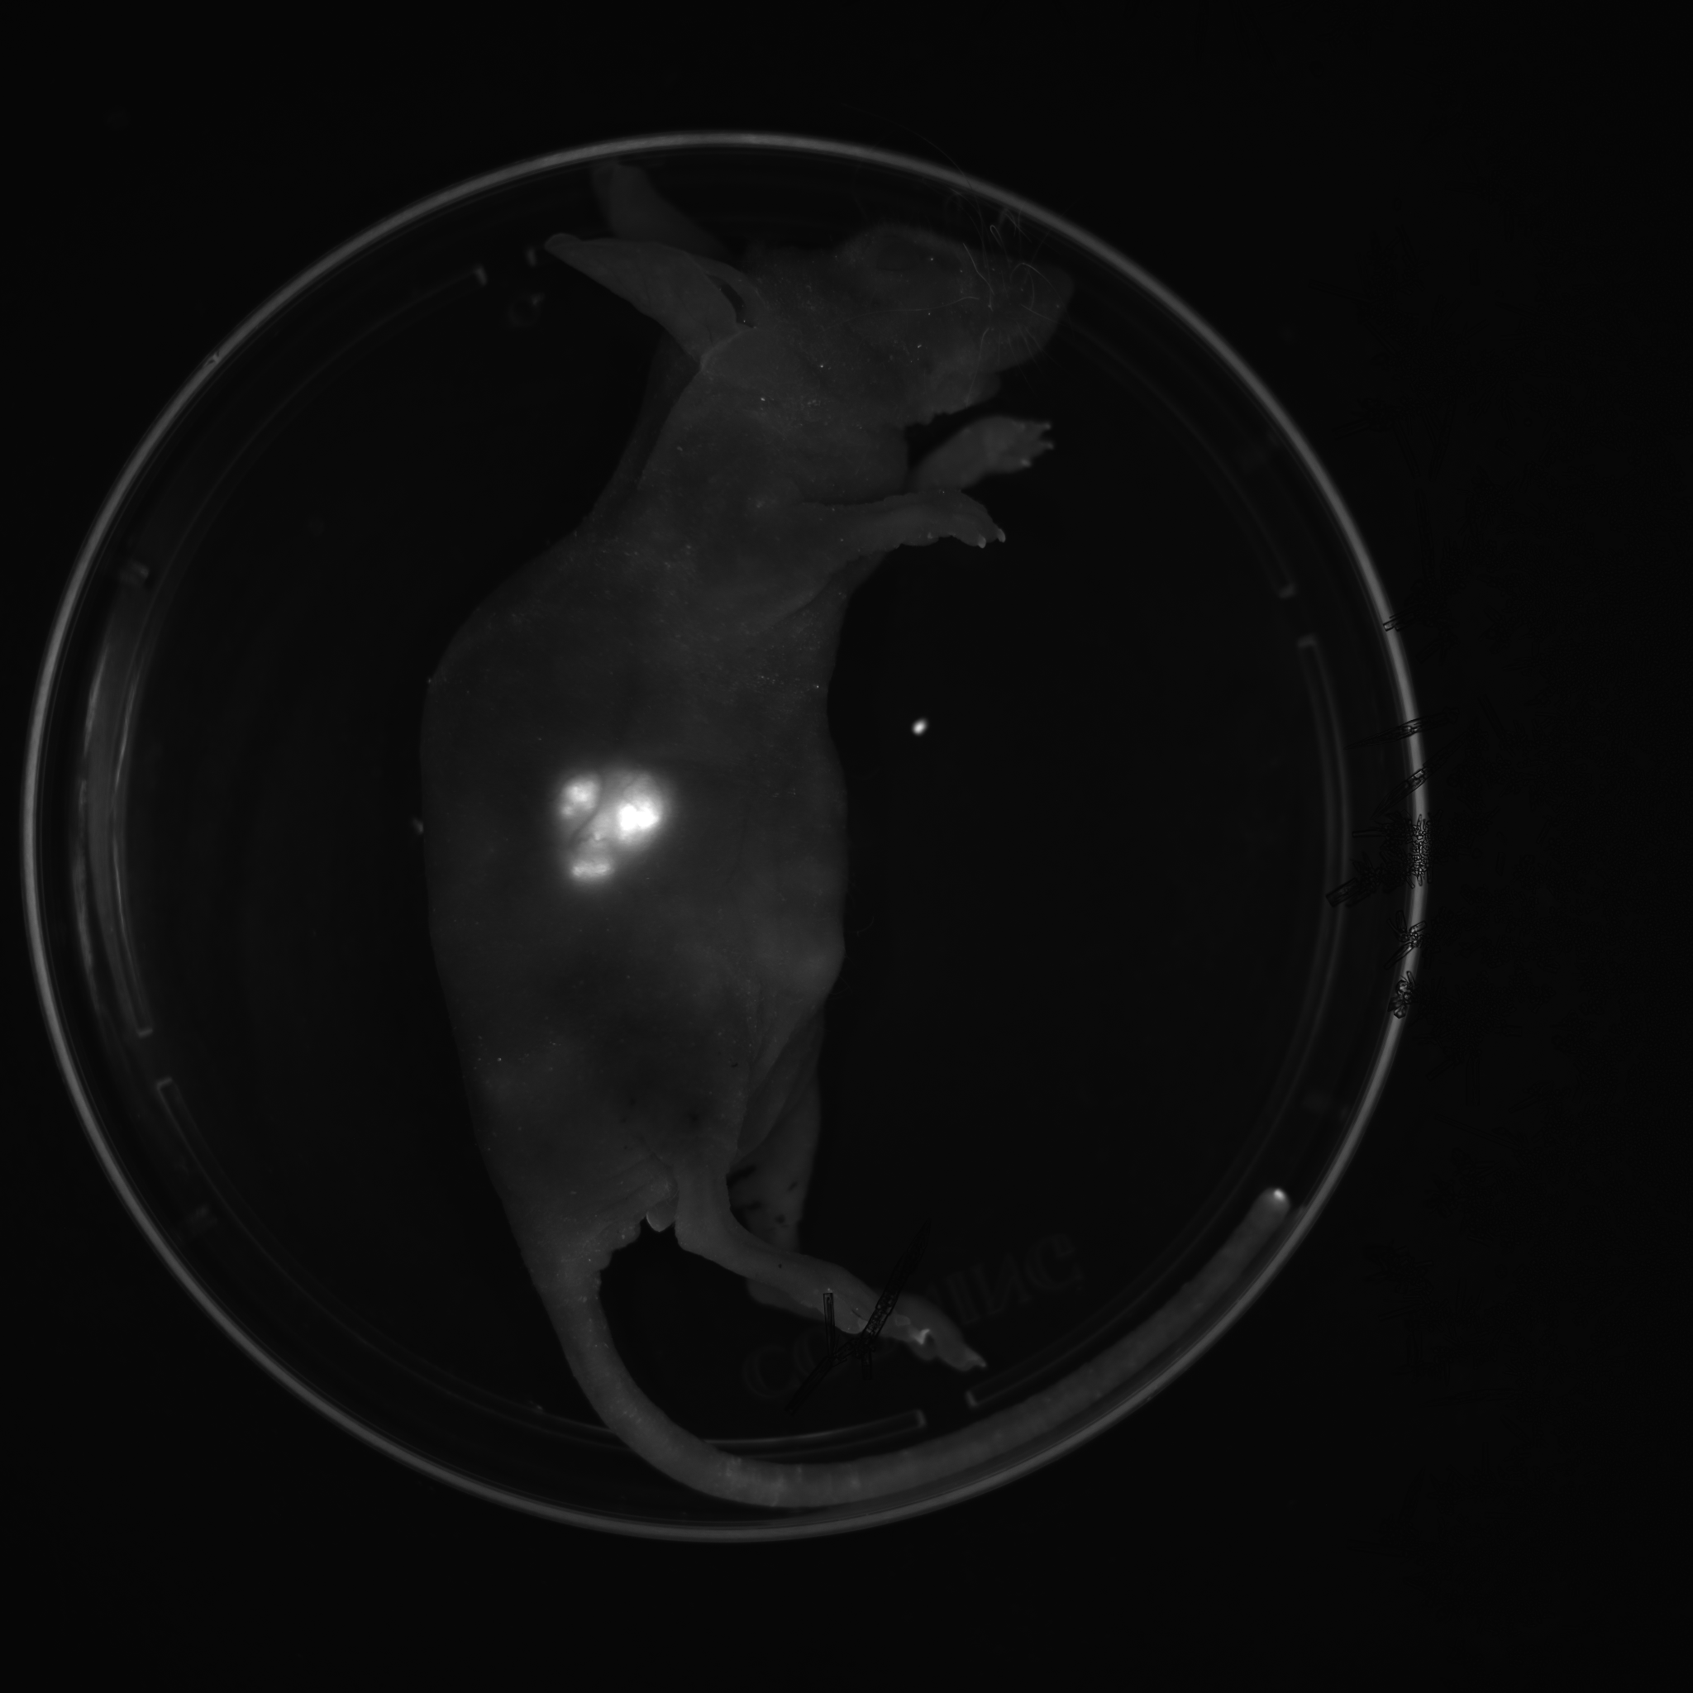
visualization of fluorescent tumor- bearing mice
TagRFP fluorescent protein expression in HEp-2 adenocarcinoma cells
OC:
glycerol 70%
water 25%
DMSO 5%
15 min OC application
FI /MRI
0 min
15 min
30 min
Fluorescence intensity ratio after/before OC : F_{i}/F_{o}
Fluorescence intensity increase (i.e. F_{i}/F_{o}>1)
OC effect was detected in
N=19 ROI from N=22 total (3 animals)
Non-invasive/ in vivo
increase of FI,
signal/background
Notes:
The goal of this research was in testing magnetic resonance imaging (MRI) pulse sequences for monitoring local changes
of proton relaxation times after the local application of skin optical clearing (OC) compositions in vivo.
We used xenograft
mouse models of cancer, i.e. nu/nu mice bearing subcutaneous tumors expressing endogenous TagRFP red fluorescent
protein marker and tested the changes in fluorescence intensity and lifetime (FL) of the subcutaneous tumor foci after OC
application (70% glycerol, 5% DMSO, 25% water) onto the skinBy using time-correlated single photon counting within
20-30 min after the OC we observed: 1) 30-40% increase in the overall photon numbers output; 2) 50 ps increase in the
median FL of TagRFP.
We subsequently performed tracking of MR signal intensity changes within selected regions of
interest (ROI) located close to the skin surface before, during and after OC.

Slide 6
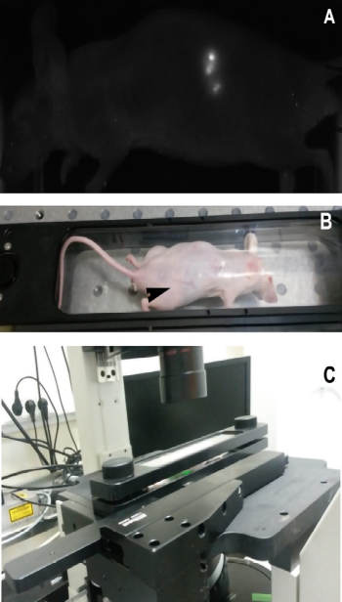
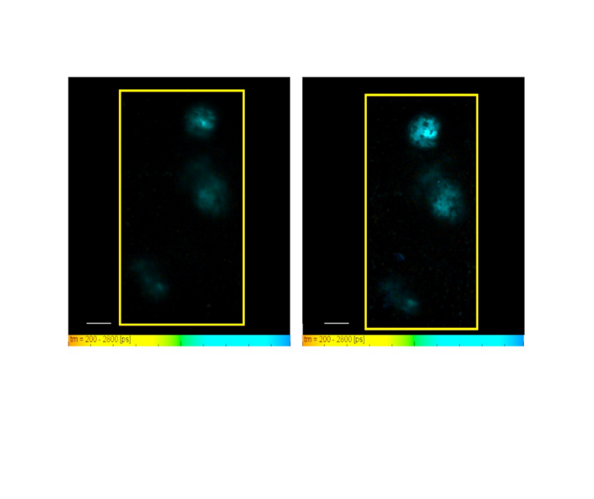
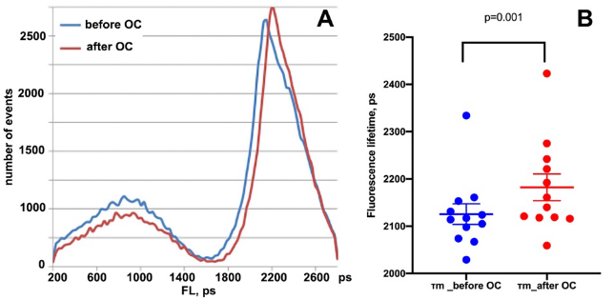
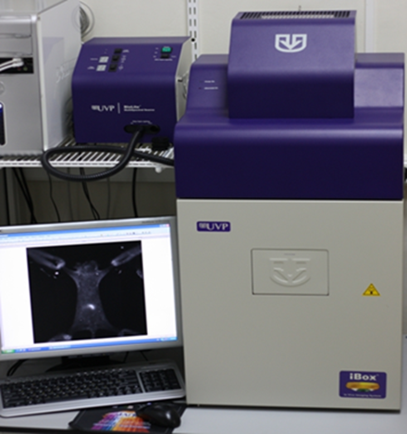
Fluorescence setup and results
A – macroscopic low resolution iBox (UVP) image of the whole mouse bearing
a HEp-2-TagRFP tumor. The tumor formed three distinct nodules in the mouse flank; B= a cassette for mouse imaging
with the tumor in a close proximity to the glass window (indicated by an arrow); C – the cassette positioning on the stage
of the confocal in vivo imaging device based on inverted microscope
Confocal microscopic image of three small HEp2-TagRFP nodules showing fluorescence intensity of TagRFP
before (A) and after (B) of OC application. FL pseudocolor scale is shown under each image. Bar = 1 cm.
Notes:
We used steady state and time –resolved fluorescence to monitor the OC effect combining to MRI

Slide 7
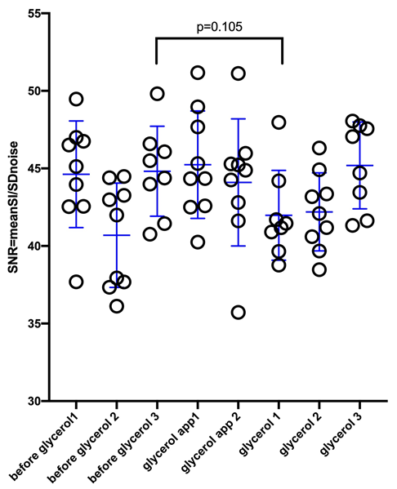
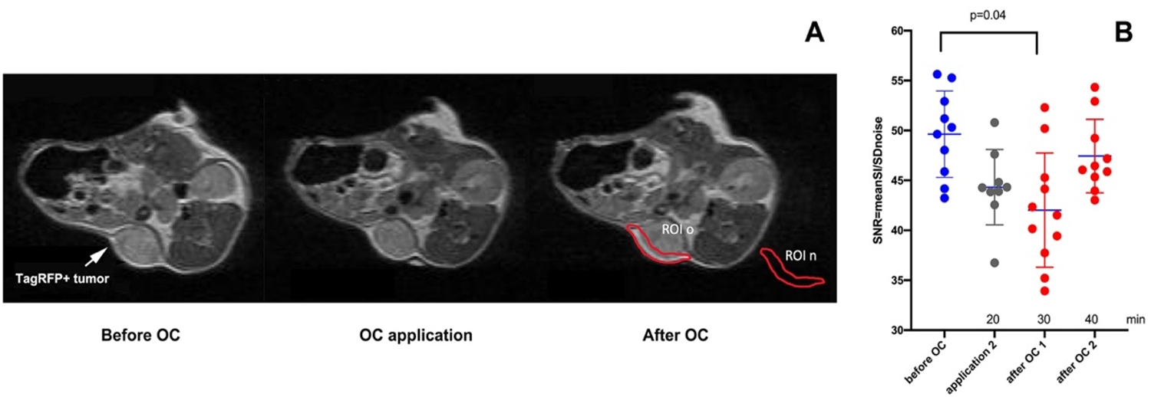
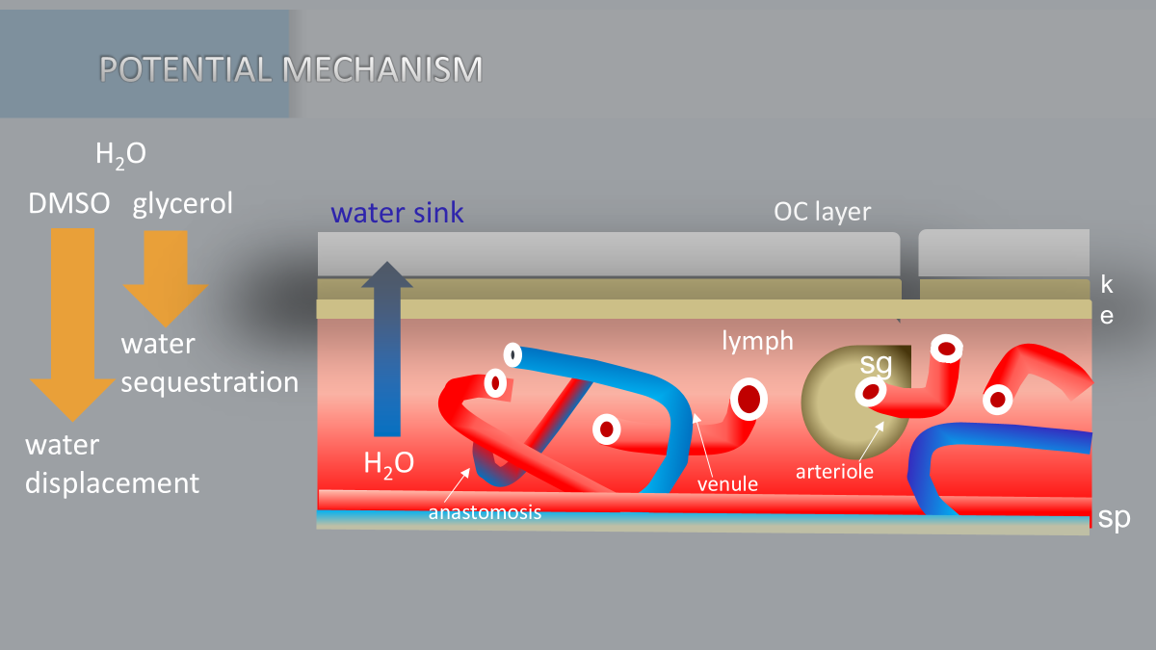
T2-weighted FSE in axial MRI slices
But in Skin/subdermal space MRI showed shortening water proton relaxation times
Whole tumor imaging revealed no
statistically significant differences in MR signal
intensity changes after OC
Notes:
Whole tumor imaging revealed no statistically significant differences in MR signal intensity changes after OC.
The analysis of 1T MR T2-weighted (T2w) ) in subcutaneously ROI space MRI showed shortening water proton relaxation times.
Our results suggest that the application of OC may cause: 1) a transient change
of the peripheral tumoral microenvironment and as a consequence, FL increase and shortening of mean proton relaxation
times within the subcutaneous tumor (i.e. T2w hypointensity increase); 2) potential microviscosity change due
to the permeability for the OC components resulting in shortening of tissue water proton relaxation times.
Both processes may be due to glycerol induced water displacement in the tissue and in-depth penetration of DMSO molecules.
These changes may stem from the water content transiently decreasing due to glycerol and DMSO penetration into the skin and sequestration of water in dermis/epidermis which may result in dehydratation and relative increase of blood volume (capillary density) in the peripheral tissue.
We presume that increase of deoxyhemoglobin contributes to paramagnetic effect and shortening of water proton relaxation times. Additional effect may be caused by local hyperthermia due to glycerol/dmso penetration and resultant vasodilation.

Slide 8

Conclusions
The obtained results point to the potential mechanism of OC clearing as it relates to a transient change of microenvironment affecting the layer of TagRFP-expressing cells and resulting in FL increase and T2w MR hypointensity increase.
T2w 1T MRI showed promise for detecting small longitudinal changes of the MR signal under the conditions of OC, which benefits not only in vivo imaging of marker protein expression in animal tumor models but vasodilatation and vasoconstriction effects as well
Notes:
The results obtained indicate a potential mechanism for optical clearing (OC). It is associated with a transient change in the microenvironment that affects the layer of cells expressing the TagRFP protein and leads to increased fluorescence intensity (IF) and increased hypointensity on T2-weighted MR images.

Slide 9
#2 effect of tissue optical clearing: paramagnetic MRI contrast agent & fluorescent imaging of red fluorescent protein expression in-vivo study
Bogdanov,
SPIE,2021
Bogdanov,
SPIE,2023
Kazachkina,
NMR in Biomedicine 2022
Kazachkina,
JBPE, 2021
Zherdeva,
MDPI, 2023

Slide 10
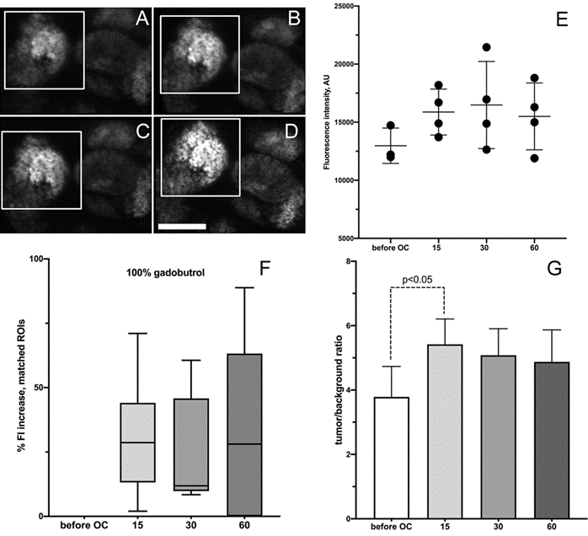
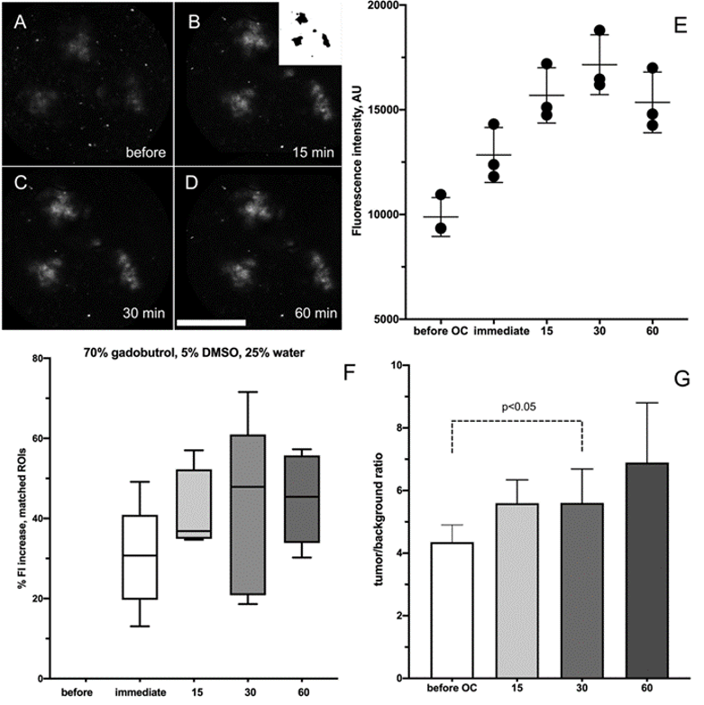
Fluorescence in vivo after OC using 1M and 0,7M Gadobutrol (GB)
1M GB
0,7M GB
A-D FI of tumor before and after 15-60 min after 100% GB application.;
Е - FI-time dependence А-Г;
F –FI\F0( %);
G – FI SNR, (n=8-9) bar(D) = 2 мм.
A-D FI of tumor before and after 15-60 min
after 70% GB application.;
Е - FI-time dependence А-Г;
F –FI\F0( %);
G – FI SNR, (n=8-9) bar(D) = 5 мм.
Notes:
What is observed with the application of 1M gadobutrol? Processing of the results is presented in the form of the same figures. Tumor nodes are shown with high magnification, Slight growth and at the same time a greater scatter of IF (E) In the Tukey plot, there is a “dip” at 30 minutes, a large scatter of values ​​​​at 60 minutes (F) and Statistically significant P < 0.050
The effect of 1.0 M GB on the tumor-to-skin ratio occurs earlier (after 15 minutes, figure G). While the overall tumor/background ratio was similar for both OP formulations before measurement, the effect for 0.7 M GB at 30 min persisted and continued to increase, which could indicate an improvement in refractive index matching between the skin and different subcutaneous tissue layers over time, possibly due to the presence of DMSO in the 0.7 M GB OC formulation.
Thus, a direct comparison of the two OP regimes led to the conclusion that, due to differences in composition, in the case of the 0.7 M GB Op mixture, there was a continuous modification of the tissue dispersion environment, possibly due to the penetration of the OP composition into deeper tissue layers.

Slide 11
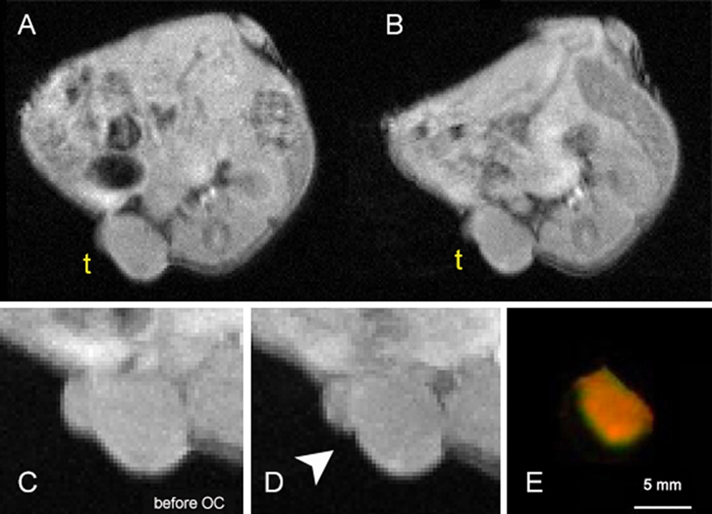
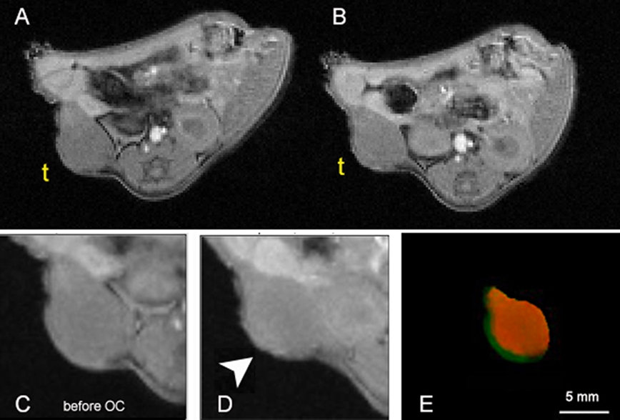
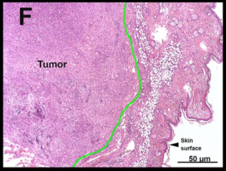
3D-GREMR-imaging before and after gadobutrol application
0,1-0,25 mm
0,74±0,12 мм
0,62±0,06 мм
1М GB visualized as empty spaces at tumor periphery
0,7М GB enhanced MR-signal at tumor periphery
3D GRE MR imaging (TR/TE= 60/2.9 ms, FA 20o, NEX 5) before (A) and after 30 min GB application (B) t- опухоль; MIP before ( N=4) (С) and after 3- min GB application (D); E –pseudocolor mapping of ‘before’ (green) and ‘after 30 min’ (red) of GB applicatiton ; bar = 5 mm
А- H&E ( green - boundary of the skin layers) bar= 500 mkm
Notes:
This slide shows images obtained in 3D gradient echo mode at 1 M and 0.7 M before and after GB. The image was obtained using four MRI slices before OP and after 30 min of GB application. And an overlay of the before and after images (in green and red) respectively. It can be seen that 1 M GB is visualized as a void on the surface, and 0.7 M gives an increase in the MR signal throughout the tumor, which was previously presented in the graphs. By superimposing separate MR sections before and after AP, it was possible to assess the degree of penetration of GB into tumor tissues (E) and determine the depth at which GB concentrated and began to dissolve in the tissue. In the case of 0.7 MGB, this depth was 0.74 ± 0.12 mm compared to 0.62 ± 0.06 mm in the case of 1.0 MGB. The depth of penetration of GB through the skin, obtained using MRI, exceeded the histological dimensions of the skin layers (F). Using standard H&E histology, we estimated that the most proximal portion of the tumor was located at a depth of 0.1-0.25 mm from the skin surface.

Slide 12
conslusions
A 1.0 M gadobutrol (GB) solution increases tumor fluorescence intensity by 30–40% within the first 15 minutes, after which the intensity decreases over time.
The use of T1-weighted MR pulse sequences showed that the 1.0 M GB concentration caused a loss of the skin MR signal due to high magnetic susceptibility. This signal loss coincided chronologically with the OC effect.
A 0.7 M gadobutrol solution leads to both a 30–40% increase in fluorescence intensity within the first 15 minutes and a steady growth in fluorescence and the signal-to-background ratio during the subsequent 15–60 minutes of observation.
MRI enabled monitoring of the OC effects of GB-containing mixtures on the skin surface and in tumor tissue, as well as investigating the in vivo correlation of fluorescence intensity increase over time.
Notes:
A 1.0 M gadobutrol (GB) solution increases tumor fluorescence intensity by 30–40% within the first 15 minutes, after which the intensity decreases over time.
The use of T1-weighted MR pulse sequences showed that the 1.0 M GB concentration caused a loss of the skin MR signal due to high magnetic susceptibility. This signal loss coincided chronologically with the OC effect.
A 0.7 M gadobutrol solution leads to both a 30–40% increase in fluorescence intensity within the first 15 minutes and a steady growth in fluorescence and the signal-to-background ratio during the subsequent 15–60 minutes of observation.
MRI enabled monitoring of the OC effects of GB-containing mixtures on the skin surface and in tumor tissue, as well as investigating the in vivo correlation of fluorescence intensity increase over time.

Slide 13
#3 effect of tissue optical clearing: paramagnetic MRI contrast agent & fluorescent imaging of dcas9 –FP expression in-vivo study
Abushinova,
JBPE, 2024
Zherdeva,
MDPI, 2023

Slide 14
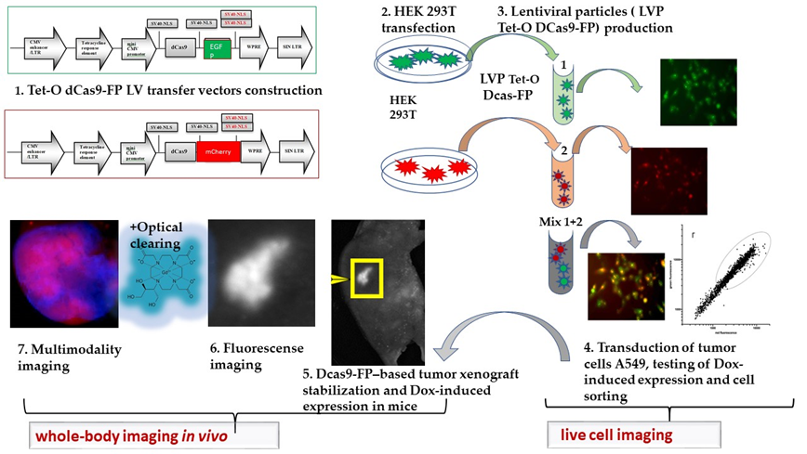
Notes:
We further investigated the effects of OС in more complex models; we developed CRISPR-based tools that included steps from vector construction, transfection of packaging lines, production of lentiviral particles, followed by transduction of tumor cell lines and sorting of transduced cells after doxycycline-mediated induction. This system was tested in vivo on murine subcutaneous xenografts. The use of doxycycline for induction also resulted in the expression of chimeras in subcutaneous xenografts. Imaging was improved using OPA gadobutrol (an MRI contrast agent)
.

Slide 15
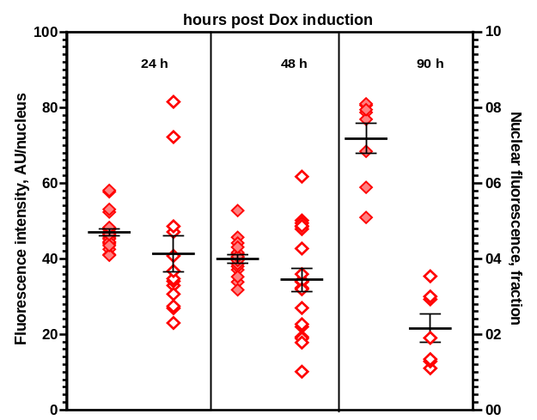
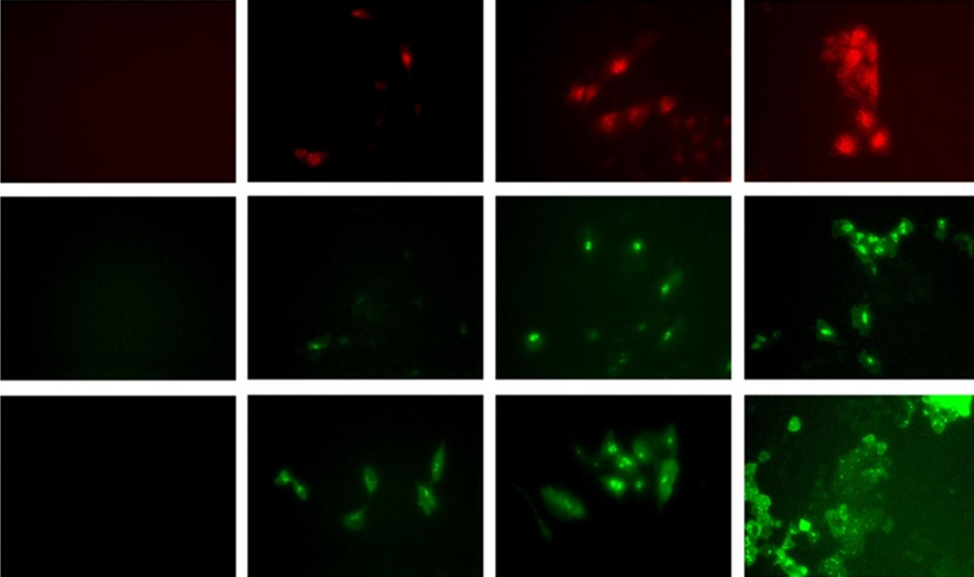
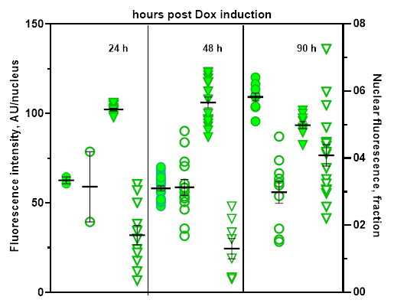
Evaluation of fluorescent signal development kinetics in cells (Tet-On induced expression of St, Nm, Sp dCas9 orthologs)
Nm
St dCas9-EGFP-Nm mCherry ?
Nm
St
Sp
Zeiss Axio Observer, X40
0h | 24h | 48h | 90h
Sp
Dependence of the intensity of red cell nuclear fluorescence (red symbols), green FI (green symbols) in A549, and the fraction of total FI in cell nuclei (open symbols) on the time elapsed since the induction of chimera expression with DOX
St
Maloshenok et al., Materials. 2023
Notes:
We also studied time-dependent expression of these chimeric fluorescent constructs (dCas9-FP) after Tet-On-induction in live cells and
The maximum level of expressed fused proteins have been demonstrated up to 90 hours. The optimal pairs with similar dynamics of fused products accumulation in nucelia and optimal fluorescent proteins with FRET capability.
quantitative measurements of nuclear FI changes after transduction and the morphology of the distribution of fluorescence showed that: 1) the optimal time (time window) for monitoring the co-expression and co-localization of fluorescent chimeras of dCas9 was 24-48 hours; 2) StdCas9-EGFP chimera can be used as a preferred donor of excitation photons in combination with NmdCas9-mCherry as a FRET pair donor. Cells expressing StdCas9-EGFP (Fig. 2 - A) and NmdCas9-mCherry (Fig. 2 - B) showed normal morphology with predominantly nuclear dual fluorescence in co-transfected cells after LV transduction. Dual expression of both chimeras was present in about 20% of all cells (Fig. 2 - C). Sorting of single cells enabled obtaining a set of clones (e.g. E9 used for in vivo work, Fig. 3) with subsequent stabilization in culture after10 passages.

Slide 16
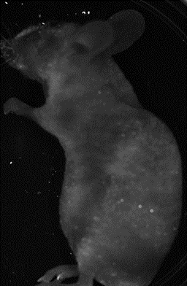
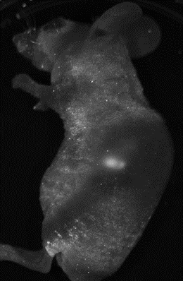
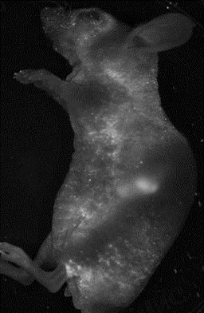
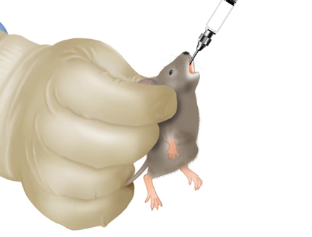
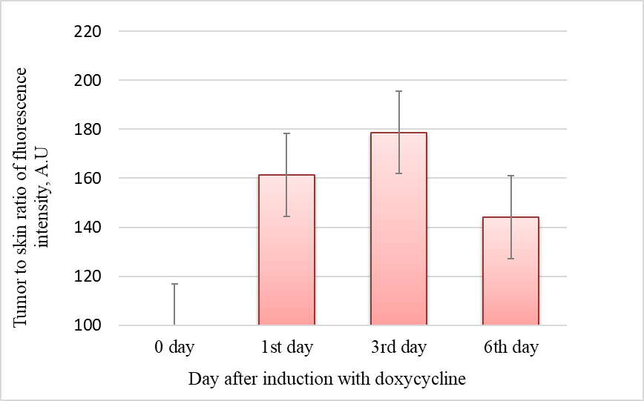

Индукция экспрессии ортологов St dCas9 EGFP-Nm/ dCas9-mCherry в опухолевых ксенографтах на мышах линии nude
Dox gavaging
200 µg per a day– 2 days
iBox (UVP, USA)
Excitation: 502-547 nm, emission: 570-640 nm (iBox).
A549 St dCas9-EGFP-Nm mCherry
Xenografts in nude mice
Notes:
To test dCas9 chimera expression imagingin vivo, the experimental tumors xenografts were propagated in athymic mice by subcutaneous injection of A549 (clone E9) cells. Cells showed Dox-dependent expression of dual chimeras (StdCas9-EGFP and NmdCas9-mCherry) after the animals were given Doxycycline (200 μg 2xdaily) on the second week post implantation. The initial induction of expression was followed by FI measurements with 3 d intervals in between the measurements, i.e. on the 1st day (24 h), 3rd (72 h) and on the 6th day (148 h) post Dox induction (Fig.3-A). Fig. 3-A shows the mean FI of the tumor normalized by the reference FI value of the skin. Dox-induced expression of FP-chimeras in tumor xenografts was observed already at 24 h post-induction [20]. The corresponding increase of tumor FI was 1.6-times on the 1st d, 1.8-times on the 3rd d, with a subsequent decrease of 1.4x times of initial FI recorded on the 6th d after
In vivo Dox-induction of mCherry-chimera expression occurred in tumor xenografts as early as at 24 h post-induction and was visualized by using optical clearing (OC) of the skin. OC via topical application of gadobutrol enabled high-contrast imaging of FP expression in tumor xenografts due to 1.1-1.2-fold increase of FI in both red and green channels.

Slide 17
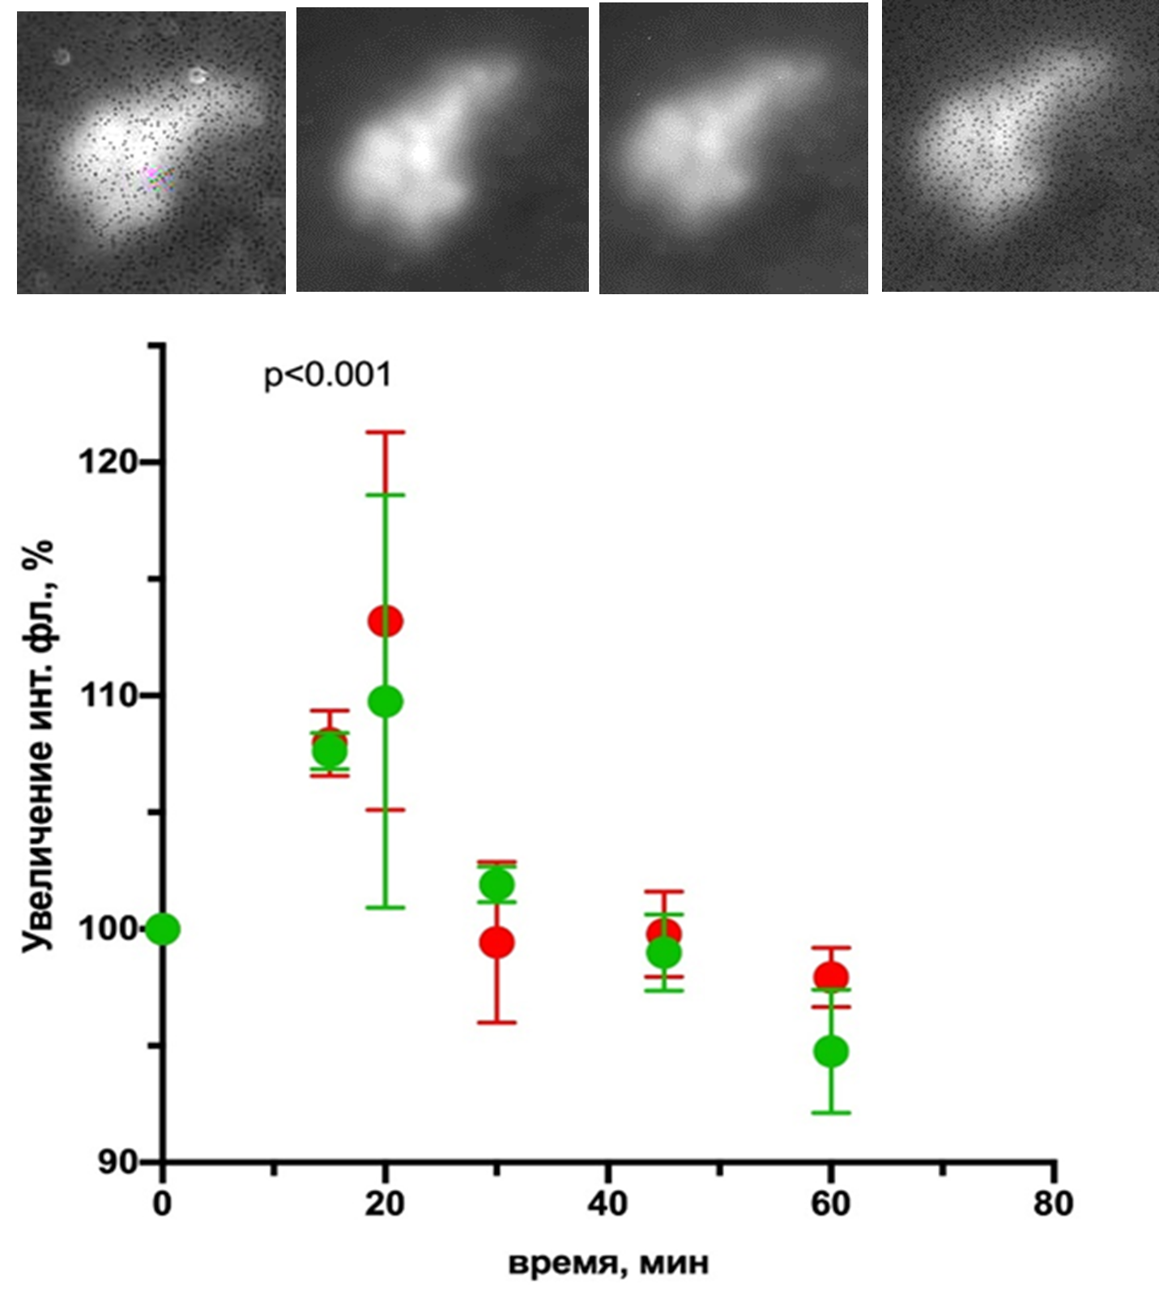
Planar imaging of s.c. tumor using optical clearing with 0.7 gadobutrol
A
- Fluorescence imaging (A) and skin-normalized fluorescence in the E9 tumor (B) at 3rd day after tet- induction using 0.7 M gadobutrol as an optical clearing (OC) agent (before optical clearing, 15 min after OC, 30 min after OC, after 45 min after OC, 60 min after OC) ( ex 502-547 nm, em 570-640 nm, iBox UVP)
B- P values ​​(Wilcoxon-Mann-Whitney test, n = 6-12 data points) are shown above the bars. Data are presented as mean ± standard deviation
B
Notes:
We use gadobutrol (0.7 M) not only as an MRI contrast agent but also as an optical clearing agent.
This dual effect allows simultaneous assessment of tumor perfusion (via MRI) and improved fluorescence visualization.
The key is timing: imaging must be performed within a short window—up to 10-20 minutes after injection—to maximize both signals.

Slide 18
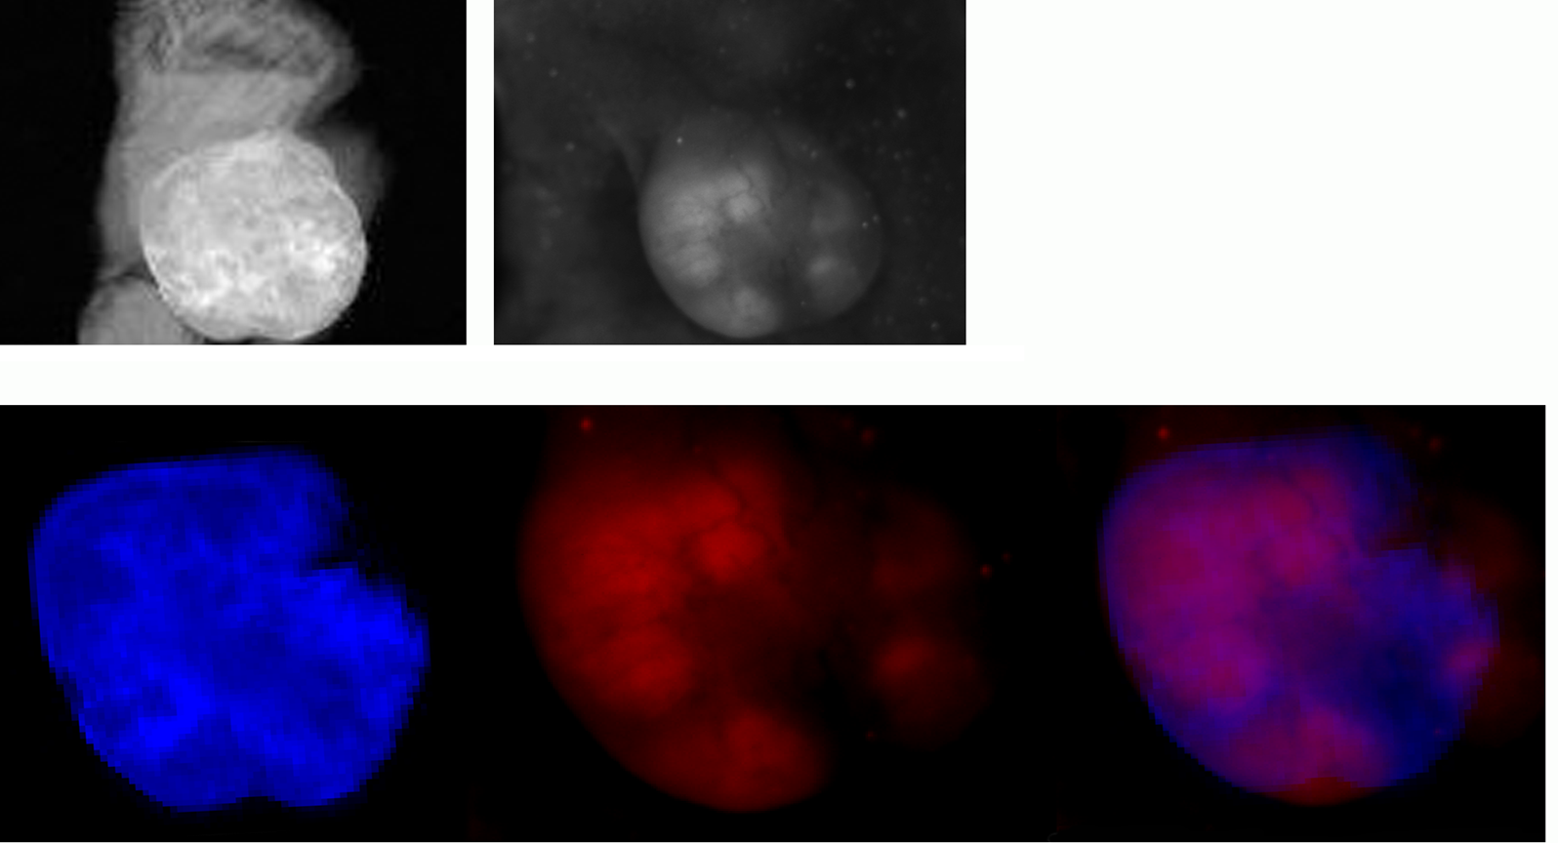



MRI & Fluorescence imaging of s.c. E9 xenograft
А- 1T 3D GRE MR images (TR/TE=60/2.9 ms, FA 20o, NEX=5) 30 min after the application of 0.7M GB, maximum intensity projection image obtained using a stack of four MRI slices before OC; В - fluorescence of Nm dCas9-mCherry ortholog chimera (Supercontinuum laser (Fianium, UK): ex 540 nm, LP550nm, BP 590-620 nm, DCS-120 (B&H, Germany); E – a pseudo color image showing the overlay (C) of the MR-image (blue) and FI (red) of E9 tumor in the animal injected with 0.15 mmol/kg gadobutrol. Scale = 5 mm and FLT

Slide 19
Conclusions
In experiments involving E9 xenografts grown in athymic mice we observed that the highest FI was achieved on the 3rd day after induction of chimeric protein expression.
To improve the contrast, a 0.7 M solution of gadobutrol was found to be useful for optical clearing of the skin surface resulting in overall increase of FI. I.V. injection of gadobutrol assisted in detection of regional tumor perfusion which delineated areas with inducible dCas9-FP chimera expression
Notes:
In the future, based on this system, it is planned to use different approaches to labeling target loci, not only based on fluorescent proteins, but also on the basis of synthetic fluorogenic molecules for in vivo use, taking into account sgRNA different labeling efficiencies in different cell types. First, it is proposed to use highly amplified regions, such as, for example, telomeric regions.

Slide 20
#4
Enhanced fluorescence imaging of implants based on polyester copolymers in combination with MRI.

Slide 21
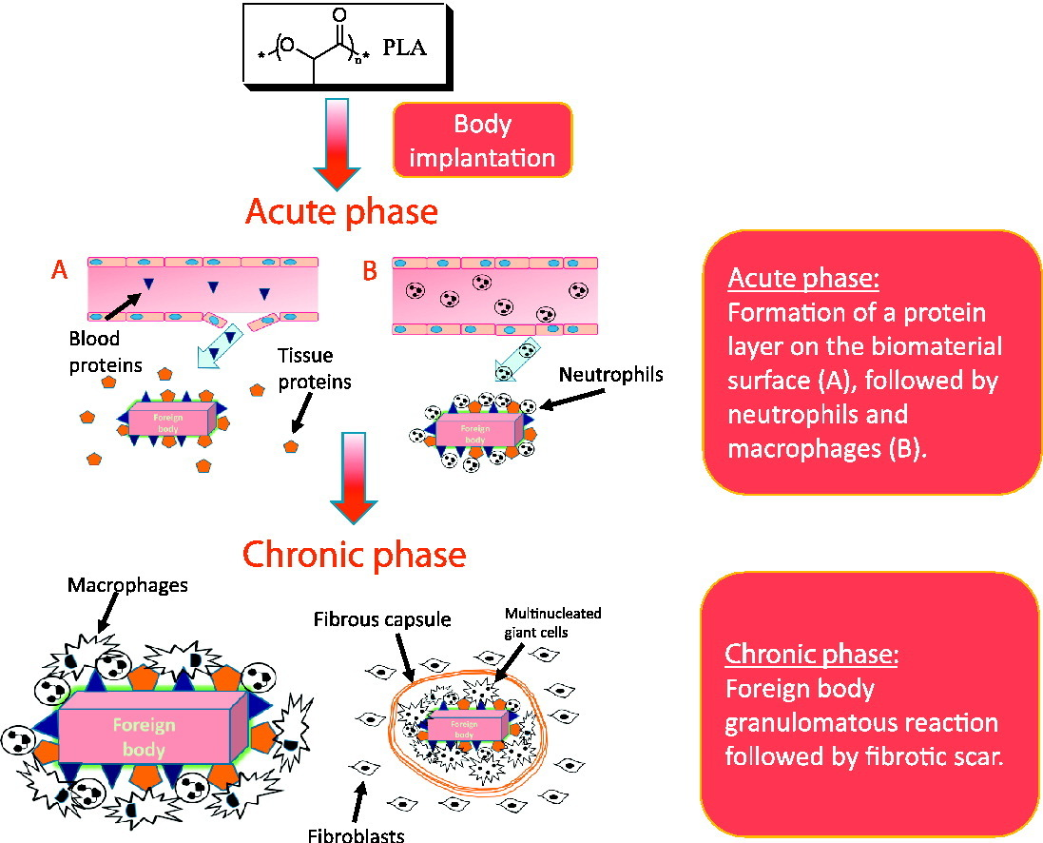
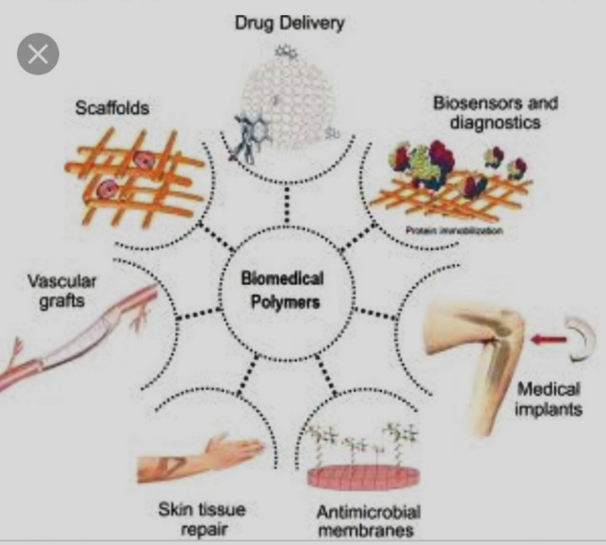
Background
Premkumar, Polymers in Biomedical Use, 2021
Yuval Ramot, Advanced Drug Delivery Reviews, 2016
Notes:
The main way to study the polyester copolymers behaviour is modelling in in vitro.
But no investigation demonstrated the in vivo studying of monitoring the resorption process of such a polyester copolymers-based materials in vivo. The implantation of biomaterials always results in a foreign body reaction lead in some cases to possible clinical side effects and individual reactions in animals.

Slide 22
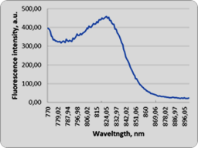
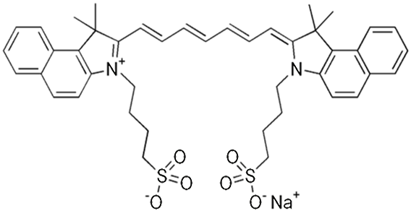
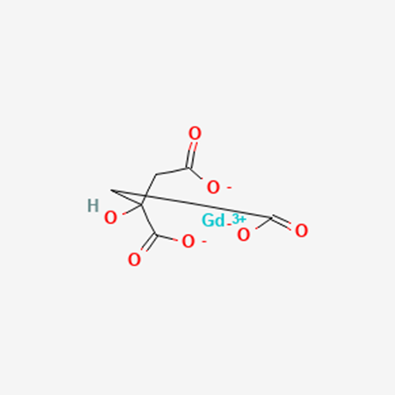
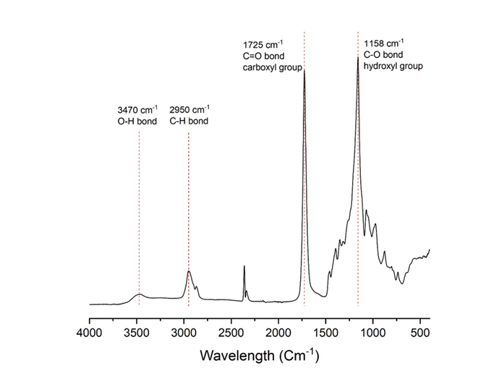
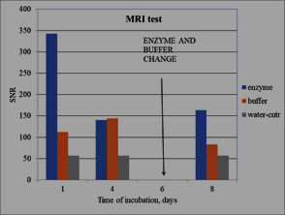
Polyester copolymers (PC) samples
ICG Gd citrate
ICG fluorescence spectra
T1w 3DGRE
MRI
based on the 1,3 propanediol, 1,5-pentadiol, succinic acid and citric acid. The copolymers were labeled with indocyanine green (ICG) and paramagnetic Gd-citrate complex
FTIR
Demin et al., 2023
Zherdeva V.V., J. of Biophotonics. 2025
Notes:
Copolymers samples were based on the 1,3 propanediol, 1,5-pentadiol, succinic acid and citric acid. The copolymers were labeled with indocyanine green (ICG) and paramagnetic Gd-citrate complex. Fourier-transform infrared spectroscopy (FTIR) analysis showed no structural differences between the labeled polymer samples and the initial polymers. The incorporation of Gd-citrate and ICG have been checked by MRI and FI in vitro

Slide 23
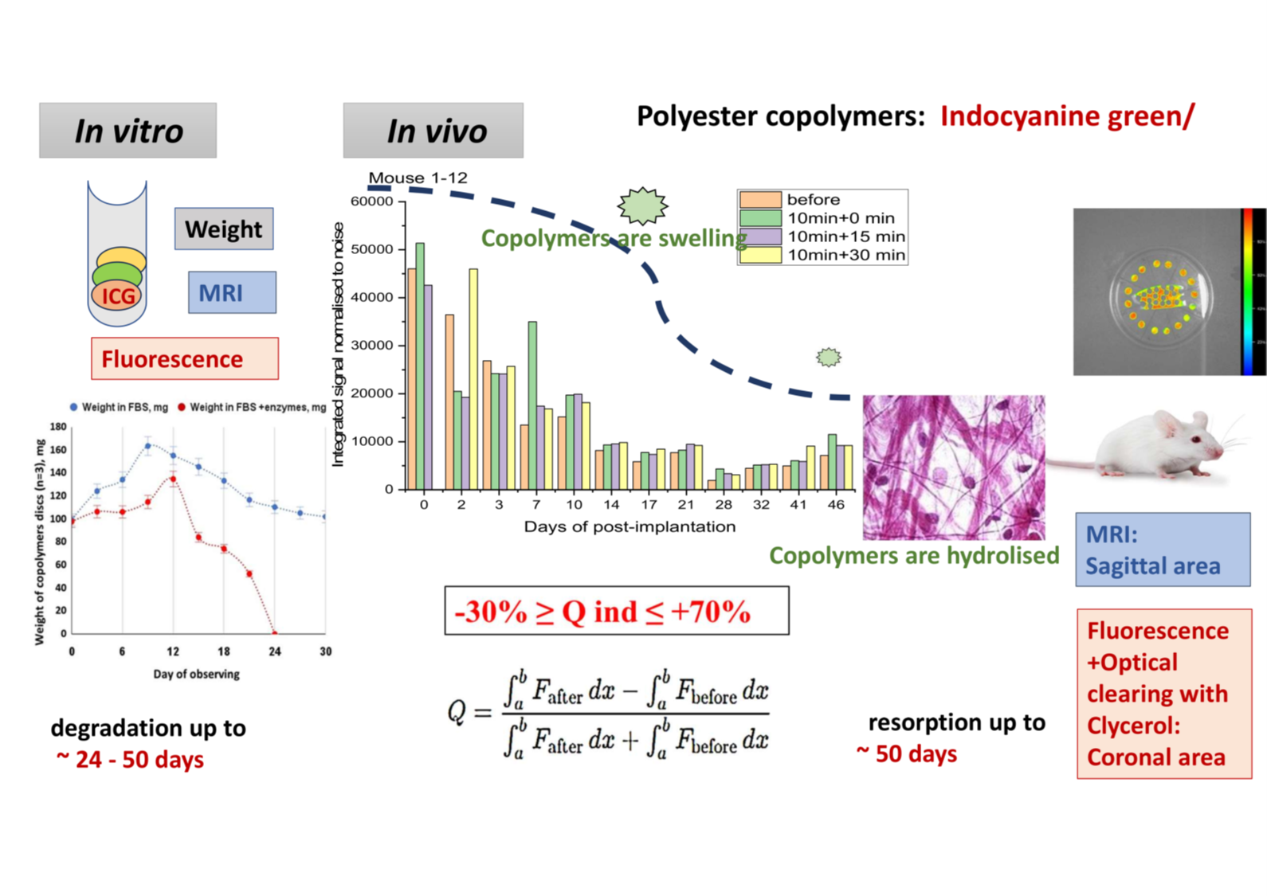

Slide 24
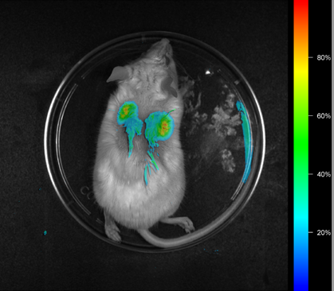
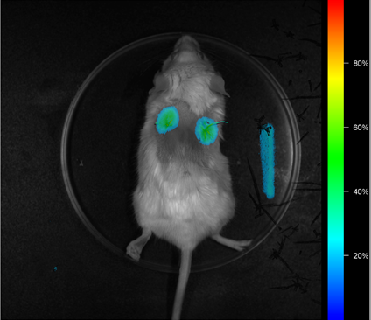
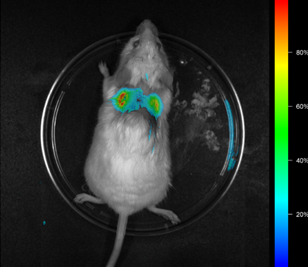
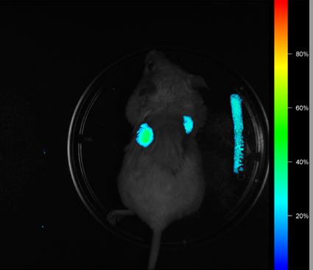
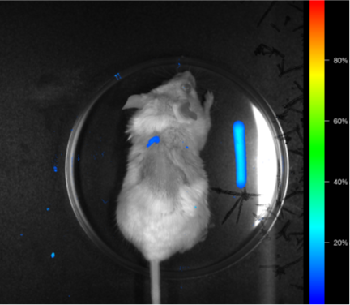
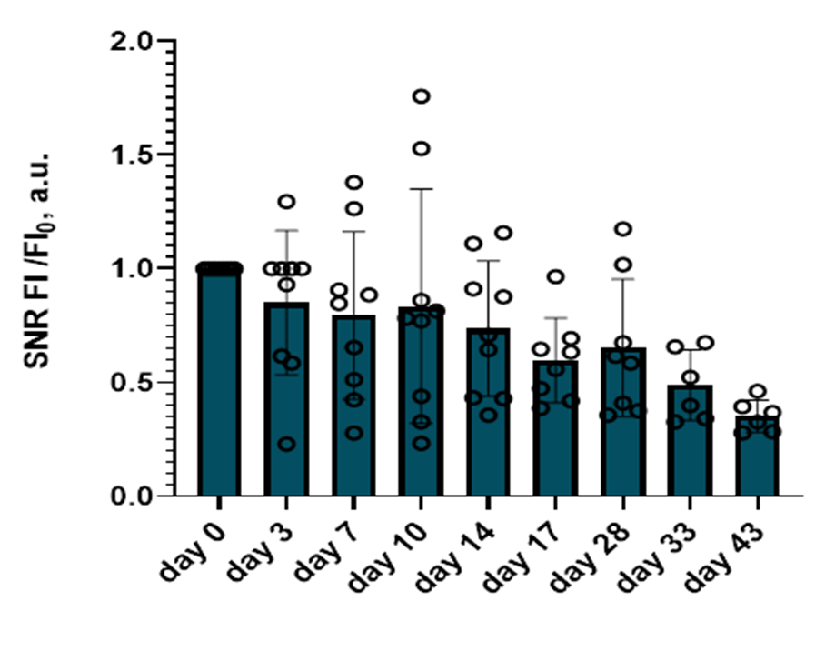
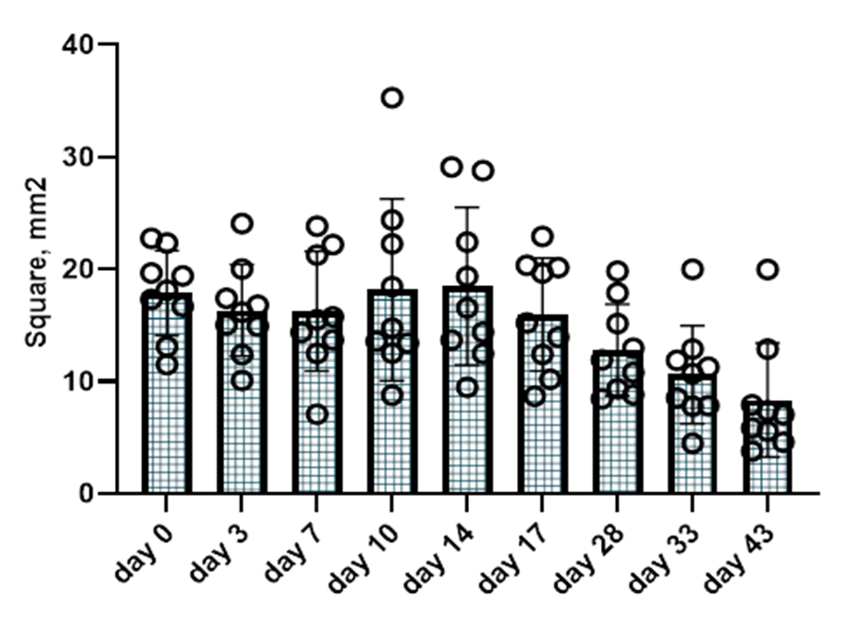
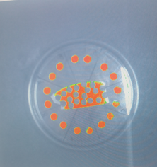
Fluorescence monitoring the resorption of ICG- labelled polyester copolymers in BALB/c/ mice during the period of 0-50 day post implantation
0 day
3 day
10 day
17 day
28 day
UVP, USA
Ex 600-645nm em 747±40 nm
Zherdeva V.V.,
J. of Biophotonics.
2025
Notes:
Polyester copolymer disks of 5 mm size were implanted subcutaneously subdorsally in mice. Measurements were performed for 50 days after implantation. A 70% aqueous solution of glycerol with 5% DMSO was used as OCA, application time 10 min. Imaging was performed before OCA application, immediately after removal of the application, at 15 min and at 30 min after removal of the application.
The images obtained were analyzed using ImageJ software (Fiji). ROIs were selected and fluorescence profiles were analyzed before and after using different exposure times (30-120s). To take into account the background signal nearby skin areas. FI profiles were built to analyze different exposure times of the brightening agent and the time elapsed from the day of implantation.inbox (UVP, USA) equipped with 16-bit monochrome cooled CCD camera (BioChemi HR Camera, UVP, USA) , 150-Watt quartz halogen automated multispectral light sourse BioLite (UVP, USA). Exictation filter (600-645nm) and custom emission filter (KC-17 747±40 nm). Acquisition time 30 s. Vision WorksLS software (UVP, USA), ImageJ Fiji postprocessing

Slide 25
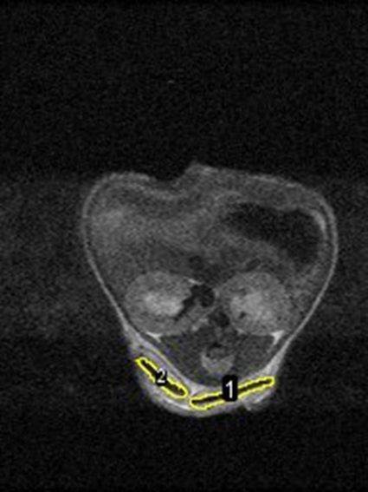









MRI monitoring the resorption of Gd+- labelled polyester copolymers in BALB/c/ mice during the period of 0-50 day post implantation
B
A
B
A
B*
A*
T2w FSE mode: TR / TE 4000/42, FOV 40x40, NEX4)
3D GRE MR (TR/TE=60/2.9 ms, FA 20o, NEX=5)
Notes:
But I was shown that regularly In vitro do not match the in vivo results in general
The results on fluorescence intensity change and MR intensity have been obtained during all period of post-implantation observation at 3 ,7, 10, 14, 17, 28, 33, 43 days and 3 ,7, 10, 15, 20, 24, 28, 35, 46 days for fluorescence and MRI registration correspondently.
The represented images demonstrate the changes of the copolymer-based implants during the observation. The Figure 8(B) presents the examples of MR-scans at different points of observation and type of projection (axial and saggital). The fluorescent images reflected the coronal projections, while the MR scans were better to estimate using sagittal and axial projections of the copolymer-based implants while the coronal projection was excluded from the calculation due to the variability of MR sections. Sagittal projection was used to segment the area of the copolymer-based implants using high contrast T2w FSE MR intensity and calculate the mean value of the one (Figure 8 (B,D), while the T1w GRE allow to obtain the integral MR intensity change for the period of observation and calculate the mean SNR (Figure 8 (B,C). The corresponded areas are marked with yellow in Figure 8 (B).

Slide 26






H&E staining of the biopsy
17 day after implantaiton
46 day after implantaion
Hematoxilyn-eosin staining:
Skin (1),
Connective tissue capsule (2),
capillars (3), adipose tissue (4),
collagen fibre (5),
Copolymer implant (6)
lymphocyte-macrophage infiltration (7).
Nikon TE2000, x2, ApoPlan x10/0,25
1
7
3-4
6
2
5
Zherdeva V.V.,. 2025
Notes:
H&E staining of the biopsy indicated to the active resorption of the implant with moderate lympho macrophages infiltration and loose connective tissue around implanted material indicating the highbiocompatibility. The regular collagen fibers formed the denser parts of fibrosis capsule.
The H&E autopsy at day 33 indicated at the connective tissue (Figure 9 (B). The signs of residual fluorescence at the implantation site were revealed presuming due to the retention of ICG in the tiny fragments of copolymers in tissues (Figure 9 (B). No any fragments of the macroscopic material were visualized.
55

Slide 27






OC during 0-30 min after 10 min immersion with Glycerol 70%
2
1
After_30 min
Before OC
30-40%
Zherdeva V.V., J. of Biophotonics. 2025
Notes:
The fluorescence OC efficiency was calculated as the ratio of the integrals of the fluorescence intensity of the ICG-labeled polymers.

Slide 28

Zherdeva V.V., J. of Biophotonics. 2025
Notes:
Individuals results and mean results on OC efficiency were dramatically different. For individual reaction it varied from -40 up to +70 %. While the mean value was in the range of 7-10% of FI improvement
We noticed that efficiency was connected with som pathophysiological aspects^ skin damaging (decrease) Inflammation (increase), time-mediated resorbtion ( following decrease).

Slide 29



Individual effects of OC at different stages of resorbtion
Zherdeva V.V.,
J. of Biophotonics. 2025
Notes:
А индивидуальное варьируется, что является своего рода маркировкой тканевых реакций
Статья Дрора по глицерину – тушение
Попросили коллег измерить однородность/неоднородность мечения
Заодно показали, что при флуоресценции инвитро также происходит усиление инт флуорес, а на время жизни не оказывает влияния
Модель с мышью – постепенное растворение, различная стпень вязкости

Slide 30
conclusion
The use of paramagnetic and fluorescent labels combining with OC enables real‑time monitoring of tissue responses, including skin damage, inflammatory (dynamic viscosity) processes, and fibrosis development.

Slide 31
#5
VALIDATION OF 1 T MRI IN CUPRIZONE-INDUCED DEMYELINATION IN C57BL/6 MICE: COMPARISON WITH HISTOLOGY AND 7 T MRI

Slide 32






Demyelination assessment
Generally accepted protocols for non-invasive monitoring of demyelination have been developed for high-field systems (≥7 T). Therefore, the development of effective MR imaging protocols for low-field scanners is highly relevant.
Cuprizone (C₁₄H₂₂N₄O₂)
Corpus callosum
Demyelination

Slide 33
Balanse of SNR and resolution
Acquired voxel: 0.149 × 0.149 × 1.0 → 0.096 × 0.098 × 1.0 mm | −57.6% volume
SNR estimate = median (signal) / σ (noise)
Sampling density per mm²
−16.1%
2.36× acquisition sampling density | 4× stored image-grid density
SNR ∝ √NEX, time ∝ NEX
2
Notes:
Компромисс между SNR и пространственным разрешением достигается от поставленной задачи. Поэтому очень важно изначально подбирать параметры в зависимости от целей визуализации.
Главный компромисс МРТ: Баланс между четкостью ( SNR-разрешением) и качеством картинки (сигналом).
Меньше воксель — больше шума: Чем меньше «пиксель» на снимке, тем меньше протонов (сигнала) в него попадает. Изображение становится более зернистым.
Матрица сбора \(\ne \) Матрица отображения:
То, как сканер собирает данные (дискретизация) — важнее всего.
То, как компьютер дорисовывает пиксели при реконструкции — ‘nj лишь цифровая обработка
Пример на графике:
Реальное пространственное разрешение (сбор данных) увеличилось в 2,4 раза, а на итоговой картинке за счет компьютера — в 4 раза.

Slide 34


demyelination in corpus callosum
A
B
B
Tw2 Т МRI of control (A) and cuprizone-treated mice CPZ (B)(TR = 5600, TE = 82).
A statistically significant difference (p < 0.05) was found between the model (cuprizone) and control (healthy) C57BL/6 mice using 1T MRI
Krasnov et a. MIB,2026 ( in print)

Slide 35


Histology: H&E +luxol blue staining
А
Histological section of a healthy brain. Staining: hematoxylin–eosin (H&E) and LFB.
A - Control: The corpus callosum exhibits intense blue staining, with a structure width of 87–100 µm.
B - Experiment: After a 12-week cuprizone diet.
87-100 мкм
B
А
73 -69 мкм
The corpus callosum exhibits reduced staining intensity and a 25–30% reduction in width compared to the control, indicative of demyelination
Krasnov et a.
MIB,2026 (in print)

Slide 36
conslusions
Low-field 1 T MRI provides a reliable means of detecting corpus callosum demyelination in the cuprizone mouse model.
The proposed T2‑weighted imaging protocol, which requires no contrast agents, minimal infrastructure costs, and straightforward post-processing, offers a practical tool for longitudinal monitoring and for evaluating the extent of lesion involvement in preclinical studies of demyelinating diseases.

Slide 37


















LAB OF MOLECULAR IMAGING
Acknowledgments
LAB OF FUNCTIONAL GENOMIC
VAVILOV INSTITUTE OF GENERAL GENETRAL INSTITUTE RAS
SARATOV STATE UNIVERSITY
A.N. BACH BIOCHEMISTRY INSITUTE RAS
LAB OF PHYSICAL BIOCHEMSTRY
Zelinskiy N.D. Institute of Organic Chemistry RAS
BAR ILAN IUNIVERISITY, ISRAEL
The Avtsyn Research Institute of Human Morphology

