Slide 1
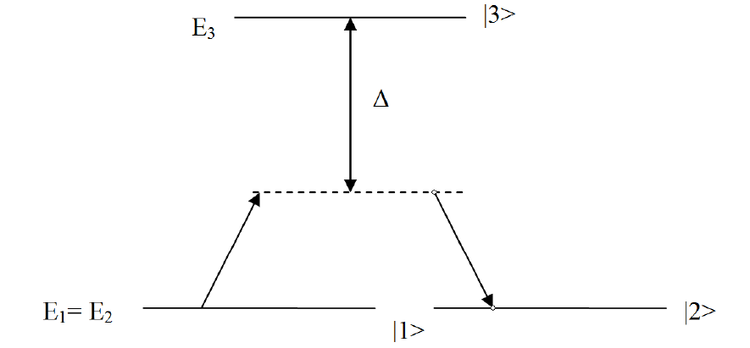
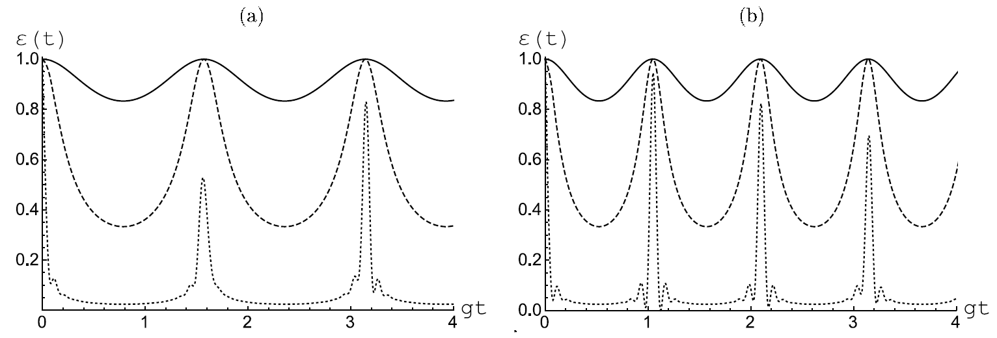
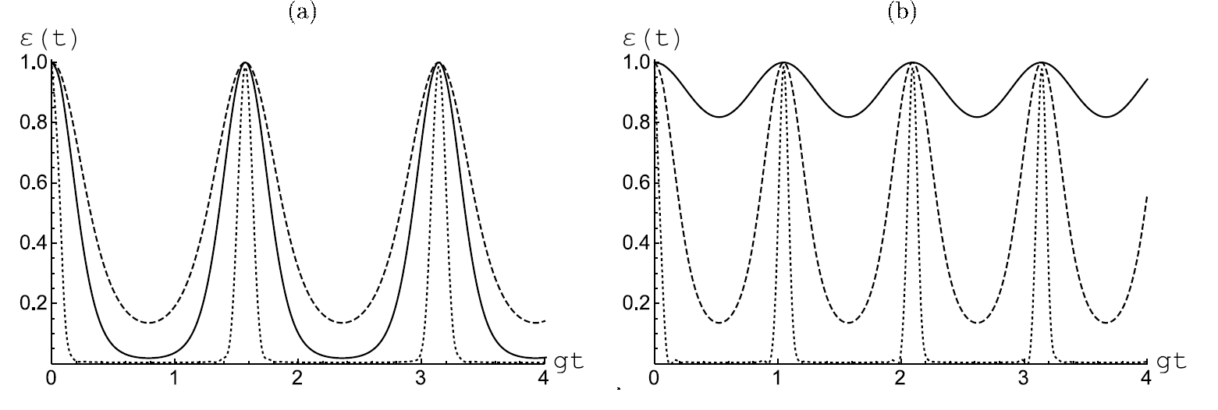
Entanglement in two-qubit model with Raman transitions
l'ya Vasiliev , Ali Othman, Rodion K. Zakharov, Eugene K. Bashkirov
Samara National Research University
Model and nega
Simulations
Hamiltonian
Initial atomic states
Initial thermal cavity field state
or Initial coherent field state
Reduced two-atom matrix
Conclusion
or
Negativity

