Slide 1
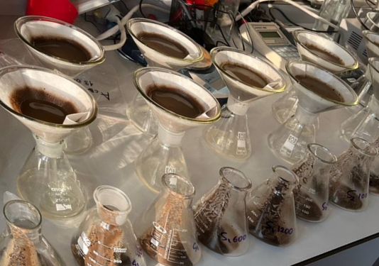
Determination of ciprofloxacin concentration in aqueous soil extracts
in the presence of humic substances using synchronous fluorescence spectra
Anastasia D. Tsvetkova¹, Yulia G. Sokolovskaya¹, Andrey D. Batakov^{1,2}, Vera A. Terekhova^{1,2}, Svetlana V. Patsaeva¹
¹ M.V. Lomonosov Moscow State University, Moscow, Russia
²A.N. Severtsov Institute of Ecology and Evolution, Russian Academy of Sciences, Moscow, Russia
Introduction
The antibiotic ciprofloxacin (Cip) is widely used in medicine, agriculture and veterinary. Accidental releases of antibiotics into wastewater, soil, or natural water reservoirs are common occurrences that fundamentally affect natural ecosystems. The Сip has been designated by the World Health Organization as a critically important antibiotic in fresh surface water, groundwater, saltwater, treated municipal wastewater, untreated municipal wastewater, treated hospital wastewater, and untreated hospital wastewater worldwide. That is why it is extremely important to develop methods for determining the concentration of that antibiotic in water and soil, taking into account the presence of organic substances of natural origin (humic substances) in them. This work is aimed to develop an optical method for fast determination of Cip concentration in aqueous medium in the presence of soil humic substances of natural origin.
Soil samples and aqueous soil extractions
Five natural soils were sampled from the upper horizons in different locations. The soddy-podzolic soils of varying degrees of cultivation (S1, S2, S3) were taken in Moscow region: S1 - highly cultivated soil, with a relatively high content of organic carbon, Corg 2.51%; S2 - poorly cultivated soil with a low content of organic carbon, Corg 2.07%; S3 – from a field previously used for growing crops, Corg 1.11%. S4 - chernozem (Voronezh region), Corg 4.48%. S5 - urbanozem (chernozem-like soil) was sampled in the central park (Maykop), Corg 1.15%. We studied also an artificial standard soil S6 used as a reference soil in ecotoxicological studies - a mixture of sand, kaolinite, peat and calcium carbonate, Corg 3.00%. To prepare extractions, 25 g of dried and ground soil and 100 ml of distilled water were mixed, shaken for 2 hours, and filtered through a white ribbon filter. For fluorescence measurements the mixtures were additionally solved in 9 times.
Spectral measurements
Fluorescence spectra were recorded using a Solar CM2203 luminescence spectrometer. Synchronous scans were measured with a wavelength offset ∆λ = 160 nm between the excitation and registration wavelengths.
Results
Fluorescence emission of soil extractions and Cip: Cip in water emit fluorescence with a maximum at 435 nm and an excitation maximum at 275 nm, however, its emission band in natural soil extraction overlaps with the fluorescence of humic substances (Figures 1-2)
Fluorescence synchronous spectra: To determine Cip concentration in the presence of humic substances, we propose to use fluorescence synchronous spectra that selectively highlight the fluorescence of Cip. We found that Cip is most clearly detected at a wavelength offset ∆λ = 160 nm between the excitation and registration wavelengths (Figure 3). This ∆λ corresponds to a difference between Cip excitation and emission maxima. Synchronous scans first were measured in a sample without the antibiotic (Figure 4, different soils) and with an antibiotic (Figure 5, S2 as example), the difference spectra were calculated (Figure 6), and the Cip content can be determined from its integral intensity using a calibration dependence.
Figure 1
Figure 3
Figure 5
Figure 2
Figure 4
Figure 6
Conclusions:
To determine Cip in small quantities in aqueous soil extractions, a new approach was developed using synchronous fluorescence spectra with an offset in excitation and recording wavelengths of 160 nm. This corresponds to the shift in the maximum of the Cip emission spectrum (435 nm) relative to the maximum in the fluorescence excitation spectrum (275 nm). To determine the Cpip concentration, synchronous scans were measured in a sample without antibiotic and with an antibiotic of unknown concentration, the difference spectrum was calculated, and the antibiotic content in the sample was determined from its integral intensity using a calibration dependence. Despite the fact that the fluorescence spectra of humic substances and Cip in water are close in the position of the maximum and bandwidth, the measurement of synchronous fluorescence spectra made it possible to identify the presence of the antibiotic in fairly low concentrations without preliminary sample preparation.

