Slide 1
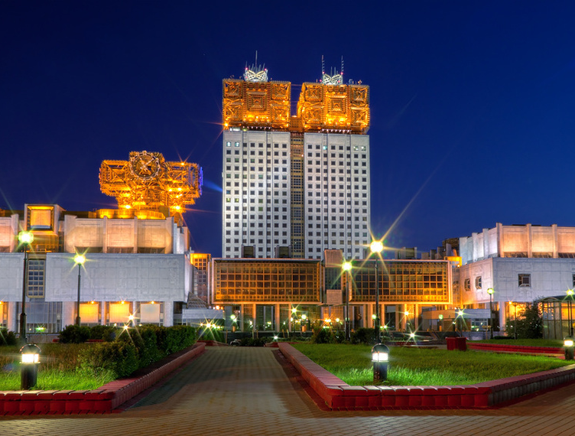
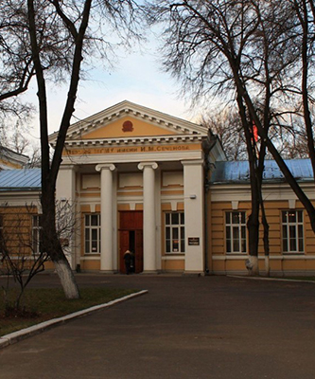
Chemiluminescence in studying the conventional and alternative nicotine-delivery tools
Nadezda G. BERDNIKOVA^{1,2} , Galina F. FEDOROVA¹, Valerii A. MENSHOV ¹, Vladimir V. NAUMOV¹, Aleksei V. TROFIMOV ¹, Yurii B. TSAPLEV¹, Timur L. VEPRINTSEV¹ and Olga I. YABLONSKAYA¹
¹ EMANUEL INSTITUTE OF BIOCHEMICAL PHYSICS, RUSSIAN ACADEMY OF SCIENCES
² I.M. SECHENOV FIRST MOSCOW STATE MEDICAL UNIVERSITY

Slide 2
Tobacco Smoke as a Source of Antioxidants in a Human Organism: Chemiluminescence Monitoring

Slide 3
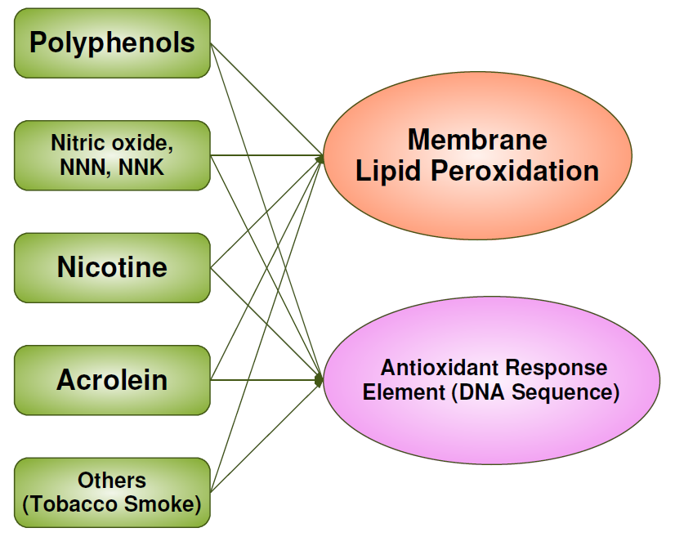
Is smoke a source of bioantioxidants?

Slide 4
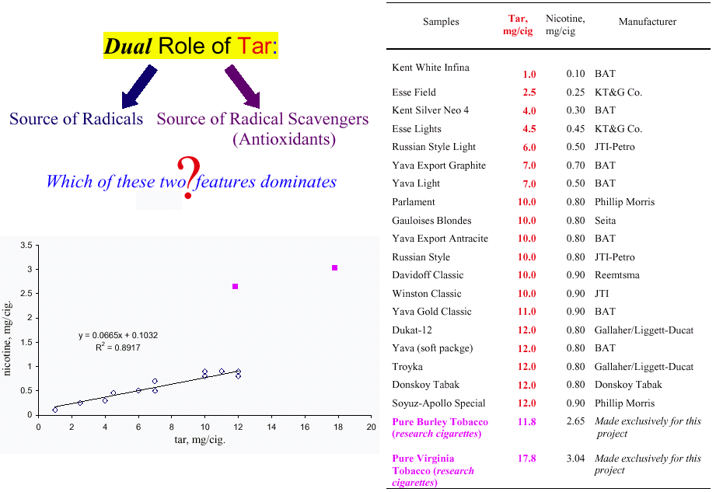

Slide 6
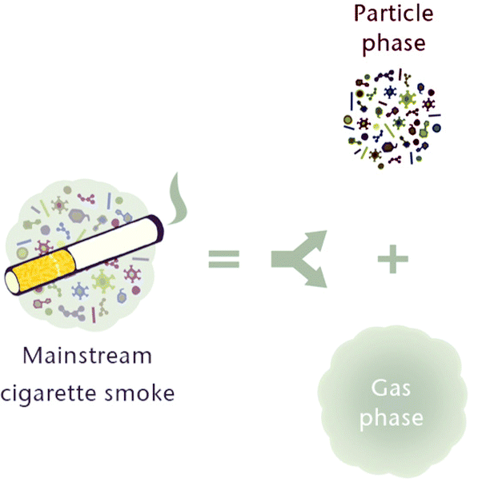
Generation of Chemiluminescence by the Smoke Phases
Synonyms:
Total particulate matter (TPM), tar
Organic substrates, which yield the light-emitter species, exist only in the particle phase!
Gas phase itself generates no chemiluminescence, but contributes to the generation of the
whole-smoke chemiluminescence!

Slide 7
Smoke Chemiluminescence Intensity as a Function of the Tar Delivery
☞ Radical-scavenging propensity of the tar is evident!
G.F. Fedorova, V.A. Menshov, A.V. Trofimov, Yu.B. Tsaplev, R.F. Vasil’ev, O.I. Yablonskaya, Photochem. Photobiol. 2017, 93, 579-589
Adenocarcinoma
sources

Slide 8
What is the nature of radical scavengers?

Slide 9
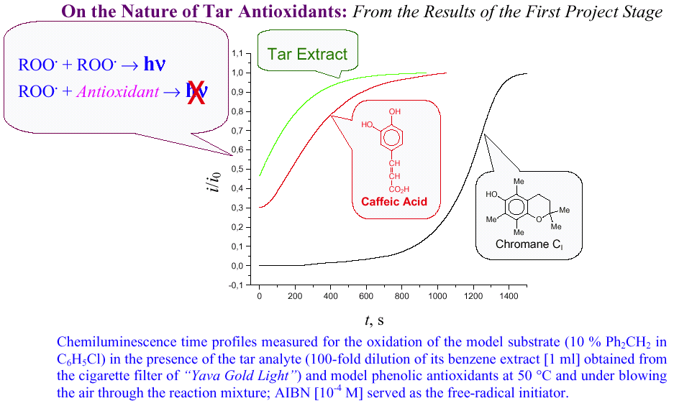
Nature of the Predominant Tar-Borne Radical Scavengers Assessed through Quenching the Chemiluminescence Derived from the ROO. Disproportionation
G.F. Fedorova, V.A. Menshov, A.V. Trofimov, Yu.B. Tsaplev, R.F. Vasil’ev, O.I. Yablonskaya, Photochem. Photobiol. 2017, 93, 579-589
Conclusion: Predominant radical scavengers are of polyphenolic origin!

Slide 10
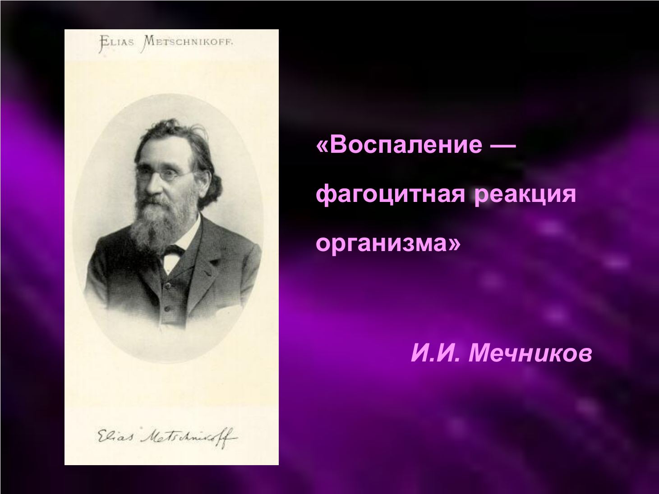
In 2020, the Humanity celebrated the 175th anniversary of Elias (Elie, Ilya) Metschnikoff, the “father of the natural immunity” (the 1908 Nobel Prize in Physiology or Medicine). It was Metschnikoff who has discovered that in animals possessing the blood, WBS accumulate at the sites of inflammation and are directly related to the death of bacteria that cause such an inflammation.
“Inflammation is a phagocytic reaction of the body”
Elias Metschnikoff

Slide 11

The prolongation of smokers’ life with ANDS:
Optimistic studies?
If Metschnikoff were our contemporary and would work on the immunity issues, then, perhaps, one of his books would be entitled somewhat differently…

Slide 12
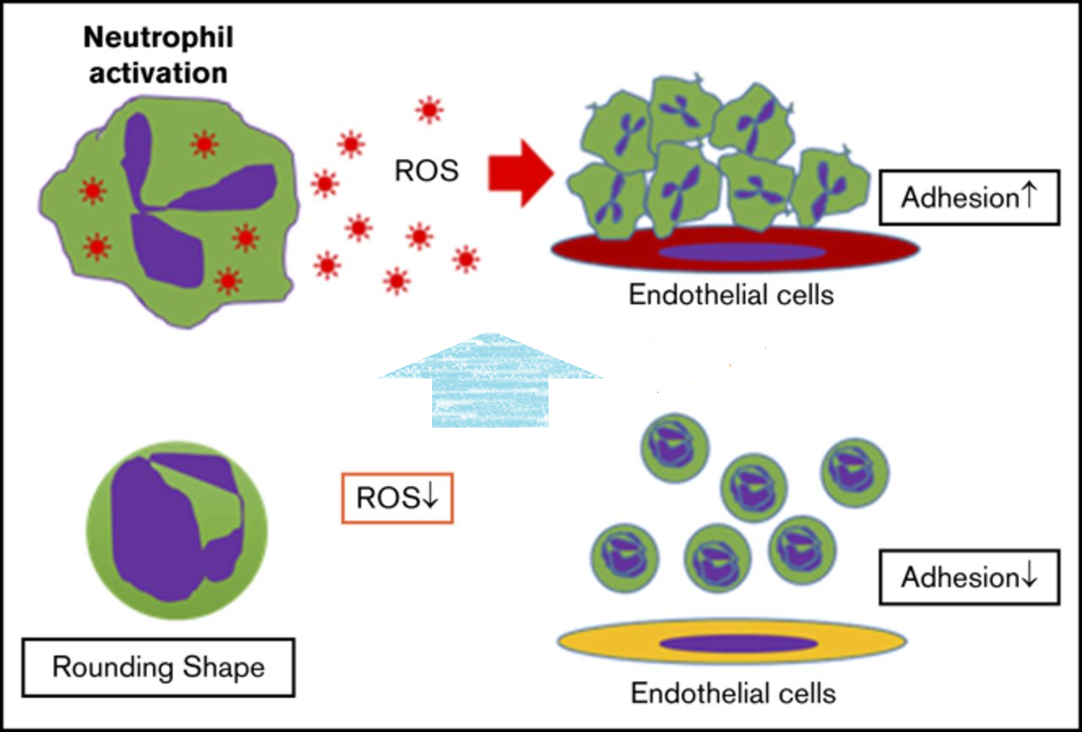
INDEED, NEUTROPHILS PLAY AN ESSENTIAL ROLE IN THE INNATE IMMUNE RESPONSE, BUT….
”…Uncontrolled or prolonged neutrophil activation uses antimicrobial responses to injure normal host cells, leading to pathologic changes to tissues and organs in autoimmune and inflammatory diseases…”
(Nathan, 2006)

Slide 13
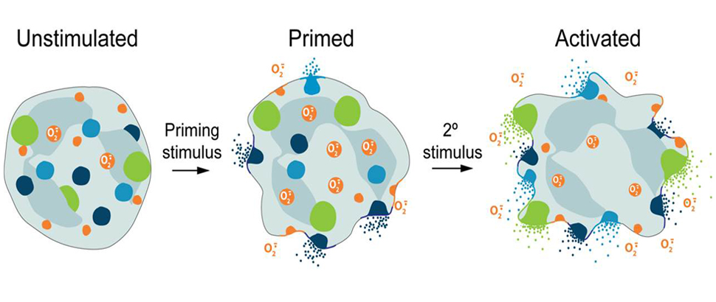
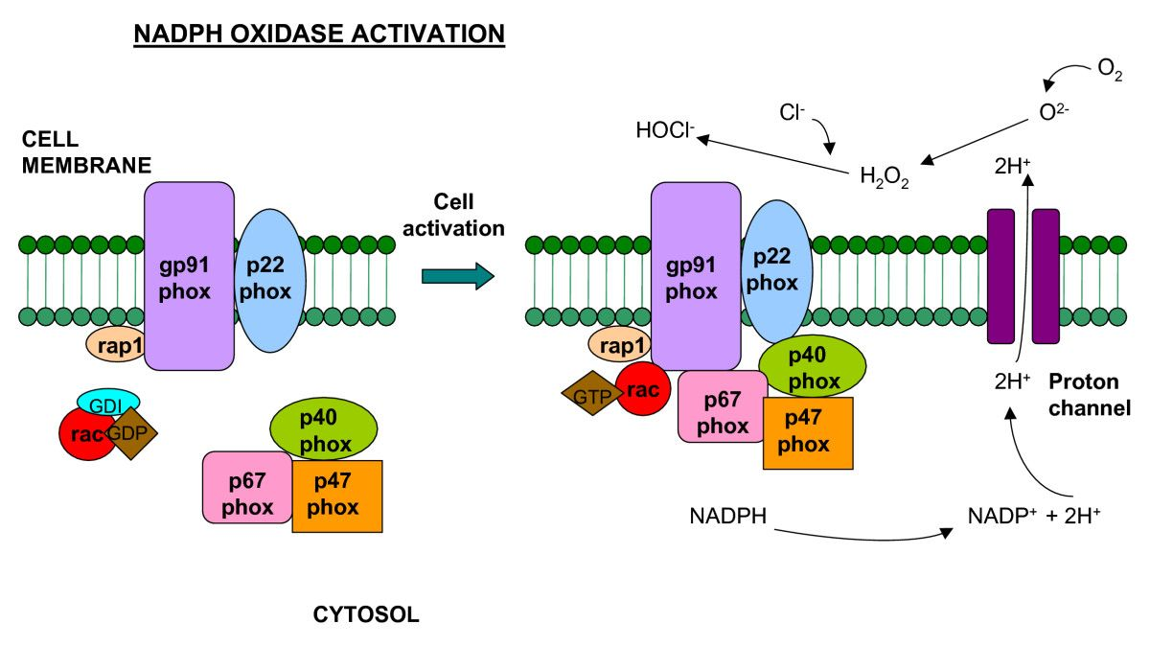
There are clear associations between neutrophils and many chronic inflammatory diseases as diverse as COPD, myocardial infarction, arthritis and inflammatory bowel disease.
Neutrophils exist in three states: quiescent, primed or active. Priming and activation appear distinct. In the primed state, there is no increase in oxidase activity; however, subsequent stimulation is able to provoke a response that is 10- to
20-fold larger than in non-primed activated cells.
CIGARETTE SMOKE IS ABLE TO PRIME NEUTROPHILS
FOR AN INCREASED BURST RESPONSE. AND HOW ABOUT E-CIGARETTES?

Slide 14
TOPICALITY OF THE ISSUES ADDRESSED IN OUR WORK
Over the past 10 years, 3 or 4 generations of alternative nicotine delivery systems (ANDS) have been changed. The market offers the smoker thousands of different modifications of e-devices and e-liquids, promising to maintain his/her health for many years but showing very limited reliable evidence for risk reduction.
Science and medicine simply do not have time to test properly this stream of new devices and their modifications, since there are no reliable and effective biomarkers for assessing long-term risks.

Slide 15
PURPOSE AND OBJECTIVES OF THE STUDY
Search for effective biomarkers of the biological response towards traditional and alternative nicotine delivery systems for a long-term risk assessment.
Studying the mechanism of priming of neutrophils in smokers and users of nicotine-free e-cigarettes in smoking cessation programs and immune cells reactivity modulation.

Slide 16
DESIGN OF THE STUDY:
METHODS AND
COMPOSITION OF VOLUNTEERS

Slide 17
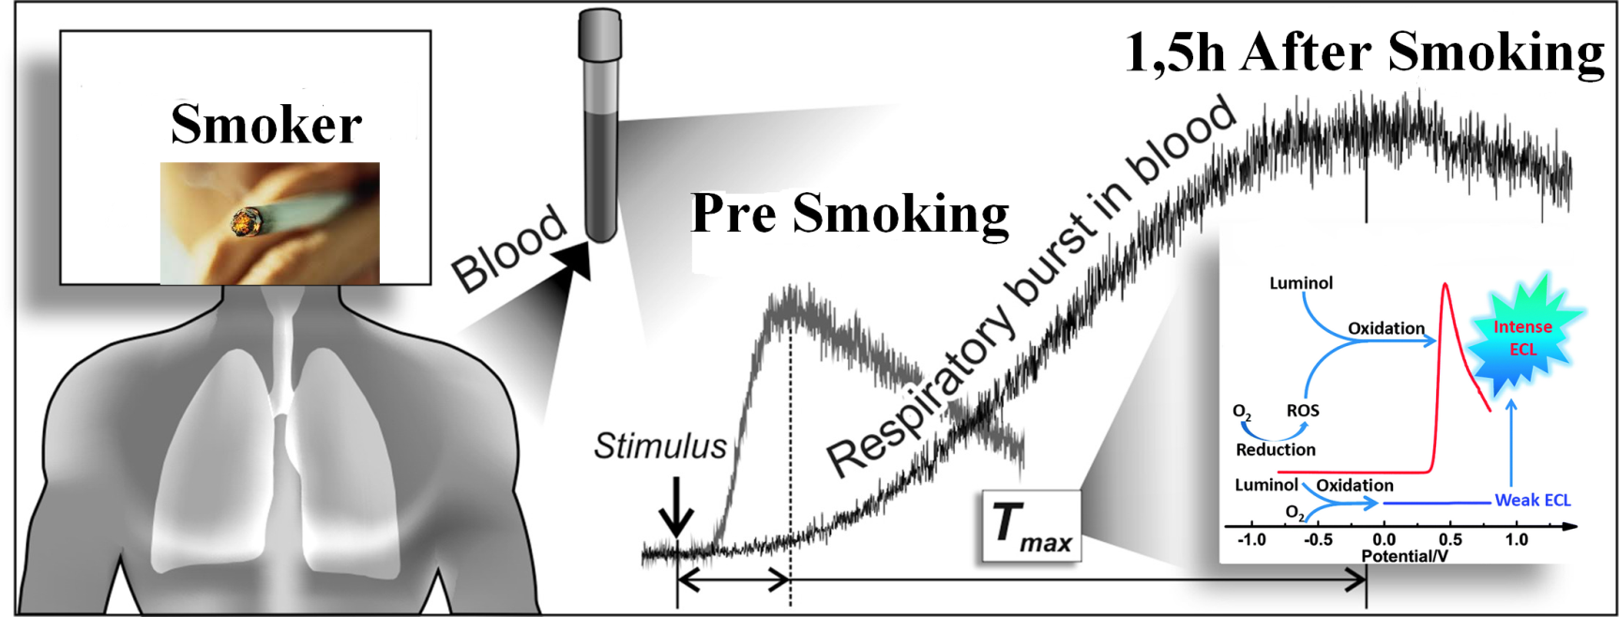
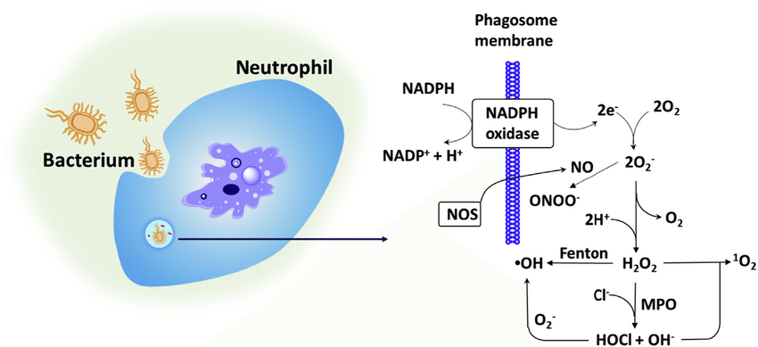
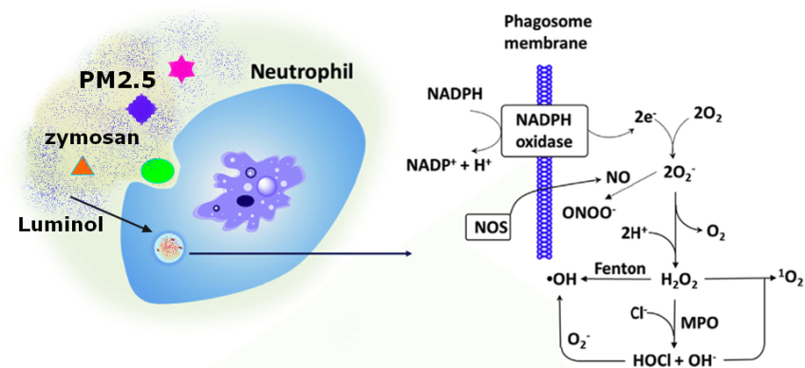
STUDIES ON THE ROS GENERATION BY LEUCOCYTE CELLS AFTER ACUTE SMOKING USING NON-OPSONIZED ZYMOSAN-INDUCED AND LUMINOL-ENHANCED CHEMILUMINESCENCE IN A CONTINGENTLY WHOLE BLOOD
Particulate matters of cigarette smoke or bacterial cells stimulate phagocytosis and ROS production, whose the rate correlates with the number of primed white blood cells and the composition of the plasma.

Slide 18
AGE COMPOSITION & SMOKING STATUS OF VOLUNTEERS
 |  | Healthy Smokers |  |  |  | Healthy Non-Smokers/ Ex-Smokers
Age group | Age, years | Smoking stage, packs | N (m/f) | exCO, ppm | WBS, х10⁻⁹ | N/Ex-Sm (m+f) | exCO, ppm (*p<0,001) | WBS, х10⁻⁹
I | < 30 | < 10 | 12 (6 + 6) | 18.9 ± 7.6 | 7.4±1.8 | 16/2 (7 + 9) | 3.3 ± 2.1* | 5.9±1.9*
II | 31-50 | 10-30 | 26 (17+9) | 20.2 ± 5.9 | 6.2±1.7 | 31/4 (21+10) | 3.6 ± 2.6* | 6.8±2.3
III | > 50 | > 30 (30-60) | 8 (8+0) | 27.4 ± 8.8* | 5.9±2.1 | 17/3 (11 + 6) | 2.8 ± 1.7* | 6.4±1.6
Selection Criteria:
- Body Mass Index – [18-30];
- Body Temperature (Ear) – [36.3-36.8];
- Blood Pressure, FEV₁/FVC, Complete blood count in accordance to the age
norm. No drug administration during last month;
- At least 3 years of abstinence from smoking for ex-smokers.

Slide 19
MAIN RESULTS
PART № 1. PHYSIOLOGY

Slide 20
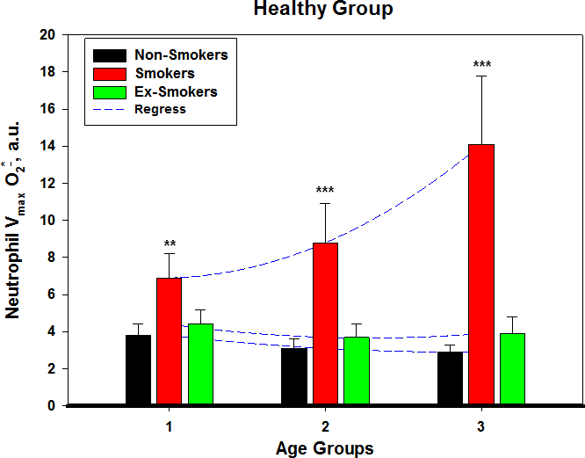
MAXIMAL RATE OF THE ROS GENERATION BY ZYMOZAN-STIMULATED NEUTROPHILS IN THE CONTINGENTLY WHOLE BLOOD IN SMOKING AND NON-SMOKING HEALTHY VOLUNTEERS (LEFT) AND PATIENTS (RIGHT)
Blood sampling and analysis of neutrophils' activity in smokers was performed 8-10 hours after the last puff. At the left, the differences in neutrophils' activity in the groups of never smokers and former smokers are not statistically significant.
The membrane expression of CD11b, CD15 and CD63 was significantly higher on neutrophils from smokers, indicating upregulated neutrophil functions. Stimulated neutrophils from subjects with various inflammatory tissue-destructive conditions, such as trauma, periodontal, pulmonary, gastrointestinal and cardiovascular diseases, generate more oxygen radicals and proteases, involved in tissue destruction, than neutrophils from healthy persons. Cigarette smoking aggravates these diseases.

Slide 21
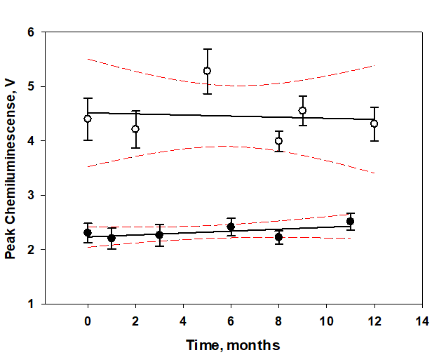
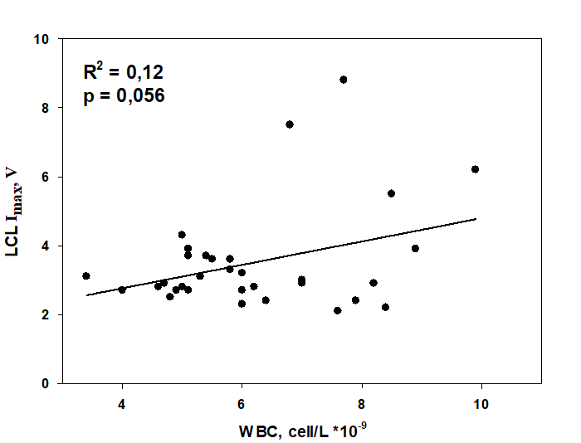
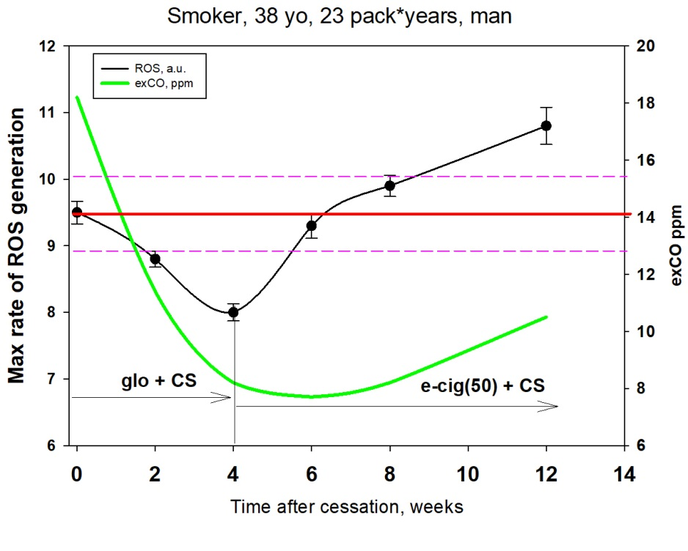
Seasonal fluctuations in the peak ROS generation rate in the contingently whole blood obtained from the two donors during the year (seasonal factor of variability). On the graphs: white symbols and the regression line with the 95 % confidence interval refer to the male smoker (37 y.o.), while black symbols and the regression line with the 95% confidence interval pertain to the non-smoking female volunteer (42 y.o.).
Correlation between the maximum rate of the ROS generation (manifested by the maximum luminol chemiluminescence intensity, LCL Imax) by the cells of the contingently whole blood and the concentration of leucocytes in the peripheral blood. The variability of the peak LCL Imax value is determined only up to 12 % by the variability of the concentration of leucocytes.
Dynamics of the reactivity of the blood phagocytes and the CO level in the exhalation of the volunteer upon the prolonged use of ANDS according to the smoking cessation program.

Slide 22
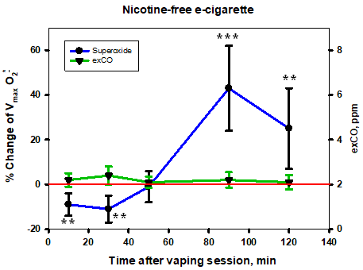
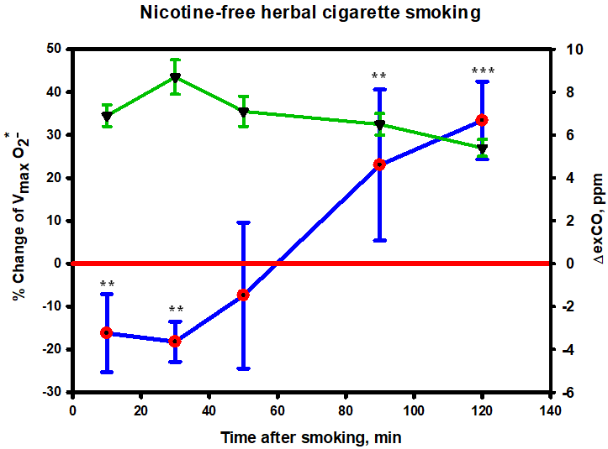
MODULATION OF THE IN VIVO NEUTROPHILS' ACTIVITY BY NICOTINE-FREE AEROSOL (LEFT) AND BY SMOKE (RIGHT) IN NON-SMOKING VOLUNTEERS
Number of participants in the experiment: 5 (1f + 4m), 2 of them are former smokers. Average age was 39 ± 5 y.o. The time interval between experiments was 1 month. Volunteers smoked one cigarette (10 puffs) or used an e-cigarette for 10 minutes (40 puffs). ExCO = exhaled carbon monoxide (green lines).

Slide 23
MAIN RESULTS.
PART № 2. PSYCHOLOGY

Slide 24
EXAMINING THE UTILITY OF NICOTINE-Free E-CIGARETTES IN THE PROGRAM ON smoking cessation: PILOT STUDIES
Experimental Design: Three groups of middle-aged smokers of 4 people each (> 20 cigs / day) with the Fagerström index IF = 10 switched to different types of ANDS, including white snus LYFT (group 1), nicotine-free e-cigs (group 2) or their combination (group 3). Volunteers passed the Fagerström test for the tobacco dependence with the determination of the CO content in the exhale after 1 week and 3 weeks from the start of the experiment.
Aim of the Experiment: To achieve the complete cessation of cigarette smoking by volunteers within 3 weeks.

Slide 25
HYMN TO A NICOTINE-FREE E-CIGARETTE
It was the nicotine-free
e-cigarette that played a decisive role in quitting smoking using the tobacco-free oral nicotine product (LYFT) as ANDS!
Only in group No. 3, 3 out of 4 volunteers (75 %) completely gave up using cigarettes during the of the experiment.

Slide 26
SUMMARY & CONCLUSIONS
For the first time, we have established in vivo a bimodal dynamics of modulation of priming of circulating neutrophils after smoking a nicotine-free cigarette or after a nicotine-free vaping session.
Both in the smoke of traditional tobacco products (cigarettes) and in aerosols of e-devices, nicotine is not the only agent that influences the priming.
Despite the “less toxic” composition of e-cigarette aerosols, their effect on immune cells reproduces to some extent the effects observed during smoking.
Modulation of neutrophil oxidative activity is a valuable biomarker of the biological response towards using traditional cigarettes and ANDS.

Slide 27
Thank you for your attention!

