Slide 1
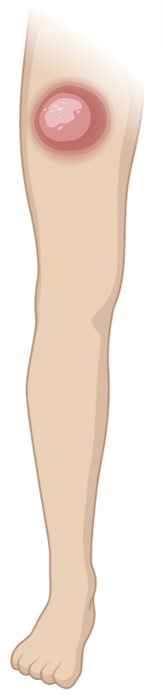
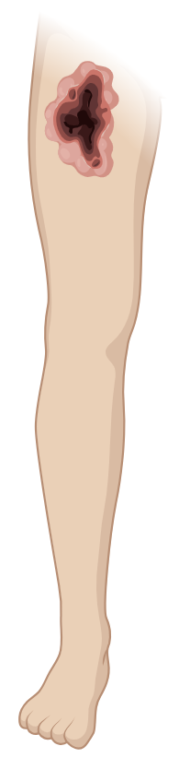
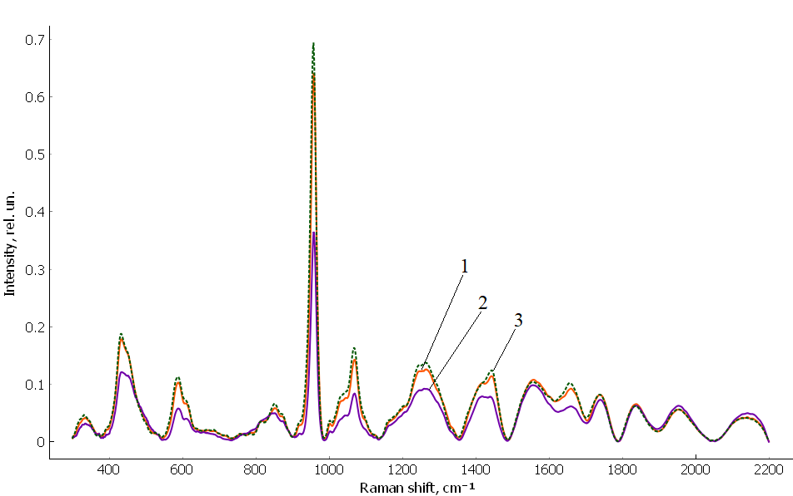
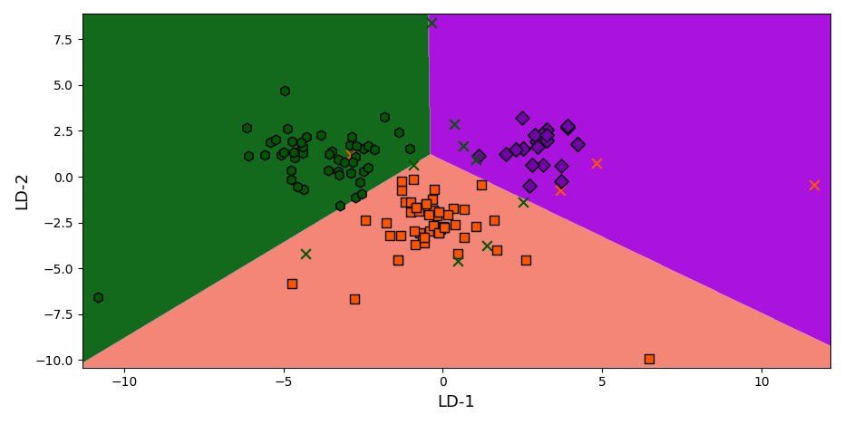
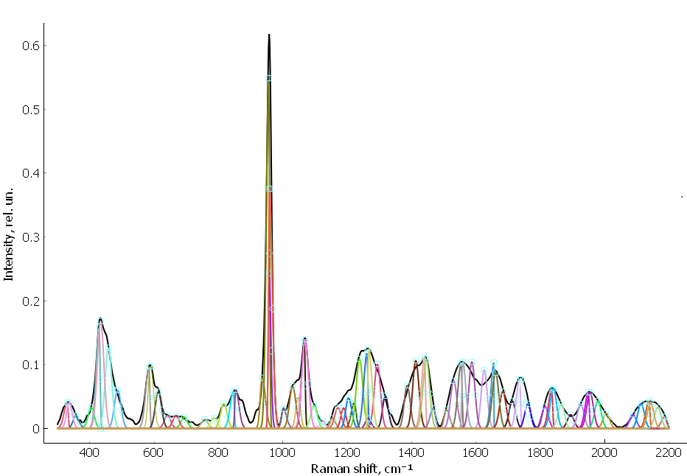
SPECTRAL DIAGNOSTICS OF THE FEMORAL COMPACT BONE CONDITION IN GANGRENE AND PHLEGMON
E.V. Timchenko^{1,2}, D.G. Glubokov², P.E. Timchenko¹, I.V. Bazhutova², L.T. Volova², F.R. Bazhutov³
¹Samara National Research University, 34 Moskovskoe Shosse, Samara, 443086, Russia
²Samara State Medical University, 89 Chapaevskaya St., Samara, 443099, Russia
³Lomonosov Moscow State University, Faculty of Chemistry, Moscow, ul. Leninskie Gory, Building 1, Bldg. 3, 119991, Russia
BACKGROUND & OBJECTIVE
DISEASE-SPECIFIC PATTERNS
Bone involvement can extend beyond visibly affected soft tissue and influence the choice of treatment and amputation level. Raman scattering provides molecular information on both the mineral phase and collagen-rich organic matrix
PHLEGMON
A diffuse, spreading bacterial infection of soft tissues characterized by purulent inflammation without clear boundaries
GANGRENE
Tissue necrosis caused by severe loss of blood supply and/or infection, resulting in irreversible tissue death
Objective: assess whether Raman spectra reveal distinct changes in femoral compact bone in gangrene and phlegmon compared with conditionally healthy controls
SPECTRAL SIGNATURE
Greatest relative-intensity loss at
432, 587, 957 and 1044 cm⁻¹ (PO₄³⁻), 1068 cm⁻¹ (CO₃²⁻),
1264, 1443, 1658 cm⁻¹ (organic matrix)
SPECTRAL SIGNATURE
The same characteristic bands than in phlegmon are affected, but the intensity changes are smaller
RAMAN SPECTRA
CHEMOMETRIC DISCRIMINATION
Femoral compact bone from 20 recipients (both sexes, 58–76 years): gangrene, phlegmon, and conditionally healthy control.
Figure 2. LDA score map: gangrene (orange squares), phlegmon (violet diamonds), control (green circles)
The samples were divided into 3 groups: gangrene, phlegmon, and conditionally healthy controls without diagnosed bone pathology
Figure 1. Mean Raman Spectra: 1 - gangrene; 2 - phlegmon; 3 - control
SPECTRAL DECOMPOSITION
INTERPRETATION
Spectral decomposition helped resolve overlapping organic-matrix components in the 1200–1700 cm⁻¹ region and additional weak components in the 1800–2200 cm⁻¹ region
The spectra of all three groups contained the same characteristic Raman bands, and no shifts of the principal peak positions or appearance of new dominant bands were observed. Therefore, the differences between phlegmon, gangrene, and control samples were mainly related to the relative intensities of the spectral components.
The phlegmon group showed the greatest decrease in the PO₄³⁻ bands at 432 cm⁻¹ (ν₂), 587 cm⁻¹ (ν₄), 957 cm⁻¹ (ν₁), and 1044 cm⁻¹ (ν₃). The CO₃²⁻ band at 1068 cm⁻¹ and the organic-matrix bands at 1264 cm⁻¹ (amide III), 1443 cm⁻¹ (CH₂ deformation), and 1658 cm⁻¹ (amide I) were also reduced.
The simultaneous changes in PO₄³⁻, CO₃²⁻, and amide bands are consistent with more pronounced differences in both the mineral phase and collagen matrix of compact bone in the phlegmon group.
The gangrene group showed changes in the same spectral regions, but their magnitude was smaller than in the phlegmon group.
Thus, the spectra of gangrene and phlegmon differed mainly in the extent of the intensity changes rather than in the positions or composition of the principal Raman bands.
Figure 3. Decomposition resolves overlapping biochemical contributions to the measured spectrum
CONCLUSION
Raman spectroscopy detected disease-associated molecular changes in femoral compact bone. The spectral pattern suggests secondary bone involvement in phlegmon and earlier, less pronounced matrix destruction in gangrene. Combined spectral and chemometric analysis therefore shows promise for assessing bone condition in these diseases
Optical Technologies in Biophysics & Medicine XXVIII
CORRESPONDENCE: laser-optics.timchenko@mail.ru

