Slide 1
Optical clearing of ex vivo porcine dura mater by mannitol studied by confocal Raman micro-spectroscopy
Ali Jaafar,^{1,2,3} , Maxim E. Darvin⁴ , Ágnes N. Szokol¹ , Valery V. Tuchin,^{4,5,6} and Miklos Veres¹.
¹ Institute for Solid State Physics and Optics, Wigner Research Center for Physics, P.O. Box 49, Budapest, H 1525, Hungary
² Institute of Physics, University of Szeged, Dom ter 9, H-6720 Szeged, Hungary
³ Ministry of Higher Education and Scientific Research, 10065, Baghdad, Iraq
⁴ Department of Dermatology, Venerology and Allergology, Center of Experimental and Applied Cutaneous Physiology, Charité Universitätsmedizin Berlin, corporate member of Freie Universität Berlin and Humboldt-Universität zu Berlin, Charitéplatz 1, 10117 Berlin, Germany
⁵Science Medical Center, Saratov State University, 83 Astrakhanskaya str., 410012 Saratov, Russia
⁷Laboratory of Laser Diagnostics of Technical and Living Systems, Institute of Precision Mechanics and Control, FRC “Saratov Scientific Centre of the Russian Academy of Sciences,” 24 Rabochaya str., 410028 Saratov, Russia
⁷А.N. Bach Institute of Biochemistry, FRC “Biotechnology of the Russian Academy of Sciences,” 33-2 Leninsky Prospect, 119071 Moscow, Russia
Take notice of what light does to everything

Slide 2
Optical clearing
Main mechanisms of tissue optical immersion clearing
Materials and methods:
Confocal Raman microscopy
Dura mater sample preparation
Optical Clearing Agents
Results: optical clearing using confocal Raman micro-spectroscopy
Conclusions

Slide 3
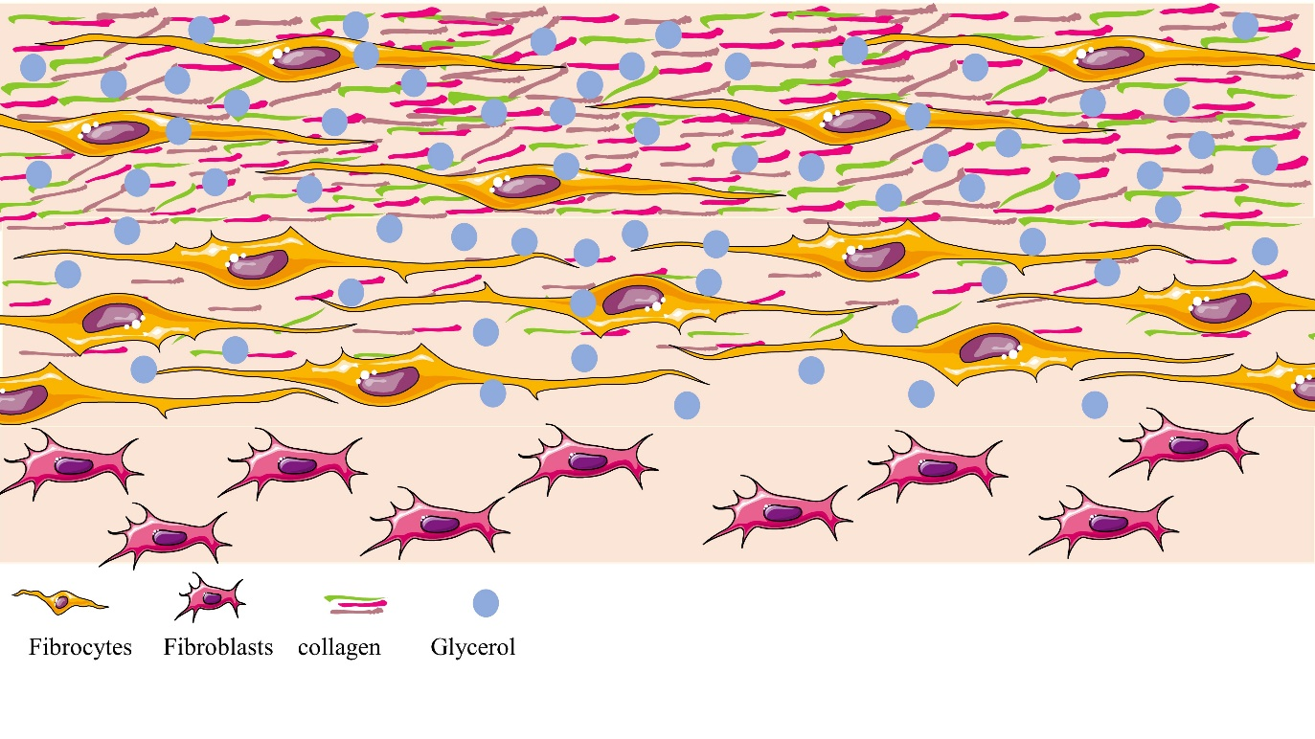
Optical clearing
Noninvasive optical techniques implementation in tissue diagnosis and treatment, such as confocal Raman Raman micro-spectroscopy, coherent anti-Stokes Raman scattering (CARS) spectroscopy and tomography, multiphoton tomography (MPT), SHG-microscopy and OCT.
Main limitation of the deep biological investigation that all tissue layers are characterized by high light scattering and absorption
Since it was reported in the nineties, the optical clearing (OC) technique was developed to allow effectively reduce light scattering in tissue to reach the maximum probing depth, improve contrast and spatial resolution of optical diagnostic methods.
Schematically shows the distribution of mannitol molecules when a dura mater sample is immersed in glycerol

Slide 4
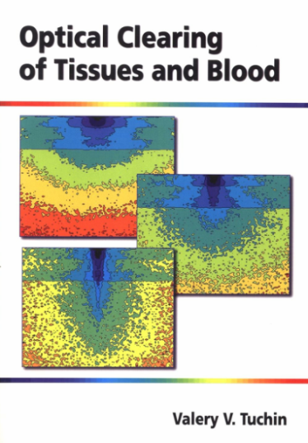
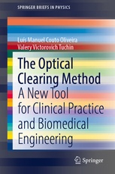
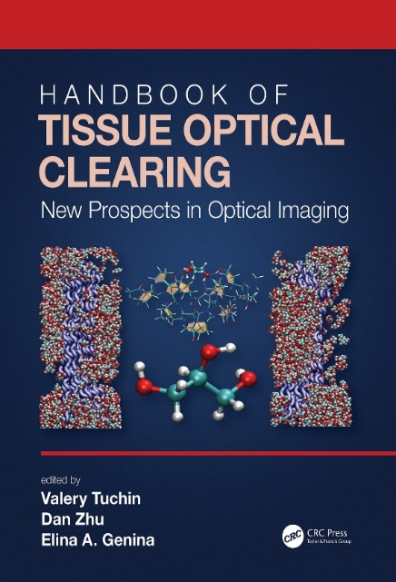
SPIE Press 2005
Three hypothesized mechanisms of OC were suggested:
Matching of refractive indices between tissue components and interstitial fluid
Tissue dehydration
Reversible dissociation of collagen fibers
These and possibly other not known OC mechanisms usually work not independently but simultaneously with different relative contributions dependent on tissue and OCA and delivery method.
Main mechanisms of tissue immersion optical clearing (OC)
Springer 2019
CRC Press 2022

Slide 5
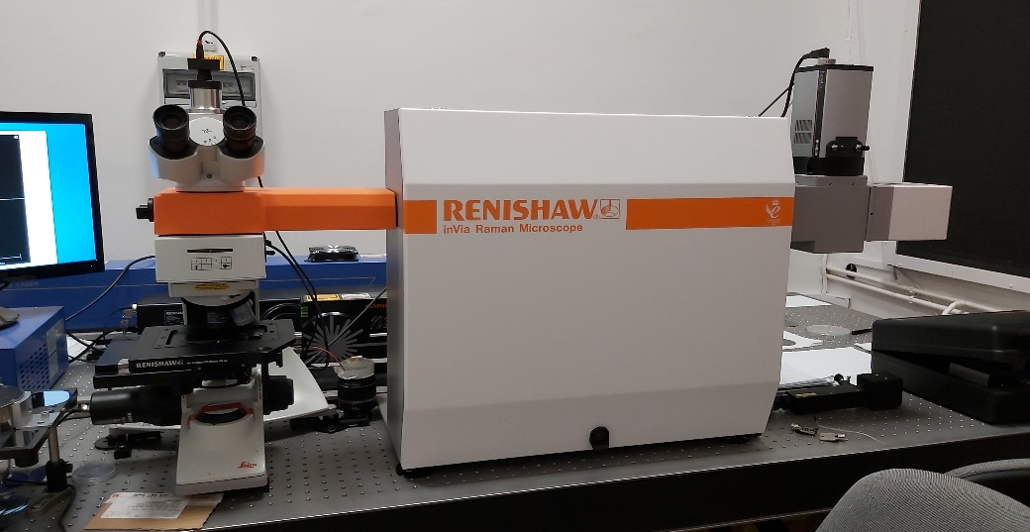
Materials and methods: Confocal Raman microspectroscopy
The excitation source: laser: 633 nm, power: 8.3 mW, exposure time 5 sec, Grating: 1200, spectral range: 400 to 1800 cm⁻¹ , 50× objective and was used to focus the laser beam and to collect Raman signals
Measurement protocol of sample OC:
Measurements were performed on fresh ex vivo porcine Dura mater (DM).
Treatment time was for 1, 2, 3, 5 and 10 min immersion in mannitol bath of petri dish with concentration 0.16 g/ml, the refractive index was 1.354.
Series of Raman spectra obtained from the DM at different depths ranging (from 0 to 125 μm) with 25 μm step size.
Before measurements, mannitol was removed from samples surface using a paper towel
Sample size 19 mm, thickness 400 µm approx., 5 samples used for each treatment time.
Renishaw inVia Raman microspectrometer

Slide 6
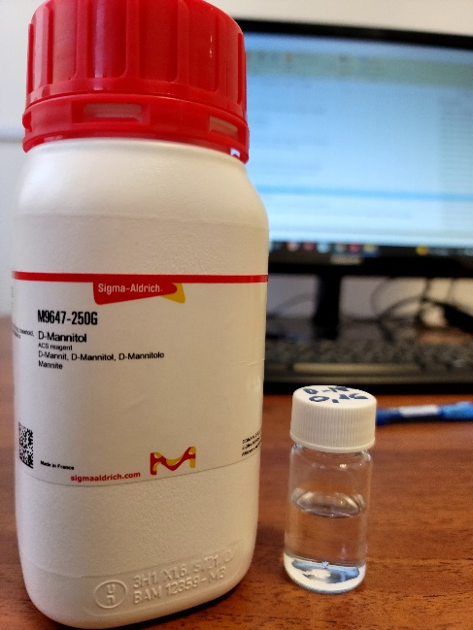
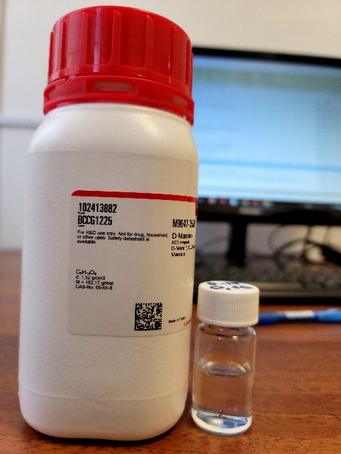
Optical Clearing Agent
For the study the OC effect the following agent was chosen:
Mannitol, which is used as an OCA as its biocompatibility and pharmacokinetics render it suitable for tissues.
Apart from being used as an immersion agent, mannitol is widely employed in cerebrovascular surgery as a measure in preventing necrosis and apoptosis of cells.
For brain tumor therapy, for increasing vessel permeability to drugs.
The use of mannitol in open brain surgery for lowering intracranial pressure and preventing cerebral edema.
At the same time, the dynamics of changes in the optical parameters of the human dura mater subjected to the action of a low-concentration mannitol solution, which does not cause osmotic shock to the biological tissue is insufficiently studied despite the fact that it is important in view of the wide clinical applications of this compound.

Slide 7
Raman band assignment
Wavenumber (cm⁻¹) | Assignment
937 | C–C stretch backbone
1003 | phenylalanine/urea
1206–1210 | (C–C) skeletal vibration
1241 | amide III
1274 | amide III
1426 | C–C stretching vibrations
1450 | (CH₂) scissoring
1665 | amide I
The principal collagen bands
Raman spectra of dura mater and mannitol solution

Slide 8
Change of Raman peak intensities with time
Raman bands intensities of DM at 938, 1246, 1268, and 1666 cm⁻¹ at different depths from 0 to 125 μm with time after treatement with mannitol

Slide 9
Conclusion
Raman intensities increasing for all peaks and most all depths and get maximum for 1 min treatment and then decreasing for all depth for 2 and 3 min due to swelling of the tissue that occurs after the initial shrinkage of the tissue caused by mannitol.
At 5 min treatment the Raman intensities increasing monotonically and slowly with treatment time which can be explained by a balance between local shrinkage and swelling abilities of tissue caused by a balance of the opposite water fluxes, thus only relatively slow mannitol molecules diffusion provides RI matching mechanism of OC.
Possible suggestion for the lack of increased OC observed for the DM immersed in mannitol is a shift in pH to a more acidic level within the tissue’s interstitial fluid caused by the OCA diffusion. A change in pH can result in swelling of a tissue. Collagen fibers swelling results in an increase in their size and changes in their packing arrangement. These changes increase the scattering of light and therefore a decrease in tissue transparency

Slide 10
Thank you
for your attention

