Slide 1
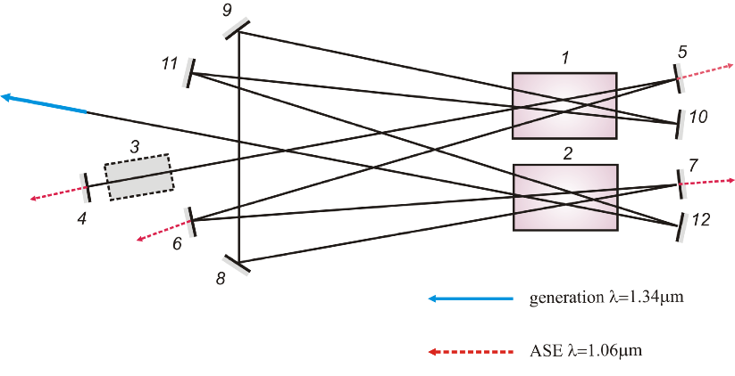
Analysis of the effect of amplified spontaneous radiation on a phase-conjugated YAG:Nd laser oscillation at a wavelength of 1.34 um at electro-optical and passive Q-switching of an open multi-loop cavity
Mikhail N.Ershkov,1, Sergei A.Solokhin,1, Alexander E. Shepelev,2, Alexander A. Antipov,2
1 Degtyarev Kovrov State Technological Academy, Kovrov, Russia
2 Institute on Laser and Information Technologies of Russian Academy of Sciences - Branch of Federal Scientific Research
Center “Crystallography and Photonics” of Russian Academy of Sciences, Shatura, Russia
Abstract: In this work, a comparative analysis of the influence of the amplified spontaneous emission (ASE) at a wavelength of 1.06 μm on oscillation characteristics at a wavelength of 1.34 μm for a YAG:Nd³⁺ laser with a phase-conjugated open multiloop cavity at passive and electro-optical Q-switching is presented. At the passive Q-switching, the intense ASE growth is associated with insufficient spectral selectivity of the cavity mirrors having residual reflection at a wavelength of 1.06 μm of about 4%. At the electro-optical Q-switching, the control by the time delay between the pump pulse and the moment of Q-switch opening made it possible to reduce the ASE power by more than a factor of two.
Experimental optical setup
1, 2 – YAG: Nd³⁺ - active elements (Ø 6.3х130 mm)
3 – passive YAG: V³⁺ or electro-optical LiTaO₃
Q-switch
4 - 12 – flat mirrors (R_{1.34}=100 %; R_{1.06}~4 %)
Pump parameters
flash-lamp energy – up to 60 J
pulse duration – 350 mks
repetition rate – 2-10 Hz

Slide 2
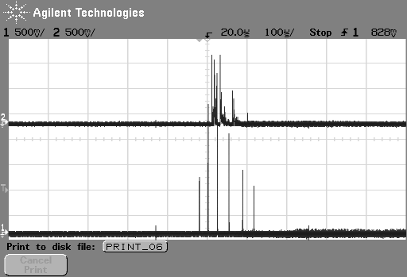
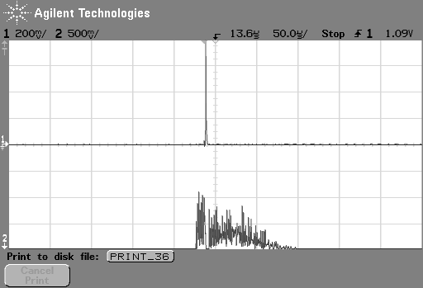
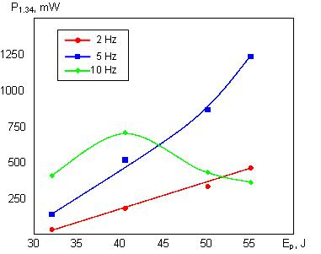
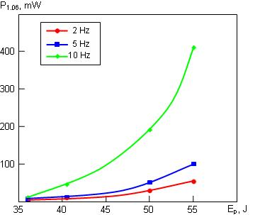
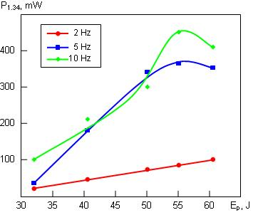
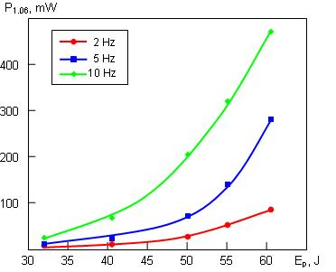
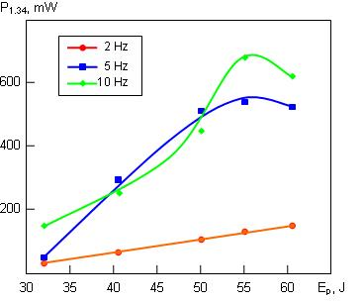
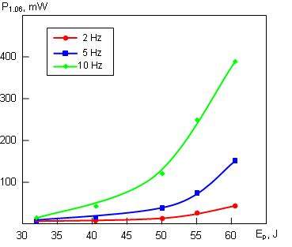
Experimental results in passive Q-switching regime
Experimental results in electro-optical Q-switching regime
λ=1.06 μm
λ=1.34 μm
λ=1.34 μm
λ=1.06 μm
1.34-μm radiation and 1.06-μm ASE output power
1.34-μm radiation and 1.06-μm ASE output power at the not optimal moment of Q-switch opening (Δτ~180 mks)
Output power at 1.34 μm
Output power at 1.06 μm
Output power at 1.34 μm
Output power at 1.06 μm
Pumping energy
Pumping energy
Pumping energy
Pumping energy
1.34-μm radiation and 1.06-μm ASE output power at the optimal moment of Q-switch opening (Δτ~250 mks)
Conclusions:
In the passive Q-switching regime at the pump frequency of 2 Hz and 5 Hz, the increase of the 1.06-μm ASE power is determined by the residual reflection of the cavity mirrors. At the pump frequency of 10 Hz the Q-factor of the 1.34-μmphase-conjugated open multiloop cavity decreased due to the excessive thermal lens, which led to an additional increase of the 1.06-μm ASE power;
In the electro-optical Q-switching regime at the pump frequency of 2 Hz and 5 Hz the control by the moment of Q-switch opening made it possible to reduce the 1.06-μm ASE power from 85 mW and 290 mW down to 40 mW and 140 mW respectively. Due to this, the output power at a wavelength of 1.34 μm increased from 100 mW and 350 mW up to 150 mW and 520 mW respectively.
Output power at 1.34 μm
Output power at 1.06 μm
Pumping energy
Pumping energy

