Slide 1
Animal anesthesia in long-term experiments on imaging and surgical intervention

Slide 2
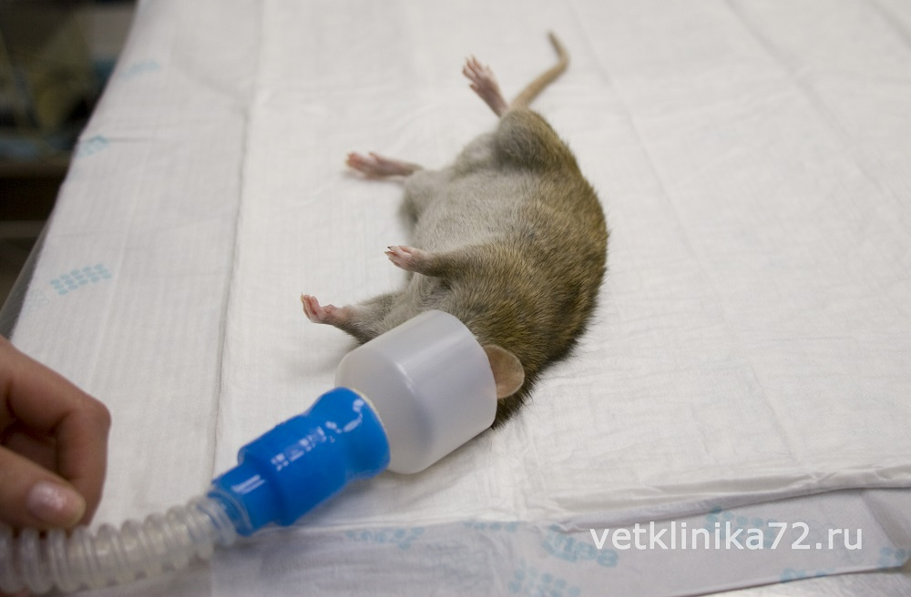
Relevance of the research topic
The relevance of this topic is the reduction of financial costs for conducting research, as well as the most humane treatment of experimental animals. The death of experimental subjects is often inevitable, which often entails financial costs. Moreover, this often happens not only as a result of the experiment itself, as its result, but also as side processes that we can influence. Thus, if we know for certain that a given method of anesthesia is accompanied by frequent deaths, we can change the protocols, which will directly affect both the cost of the study and help save several small lives.
Notes:
В медицине и биотехнологии широко используются полимерные материалы для создания различных медицинских изделий, таких как имплантаты, протезы, лекарственные доставочные системы и сенсоры. Важным аспектом при использовании таких материалов является их биодеградация, то есть способность разлагаться и обрабатываться организмом после выполнения своей функции.
Многофакторная оценка биодеградации сополимеров важна при разработке новых полимерных материалов с контролируемой скоростью биодеградации и контролируемым уровнем высвобождения включенных в состав веществ медицинского назначения.

Slide 3
Purpose and objectives of the study
The aim of our work was to understand the optimal anesthesia regimen for long-term monitoring in bimodal imaging of experimental animals (laboratory mice), especially when surgery is required.We were able to select the conditions under which all manipulations were carried out using 1.5-2% isoflurane. We have demonstrated that when using isoflurane anesthesia, the survival rate of animals is about 100% compared with 70% combined anesthesia at the same time of observation. Adequate selection of anesthesia can reduce the loss of animals during surgery and increase survival during long-term monitoring.

Slide 4
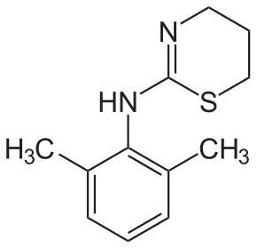
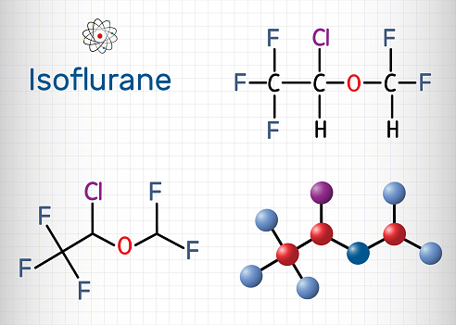
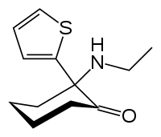
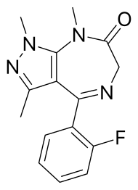
Object of study
Тiletamine
Zolazepam
Figure 1 – isoflurane
Figure 2 – zoletil and rometar
Rometar (xylazine hydrochloride)

Slide 5
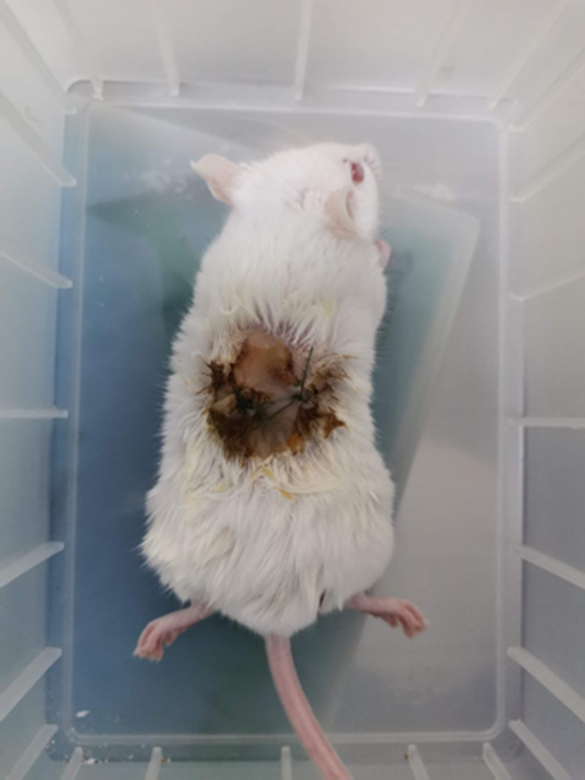
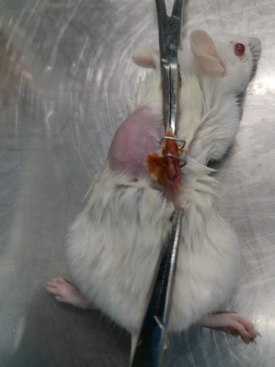
Experiment sequence
Introduction to anesthesia
Induction in a gas chamber - the mouse is placed in a box where isoflurane is supplied to put the animal to sleep
Maintaining anesthesia - the animal is given an anesthetic through a mask to maintain sleep, in a dose less than the induction dose
Anesthesia and muscle relaxation
2. Carrying out the operation
3. MRI scanning

Slide 6
Comparison of types of anesthesia
Blue – total number of mice in the experiment
Orange – number of dead individuals

Slide 7
Сonclusions
Anesthesia with isoflurane and muscle relaxation with Rometar was safer, as evidenced by the number of surviving mice. When using the combination of Rometar + Zoletil, 3 out of 8 mice died, and these 3 mice did not recover from anesthesia. When using the combination of isoflurane + Rometar, 2 mice died, and it was euthanized due to septic inflammation in the area of ​​​​the implanted discs, the second died during an MRI.
The depth of anesthesia for MRI with a constant supply of a gas mixture is sufficient for fluorimetry.
The combination of Rometar + zoletil is dangerous for rodents, because zoletil negatively affects the functions of the liver and kidneys, which leads to the death of the animal either immediately after surgery or a few days later.
Veterinarians recommend the use of lidocaine 2% as an anesthetic for minor interventions.

