Slide 1


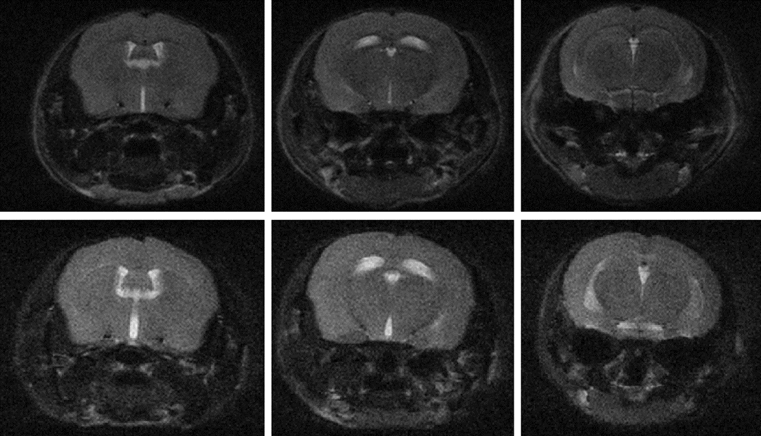
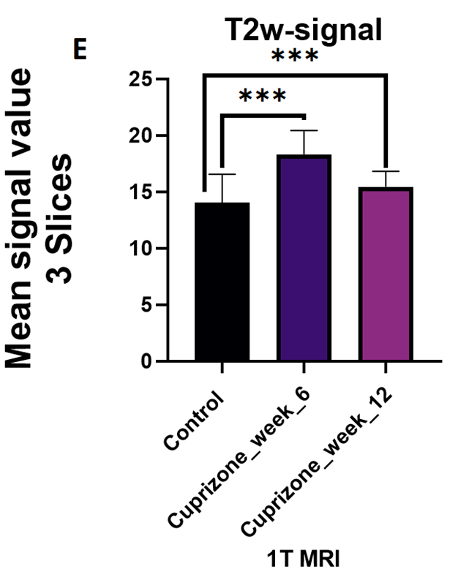
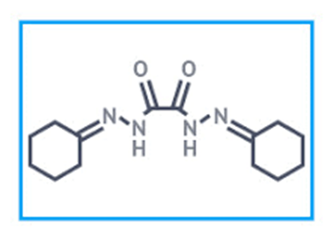
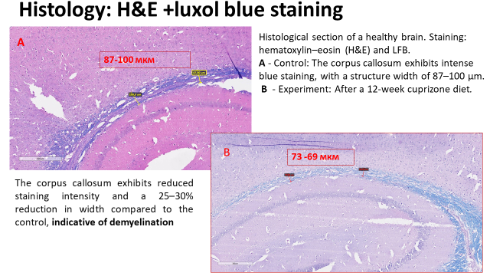
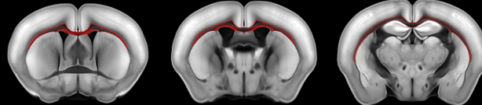
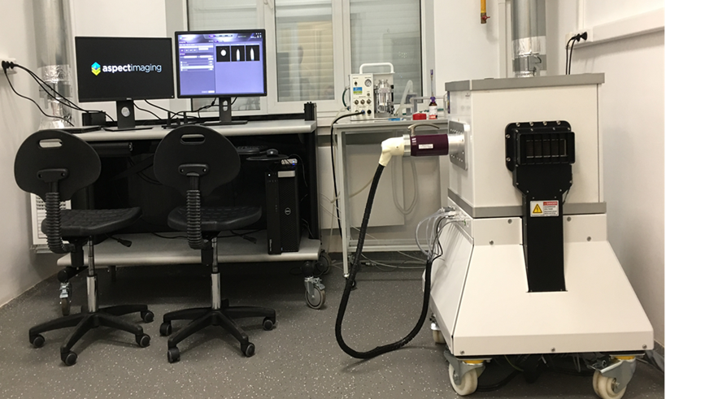
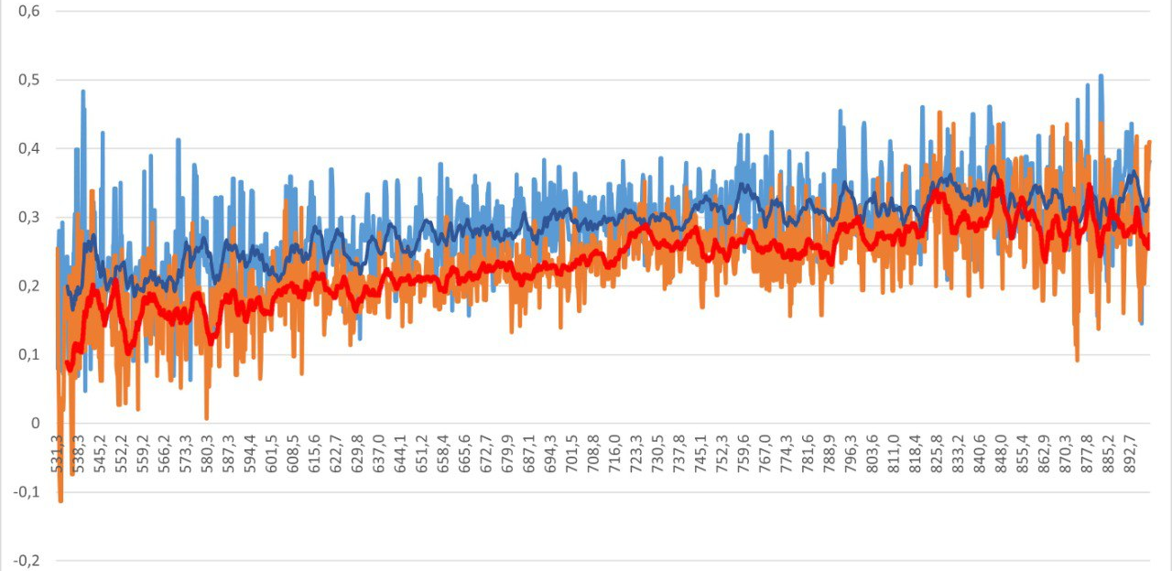
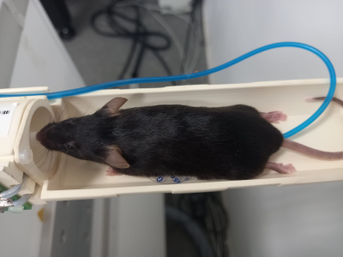
Assessment of Peripheral Hemodynamics by Diffuse Reflectance Spectroscopy in the Visible and Near-Infrared Range in the Cuprizone-Induced Demyelination Model
Veronika Nikolaevna Volodina¹, Anastasia Andreevna Chervakova¹, Alexander Vladimirovich Kolpakov², Diana Yurievna Sokolova², Petr Evgenievich Zaitsev¹, Ulyana Aleksandrovna Apukhtina¹, Tatiana Ivanovna Yaremenko¹, Mikhail Sergeevich¹, Nikolai Nikolaevich Kuznetsov¹,³, Viktoria Vyacheslavovna Zherdeva¹
¹A.N. Bach Institute of Biochemistry, Research Center of Biotechnology of the Russian Academy of Sciences, Moscow, Russia
²Faculty of Biomedical Engineering, Department of Biomedical Technical Systems, Bauman Moscow State Technical University, Moscow, Russia
³FN-5 "Chemistry", Bauman Moscow State Technical University, Moscow, Russia
Aim of the study: to evaluate the feasibility of using diffuse reflectance in the visible and near-infrared range for non-invasive monitoring of peripheral circulation and tissue oxygenation in mice with cuprizone-induced demyelination.
Fig.3. A statistically significant difference (p < 0.05) was found between the model (cuprizone) and control (healthy) C57BL/6 mice using 1T MRI
Fig. 4. Structure of the organic molecule of cuprizone, a substance that impairs oxidative phosphorylation by reducing the levels of mitochondrial enzymes, in particular monoamine oxidase, in the mouse brain, which ultimately leads to oligodendrocyte death.
Fig.1. Demyelination in corpus callosum. Tw2 Т МRI of control (A) and cuprizone-treated mice CPZ (B)(TR = 5600, TE = 82).
Fig. 6. Histological verification of demyelination. Mouse brain sections stained with Luxol fast blue. A, control mouse with intact corpus callosum. B, demyelinated brain with damaged corpus callosum. Scale bar: … µm.
Fig.2. Axial slice of the mouse brain with the corpus callosum highlighted. Image from an MRI atlas.
Fig. 5
In the course of the experiment, a 1 T MRI system (Aspect Imaging, Israel) for small laboratory animals was used. MRI pulse sequences in T2w FSE (T2-weighted fast spin echo) mode; T2w FSE MR images were obtained using fast spin-echo sequences with T2 weighting.
Fig. 8. Averaged diffuse reflectance spectra in the visible and near-infrared range (530–1000 nm) recorded from the tail vein surface of mice. The blue line represents the control group (standard diet), and the orange line represents the cuprizone-induced demyelination group (0.4% cuprizone, 90 days). Thick lines indicate smoothed data (moving average, 17 points). A decrease in reflected signal intensity in the 550–600 nm range is observed in cuprizone-treated mice.
Fig. 7. Study subjects: female C57/Bl6 mice, 10–12 weeks of age.
Results:
Statistically significant differences in diffuse reflectance (DR) spectra were revealed between the control and cuprizone groups.
In cuprizone-treated mice, a decrease in reflectance intensity in the 550–600 nm range was observed, which may reflect changes in hemoglobin concentration/oxygenation in peripheral vessels.
The prolonged recovery from anesthesia in cuprizone-treated mice may be associated with:
central mechanisms (impaired neurotransmission, mitochondrial dysfunction);
peripheral mechanisms (changes in peripheral blood flow and tissue oxygenation).
Conclusions. The use of diffuse reflectance in the visible and near-infrared range enables non-invasive registration of changes in peripheral blood circulation and tissue oxygenation in mice with cuprizone-induced demyelination, correlating with the clinically observed prolongation of recovery time after anesthesia. The obtained results open up prospects for employing this method for monitoring systemic hemodynamic disturbances in preclinical models of neurodegenerative diseases.

