Slide 1





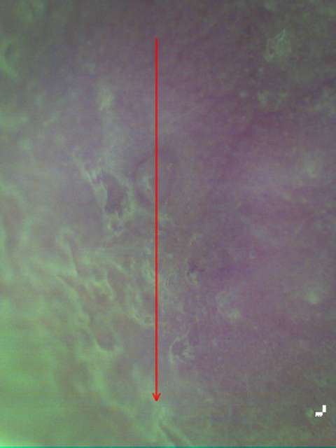
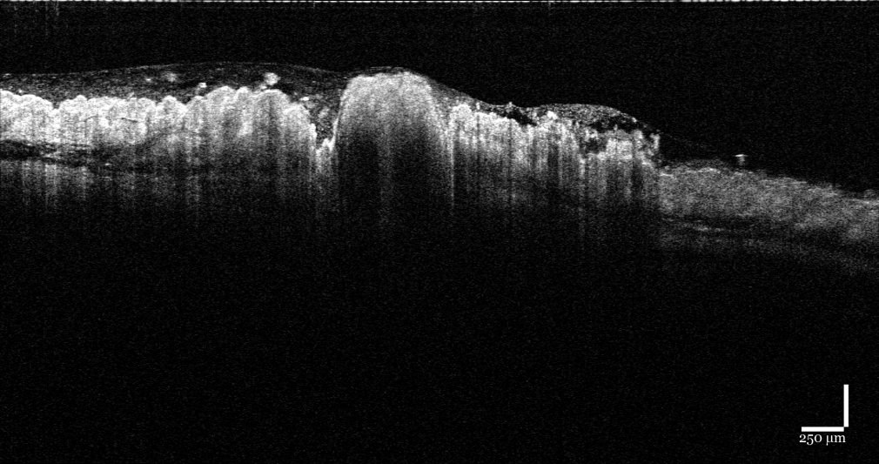
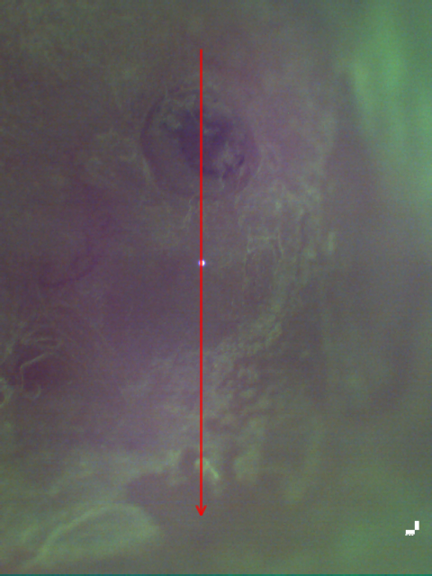
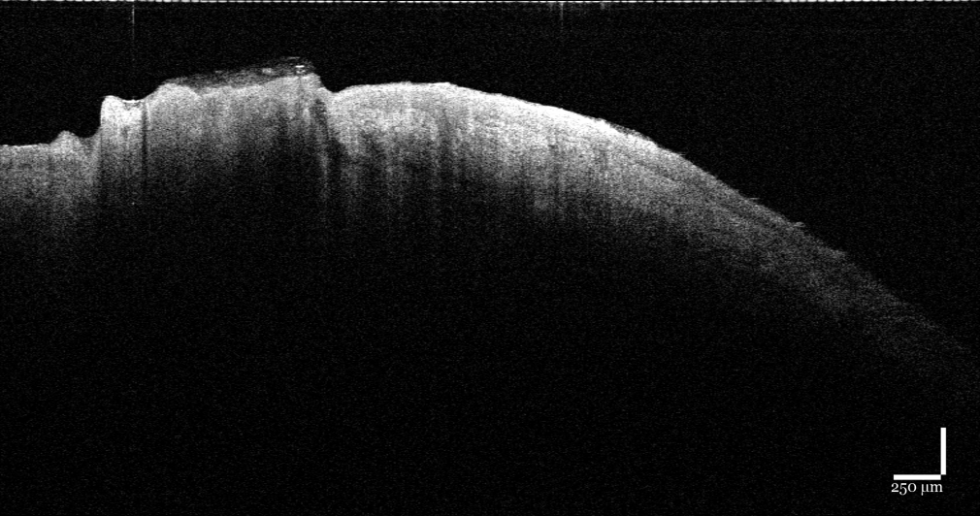
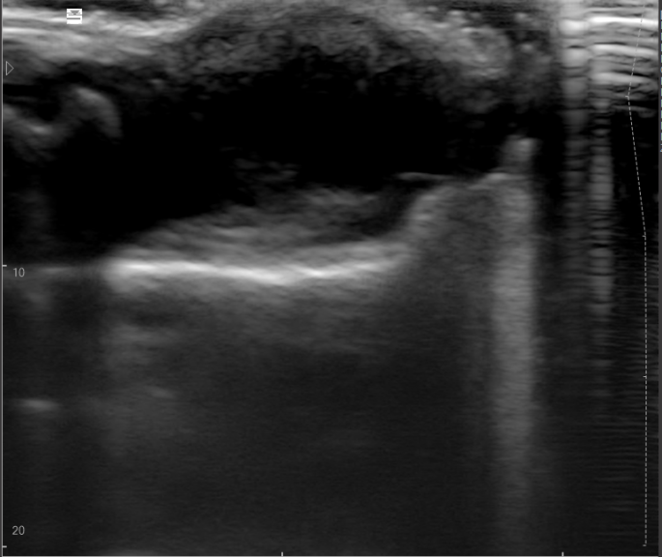
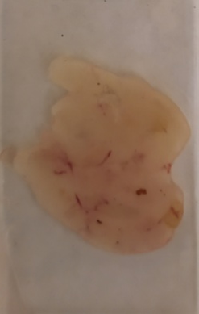
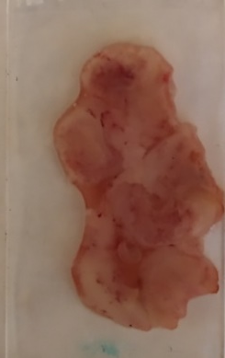

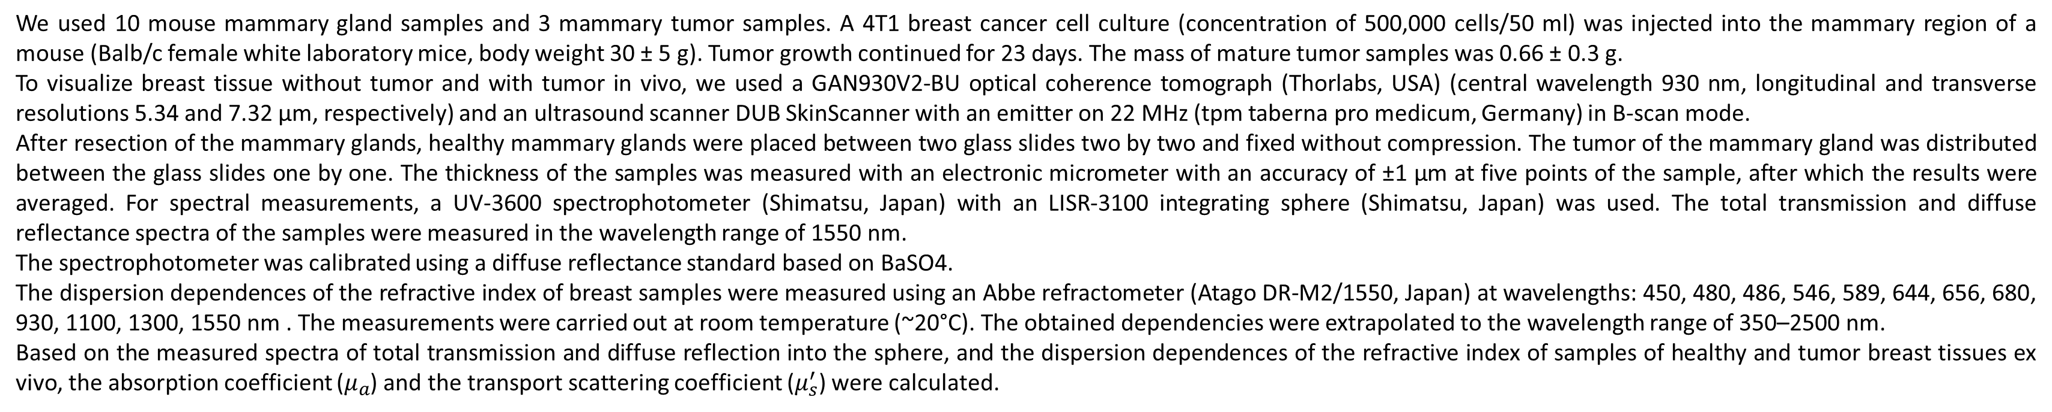
Multimodal study of the optical parameters of the murine mammary gland and a model mammary tumor ex vivo
AUTHORS
Yury I. Surkov ^{1,2}, Isabella A. Serebryakova ^{1,2}, Ekaterina N. Lazareva ^{1,2}, Mohammad Ali Ansari ³, Elina A. Genina^{1,2}
1 - Saratov State University, Saratov, Russia
2 - Tomsk State University, Tomsk, Russia
3 - Shahid Beheshti University, Tehran, Iran
ANNOTATION
In this study visualization of healthy murine breast tissues and tumors in vivo and optical parameters ex vivo are presented. The results of ultrasound examination (US) and optical coherence tomography (OCT) in vivo were obtained, and the phase refractive index was measured using a multi-wavelength Abbe refractometer ex vivo of healthy and tumor tissues. Based on the measured spectra of total transmission and diffuse reflection into the sphere, and the dispersion dependences of the refractive index of samples of healthy and tumor breast tissues ex vivo, the absorption coefficient and transport scattering coefficient were calculated using the inverse addition-doubling method.
The development of optical methods for diagnosing and treating breast cancer stimulates the study of the optical properties of the corresponding human and animal tissues, since the efficiency of optical probing depends on the propagation of radiation in biological tissue. The development of modern diagnostic and therapeutic methods is practically impossible without reliable quantitative optical models of breast biotissue and breast cancer, taking into account their multicomponent composition and structural and morphological structure. Accordingly, the development of these models requires reliable data on the optical parameters (refractive index, absorption coefficient, scattering coefficient) of both healthy breast tissues and malignant neoplasms in a wide range of wavelengths. Knowledge of these parameters will make it possible to evaluate the content of the main chromophores, which, of course, will significantly increase the effectiveness of existing diagnostic and therapeutic methods and techniques for the treatment of breast cancer.
MATERIALS AND METHODS
We used 10 mouse mammary gland samples and 3 mammary tumor samples. A 4T1 breast cancer cell culture (concentration of 500,000 cells/50 ml) was injected into the mammary region of a mouse (Balb/c female white laboratory mice, body weight 30 ± 5 g). Tumor growth continued for 23 days. The mass of mature tumor samples was 0.66 ± 0.3 g.
To visualize breast tissue without tumor and with tumor in vivo, we used a GAN930V2-BU optical coherence tomograph (Thorlabs, USA) (central wavelength 930 nm, longitudinal and transverse resolutions 5.34 and 7.32 µm, respectively) and an ultrasound scanner DUB SkinScanner with an emitter on 22 MHz (tpm taberna pro medicum, Germany) in B-scan mode.
After resection of the mammary glands, healthy mammary glands were placed between two glass slides two by two and fixed without compression. The tumor of the mammary gland was distributed between the glass slides one by one. The thickness of the samples was measured with an electronic micrometer with an accuracy of ±1 µm at five points of the sample, after which the results were averaged. For spectral measurements, a UV-3600 spectrophotometer (Shimatsu, Japan) with an LISR-3100 integrating sphere (Shimatsu, Japan) was used. The total transmission and diffuse reflectance spectra of the samples were measured in the wavelength range of 1550 nm.
The spectrophotometer was calibrated using a diffuse reflectance standard based on BaSO4.
The dispersion dependences of the refractive index of breast samples were measured using an Abbe refractometer (Atago DR-M2/1550, Japan) at wavelengths: 450, 480, 486, 546, 589, 644, 656, 680, 930, 1100, 1300, 1550 nm . The measurements were carried out at room temperature (~20°C). The obtained dependencies were extrapolated to the wavelength range of 350–2500 nm.
Based on the measured spectra of total transmission and diffuse reflection into the sphere, and the dispersion dependences of the refractive index of samples of healthy and tumor breast tissues ex vivo, the absorption coefficient ($μ_{a}$) and the transport scattering coefficient ($μ_{s}^{′}$) were calculated.
RESULTS
Microimage
OCT image
Healthy mouse mammary gland
Measured values of total transmission and diffuse reflectance of healthy breast tissue (left) and breast tumor (right)
Mouse mammary tumor
Absorption coefficient (left) and transport scattering coefficient (right) of breast tissue and breast tumors
Measured values of the refractive index of breast tissue and breast tumors
CONCLUSION
As a result of the studies, it was found that during the development of a tumor, the structure of the breast tissue changes, which is detected on OCT, since the refractive index of the tumor tissue is lower than that of a healthy breast. On ultrasound scans, the tumor looks like an increase in the echo-negative area. In the tumor tissue, there is an increased content of water and proteins and a reduced content of lipids. Scattering of tumor tissue is much less than scattering of healthy breast tissue.
Ultrasound result of a mouse mammary tumor
Image of normal mouse mammary gland (left) and mammary tumor (right)
The reported study was funded by the grant of RFBR (#20-52-56005) and the grant under the Degree of the Government of the Russian Federation No. 220 of 09 April 2010 (Agreement No. 075-15-2021-615 of 04 June 2021).
Contact: surkov9898@gmail.com

