Slide 1

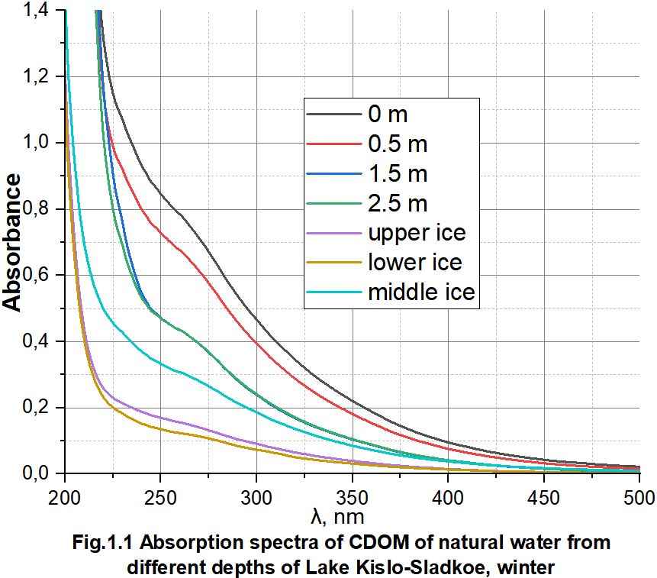
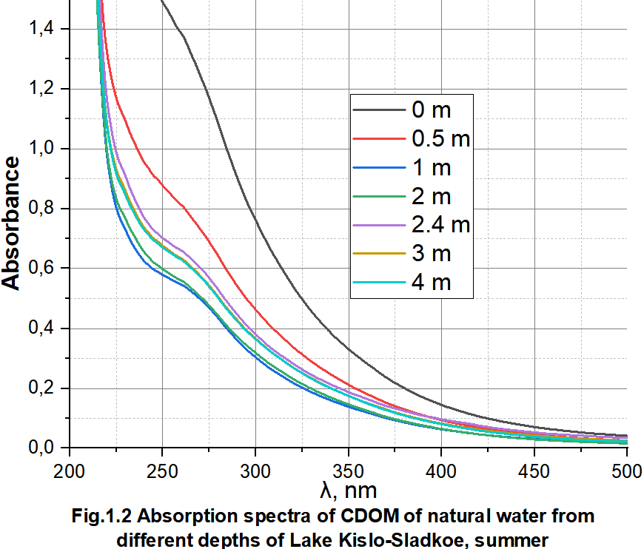
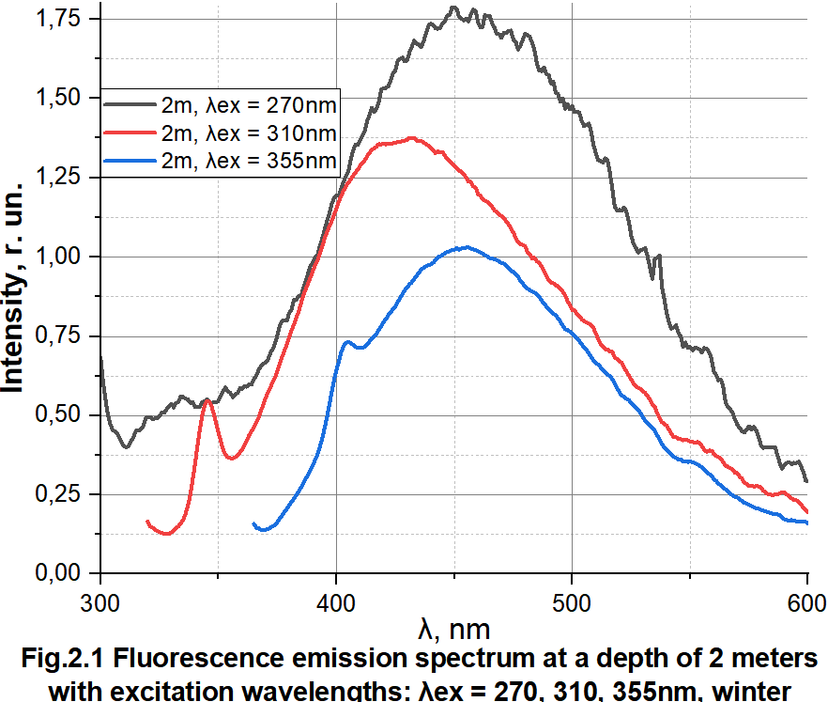
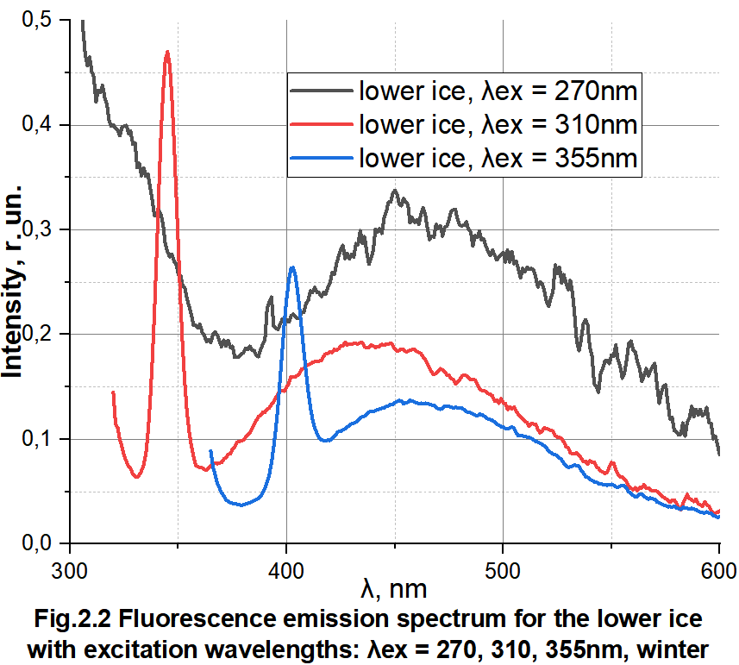
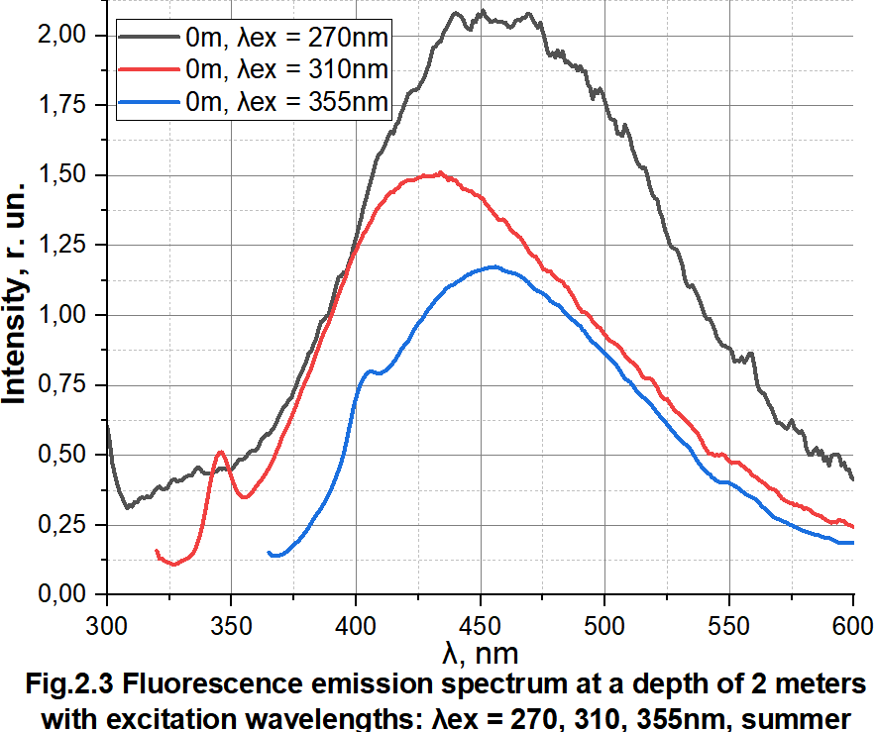
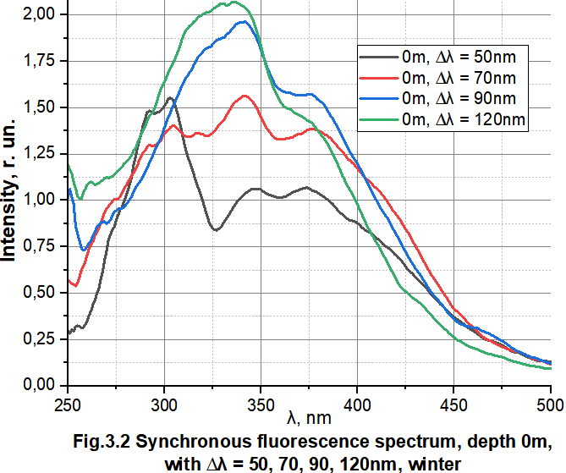
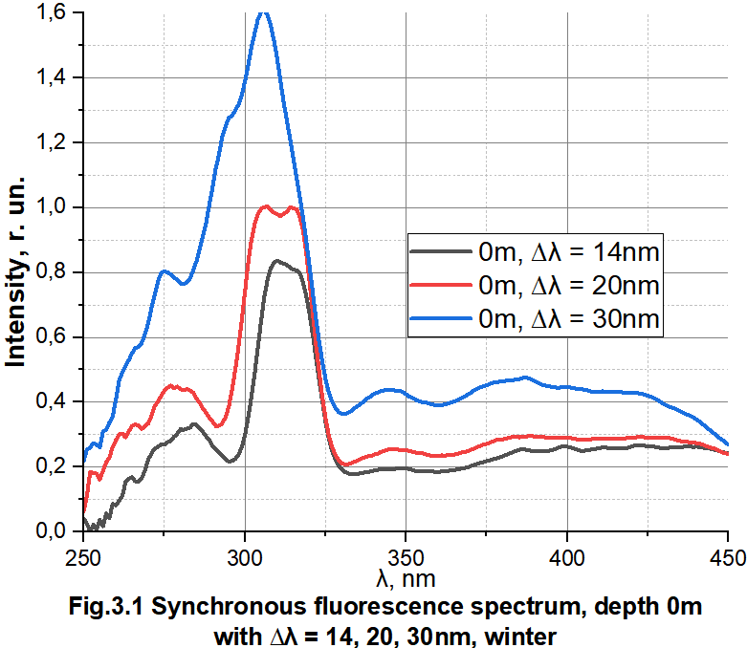
The comparison of spectral and optical properties of dissolved organic matter of the Lake Kislo-Sladkoe in the winter and summer seasons
Anastasia D. Tsvetkova¹, Yulia G. Sokolovskaya¹, Elena. D. Krasnova¹, Dmitry A. Voronov², Svetlana V. Patsaeva¹
¹Lomonosov Moscow State University, Faculty of Physics
²Kharkevich Institute for Information Transmission Problems, Russian Academy of Sciences
Introduction:
Meromictic water bodies are of particular interest for studying the composition and distribution of coloured dissolved organic matter (CDOM). These water bodies have a stable vertical stratification arising from the difference in density of water layers. In such water bodies, starting from a certain depth, an oxygen-free zone is usually present. At the upper boundary of which, with a sufficient amount of penetrating sunlight, an outbreak of anoxygenic phototrophic bacteria occurs. It is known that the optical properties of natural water significantly depend on the composition and concentration of CDOM, which affects the functioning of aquatic ecosystems, therefore, the study of CDOM in different horizons of stratified water bodies is important for understanding their evolution. A CDOM of natural origin effectively absorbs UV light and luminesces, therefore, light absorption spectroscopy and fluorescence spectroscopy are currently widely used for its study.
Objects and methods of the study:
We conducted sampling in late January and March (winter season) as well as in late June and August (summer season) at Lake Kislo-Sladkoe in 2024.
During the winter period, the ice thickness on the lake was 40 cm in January and 67 cm in March. For spectral analysis, 6 water samples were collected (from horizons 0 m, 0.5 m, 1 m, 1.5 m, 2.0 m, and 2.5 m), as well as three ice samples. The ice samples were obtained by sawing an ice core into three equal parts ("upper", "middle", and "lower"). The ice melted at room temperature was placed in plastic tubes.
During the summer period, 5 water samples were collected for spectral analysis (from horizons 0 m, 0.5 m, 1 m, 2 m, 2.4 m, 3 m, and 4 m).
To study CDOM, the samples were filtered through nylon filters with a pore size of 0.22 μm to separate suspended particles. Light absorption spectra were measured on a Solar PB2201 spectrophotometer in the range from 200 to 500 nm using quartz cuvettes with an optical path length of 3 cm. Cuvettes with a longer optical path length provide more accurate measurements for water samples with low CDOM content, but require a larger sample volume. Fluorescence spectra were recorded using a Solar CM2203 spectrofluorimeter with excitation of emission spectra at wavelengths of 270, 310, and 355 nm (registration wavelength from 280-365 to 700 nm). Synchronous fluorescence spectra were measured in the range of 230 - 500 nm with a wavelength difference ∆λ between the excitation and registration wavelengths of 14, 20, 30, 50, 70, 90 and 120 nm.
Results:
1) Absorption spectra:
In all samples, optical density monotonically decreased with increasing wavelength, which is typical for CDOM in natural water. During the winter period (Fig. 1.1), the light absorption spectra in water samples from depths of 1 to 2.5 m were approximately the same, and during the summer period (Fig. 1.2), the spectra from depths of 1-2 m and 2.4-4 m were similar. This is consistent with hydrological characteristics: salinity, temperature, and other water parameters at these depths are almost identical.
High absorption and high humic substance concentration were found for samples from the freshened water layer at depths of 0 m and 0.5 m. Meltwater ice samples contained significantly less CDOM than the water. Optical density of ice from different depths differed, which means that the amount of organics also differs.
2) Fluorescence spectra:
At an excitation wavelength of 270 nm, the fluorescence spectrum exhibits two overlapping bands: protein-like with a maximum at 300-350 nm and humic with a maximum at 450-500 nm (Fig. 2.1-2.3). At a higher excitation wavelength (355 nm), protein-like fluorescence was not observed. This is typical for natural water.
When excited with light at a wavelength of 270 nm, the protein-like fluorescence is most pronounced in the water sample from 2.5 m. The different position of the maximum of this band in water (340 nm, Fig. 2.1 and Fig. 2.3) and in melted ice (325 nm, Fig. 2.2) proves that the nature of the fluorophores responsible for this emission band is different. The humic fluorescence band was more intense than the protein-like band in most samples. (This is especially noticeable when excited at 355 nm).
Synchronous fluorescence spectra with a small wavelength difference, for example, ∆λ = 14 nm (Fig. 3.1), provide information about the wavelengths at which protein-like fluorescence is excited (aromatic amino acids, phenolic compounds). Such luminescence is excited in the ranges 275-280 nm and 310-315 nm. Synchronous fluorescence spectra with a larger wavelength difference, for example, with ∆λ = 90 nm (Fig. 3.2), show excitation of humic fluorescence, characteristic excitation bands are visible in the figure at 340 nm and 375 nm. Their ratio in different samples differed, which indicates a different composition of humic substance fluorophores.
Conclusion:
Spectral data showed the same bandshapes and maxima for CDOM in winter and summer seasons, however CDOM concentration were higher in summer which is proved by higher absorbances and fluorescence intensities. The characteristics of the spectral curves differ for samples from different layers and for samples taken in winter and summer seasons. This is explained by the different distribution, concentration and nature of the dissolved organic matter.
Therefore, using the absorption and fluorescence spectra, we can track the changes in the content of dissolved organic matter and its distribution in the layers of water in meromictic water bodies. This can then be used to study the dependence of DOM distribution on external factors and conduct statistics.

