Slide 1
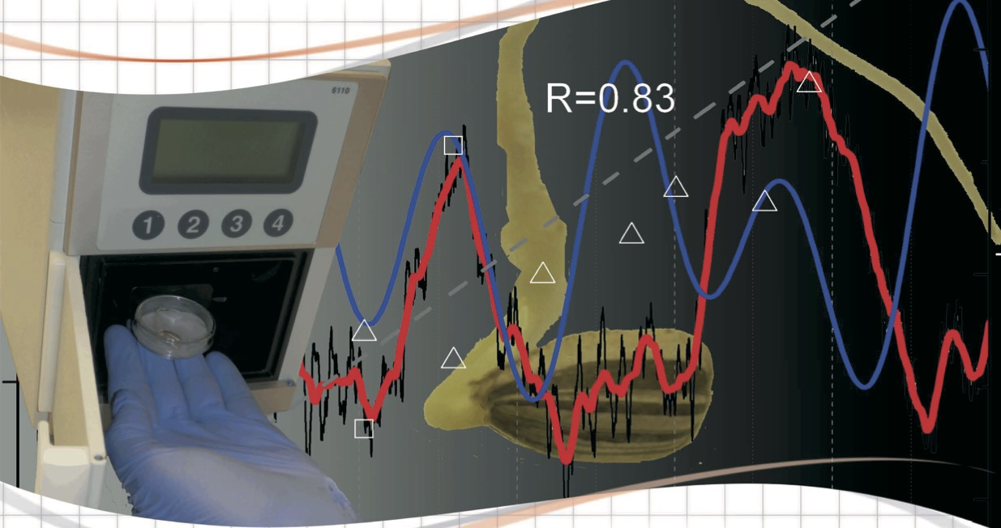
Ultra-weak luminescence in seedlings
applications
ENDOGENOUS BIOPHOTONICS: ULTRA-WEAK LUMINESCENCE FROM BIOLOGICAL SYSTEMS
Cristiano de Mello Gallep
(Dedicated to the centenary of A.G. Gurwitsch’s discovery)
gallep@unicamp.br
Lab. Fotônica Aplicada - LaFA

Slide 2
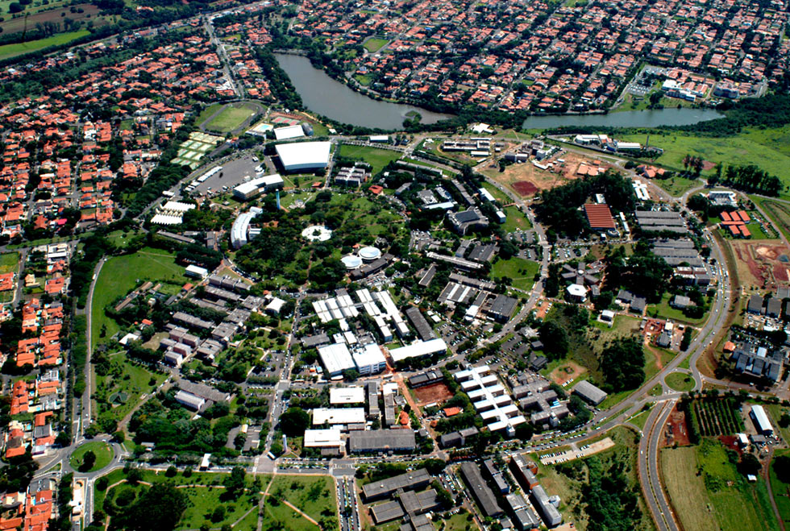
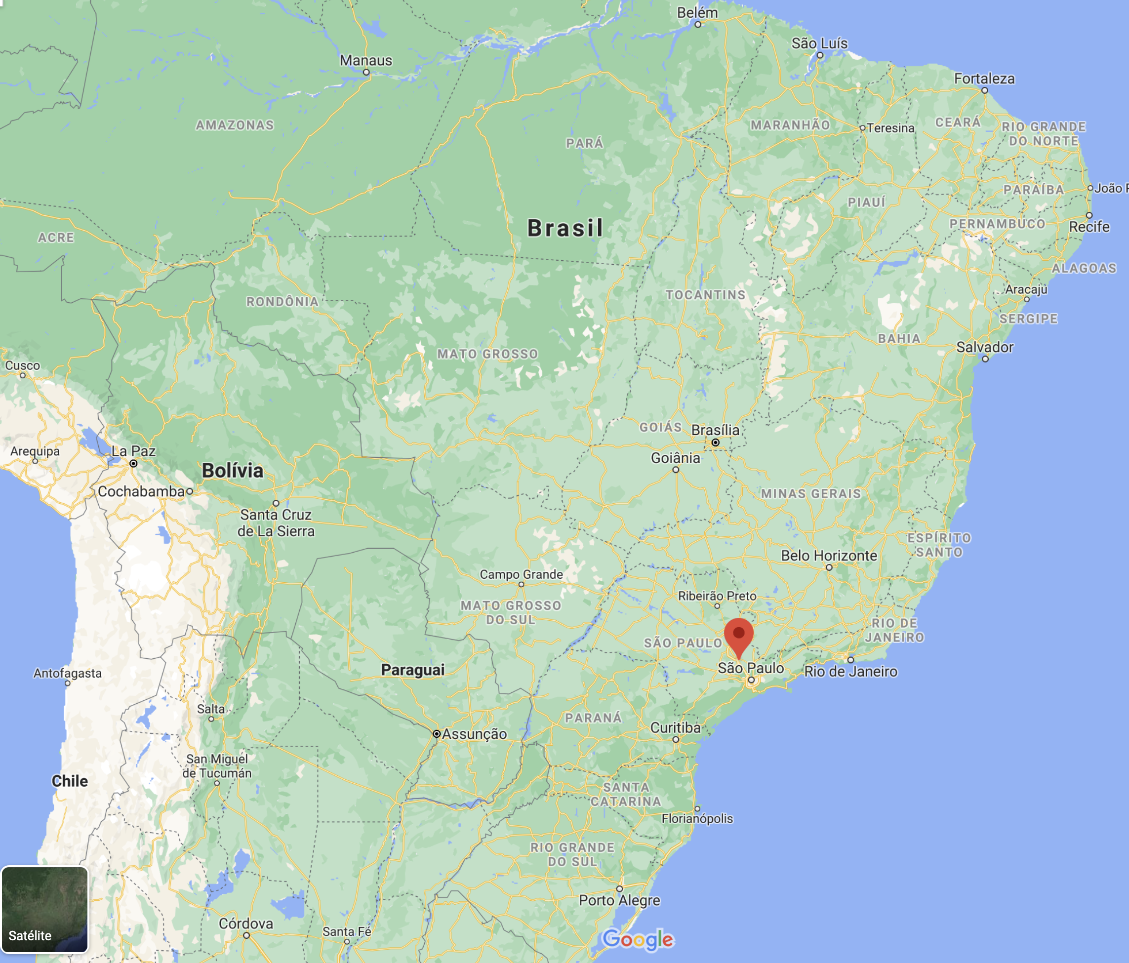
UNICAMP
Campinas State University
Campinas
Limeira
: FT and FCA
Piracicaba

Slide 3
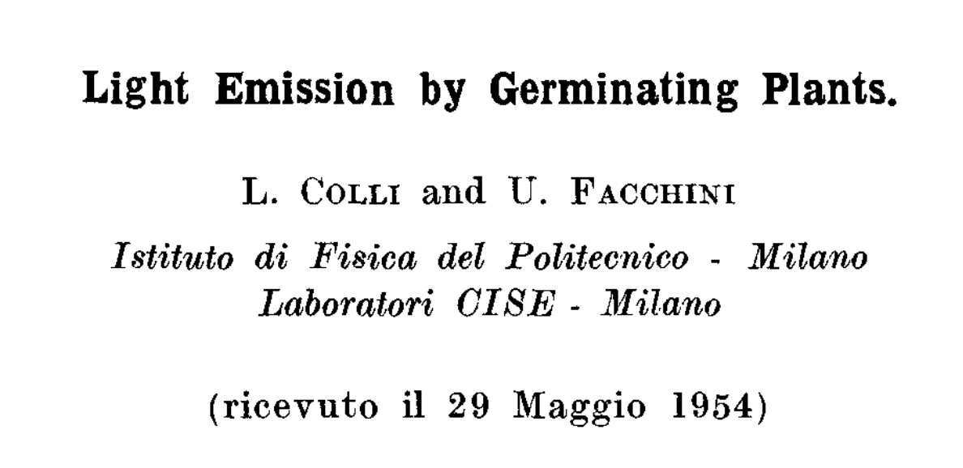
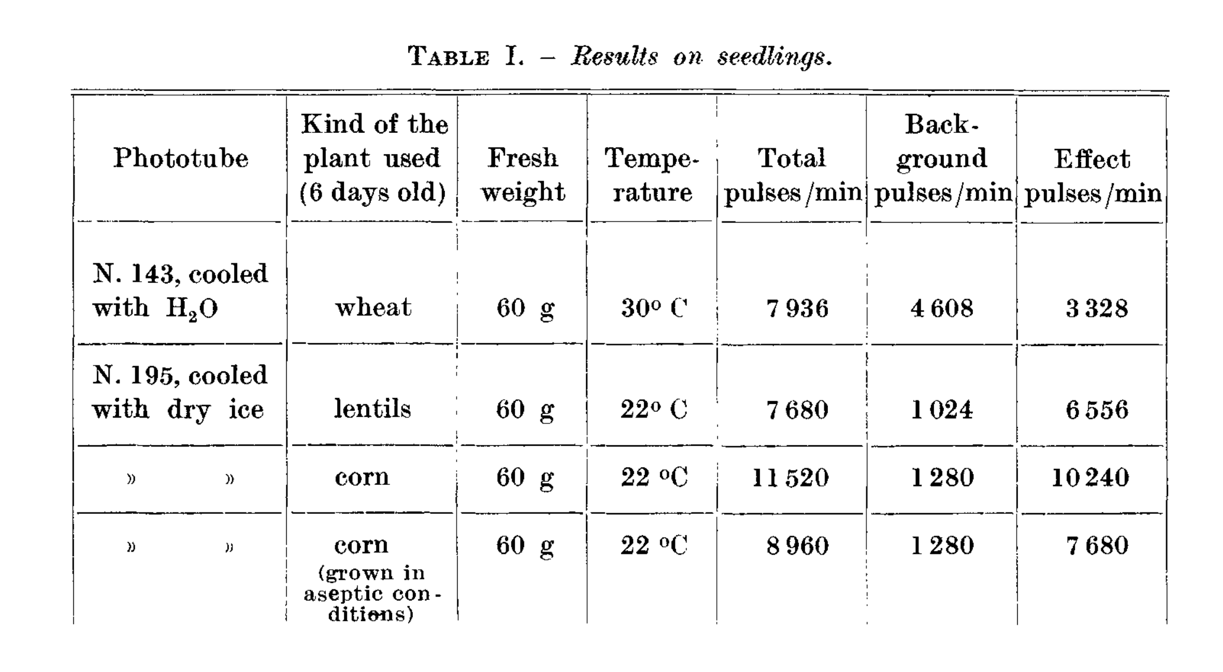
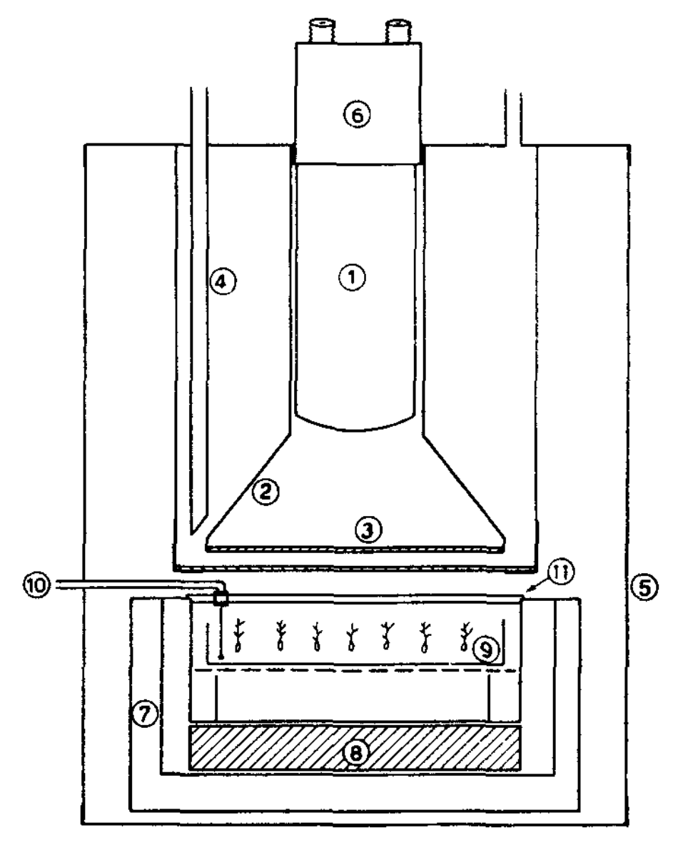
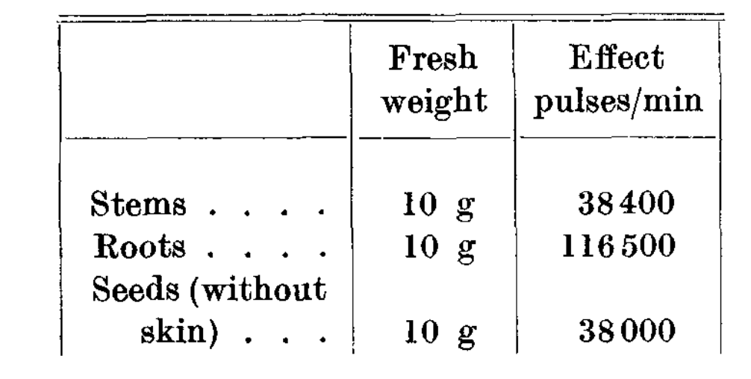

Slide 4
BAL - Biological Auto-Luminescence
UPE
UWL
UWCL
.
.
DL
https://doi.org/10.1016/j.preteyeres.2017.07.001

Slide 5
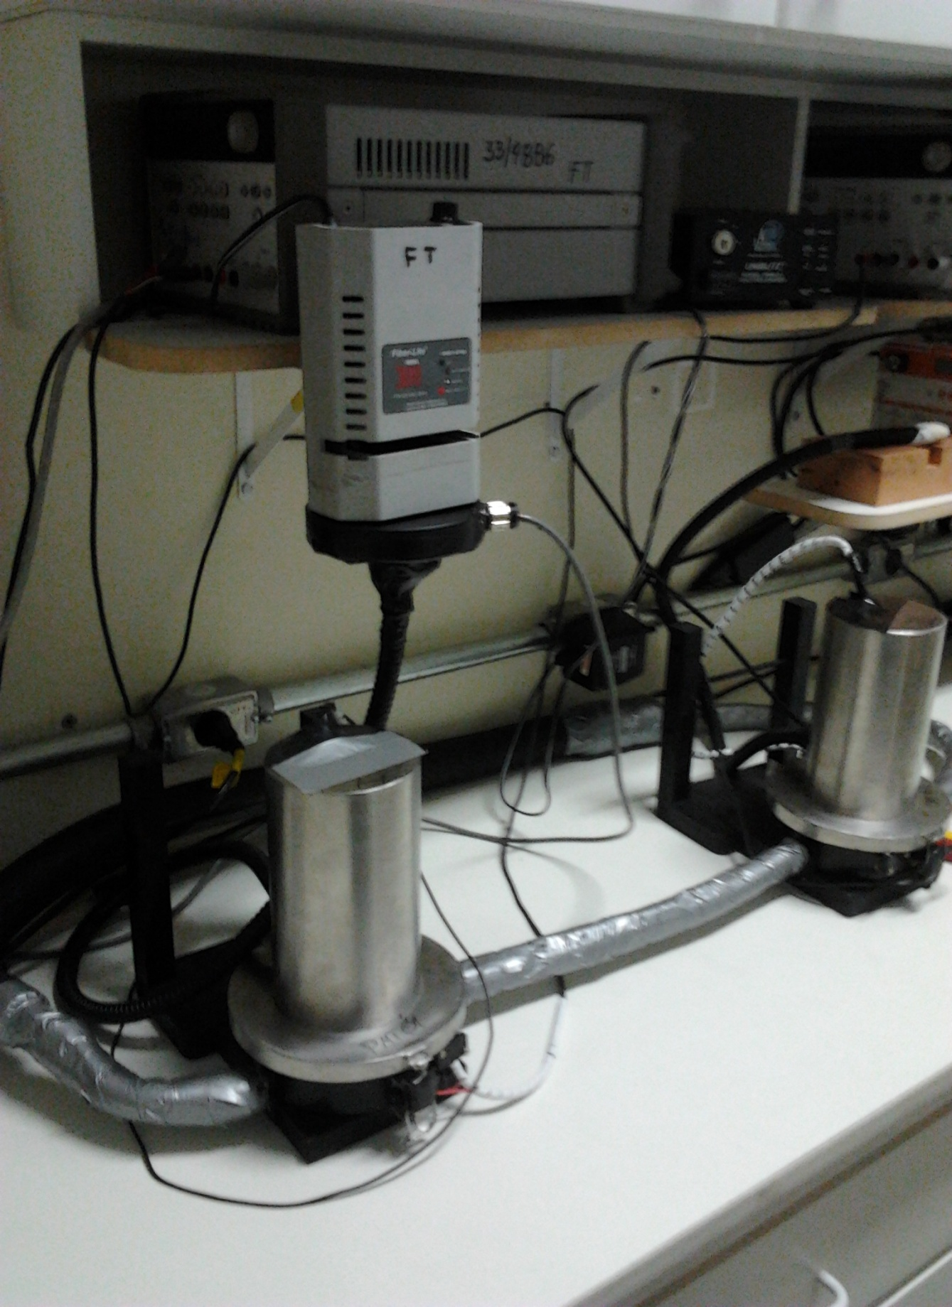
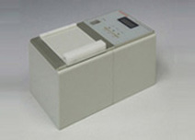
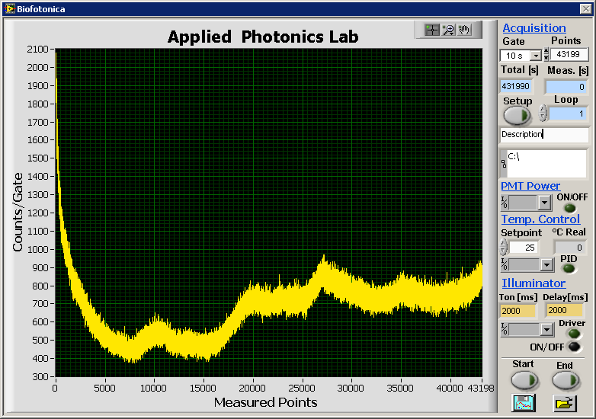
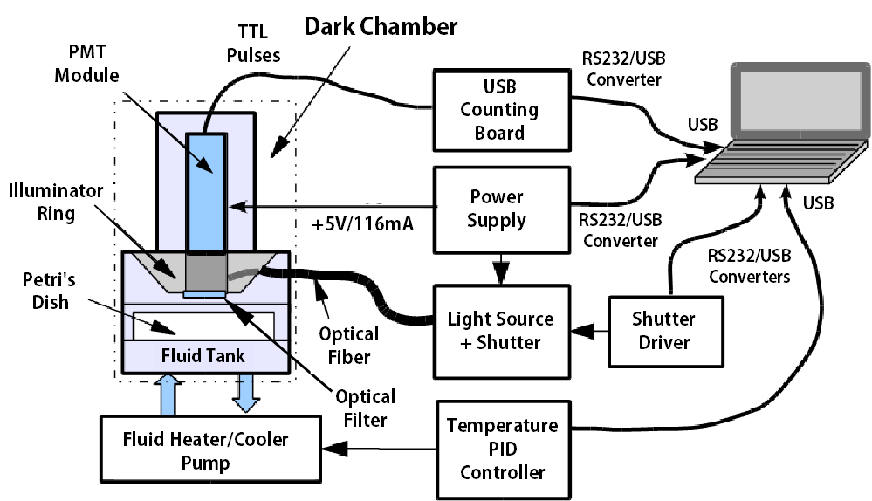
IR - set
VIS - set

Slide 6
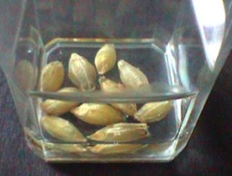
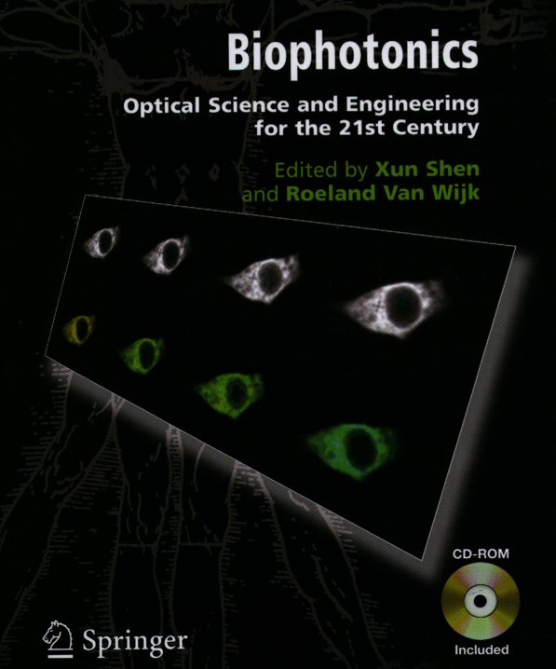
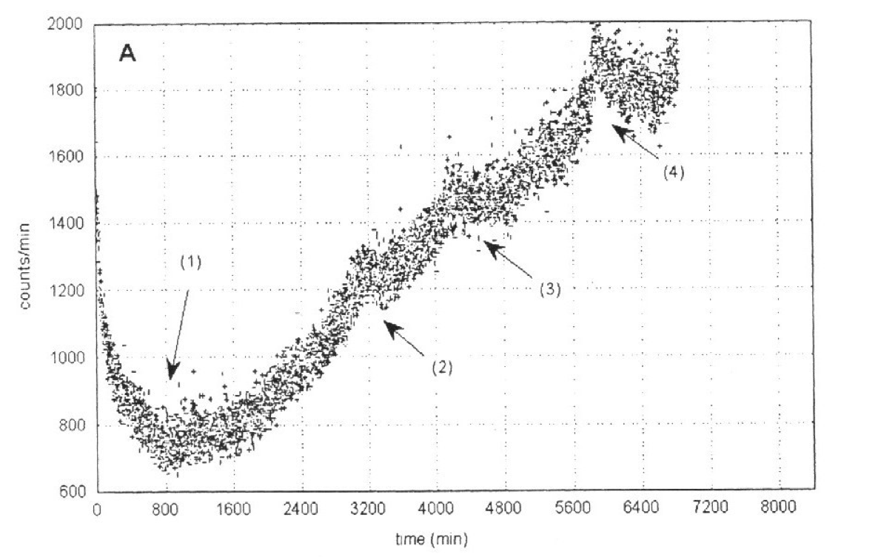
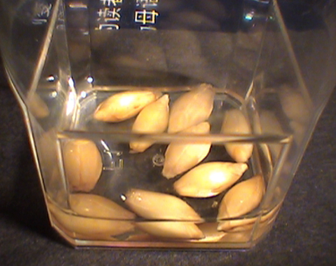
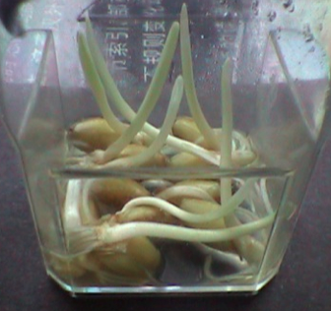
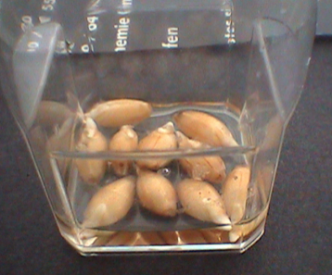
2001*

Slide 7
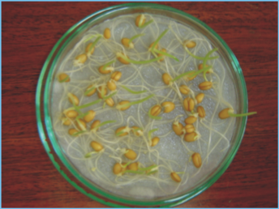
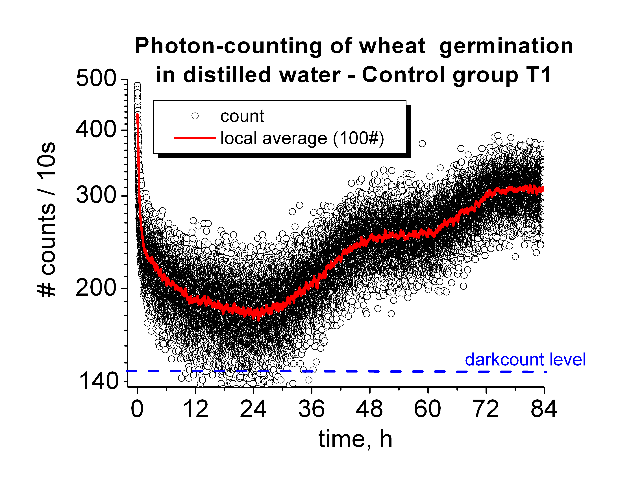
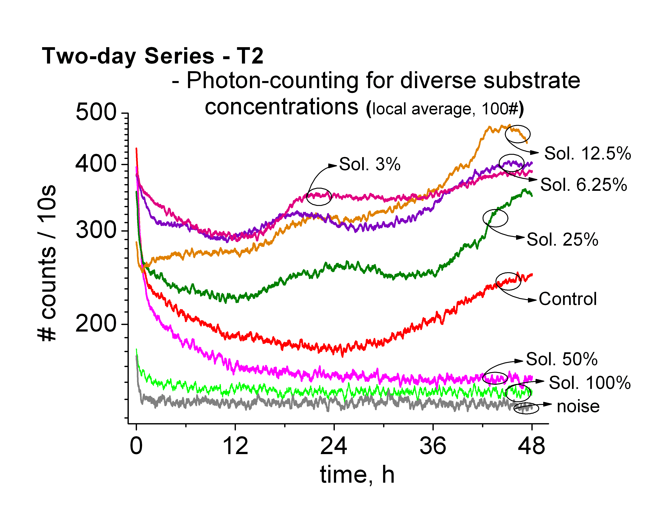

Slide 8
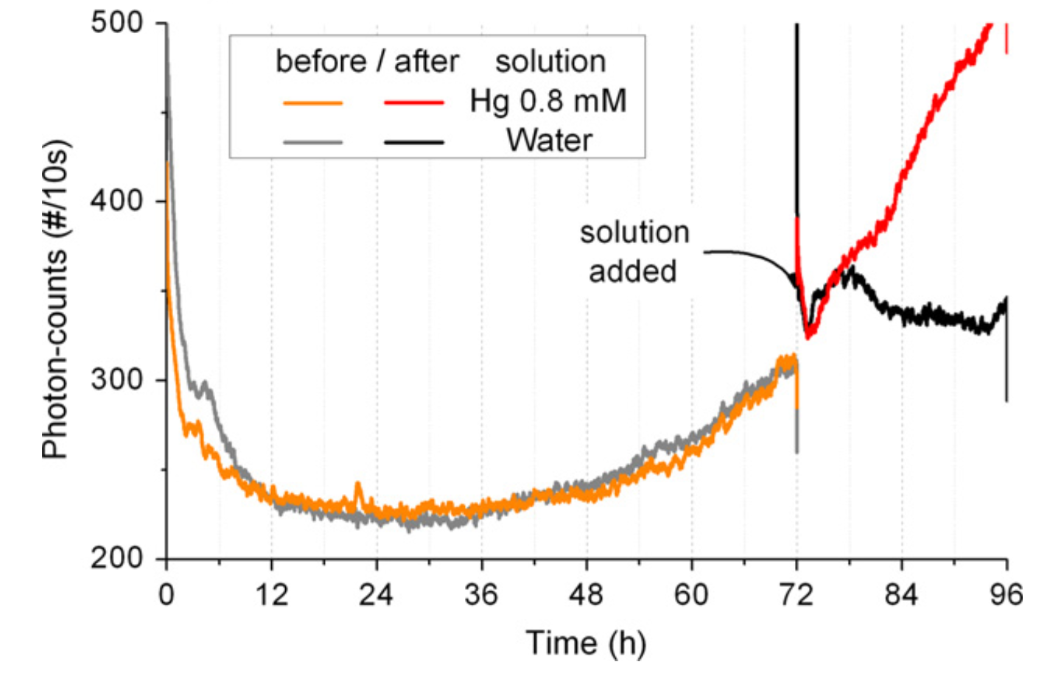
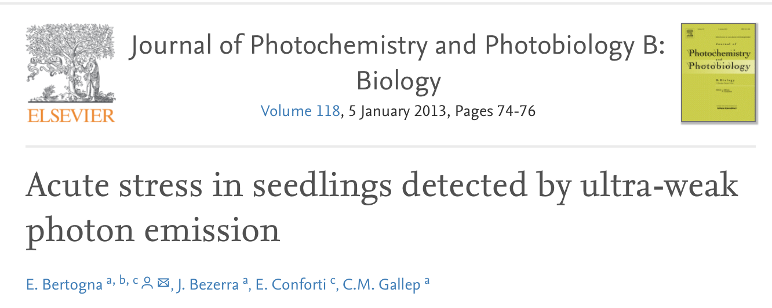
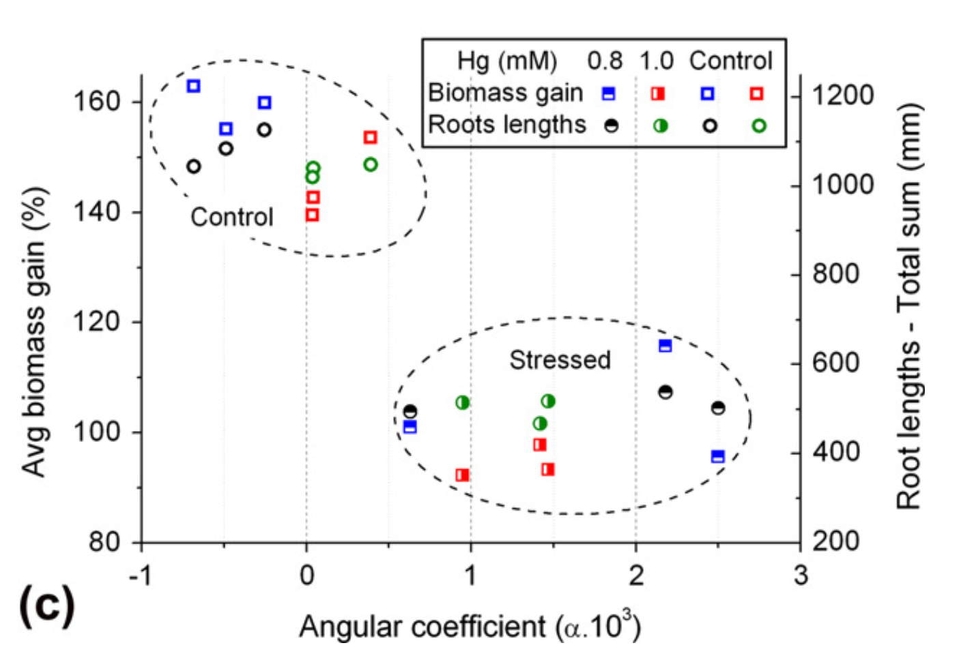
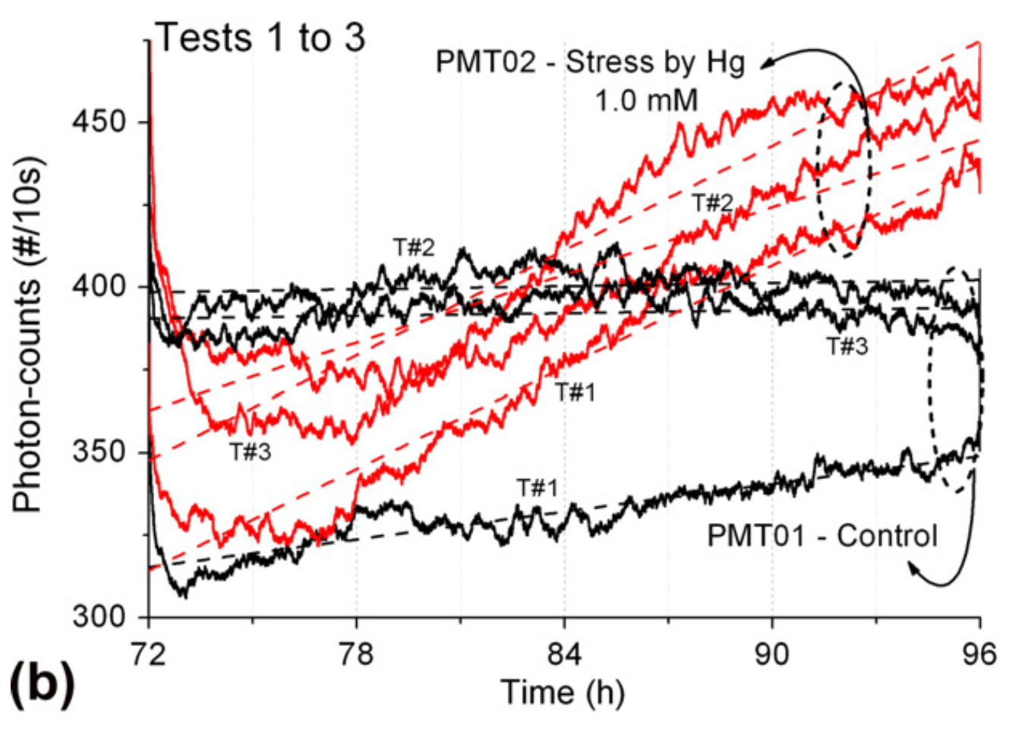

Slide 9
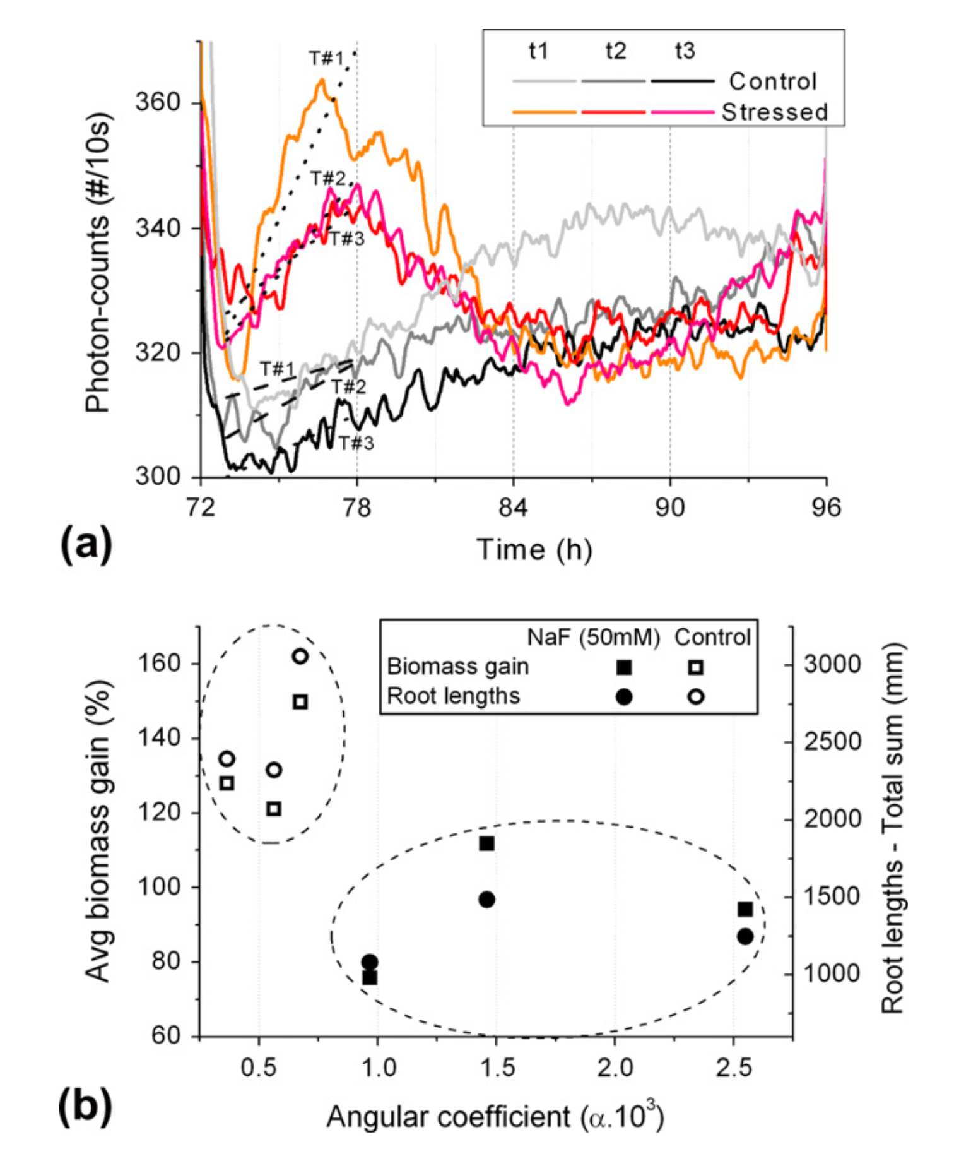

Slide 10
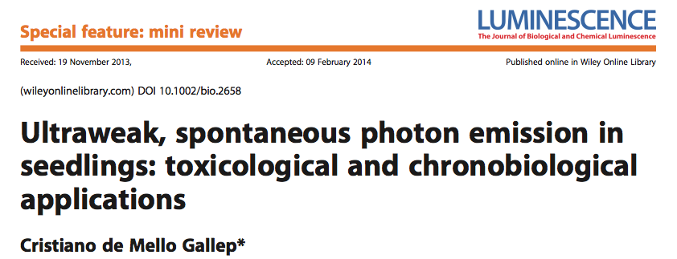
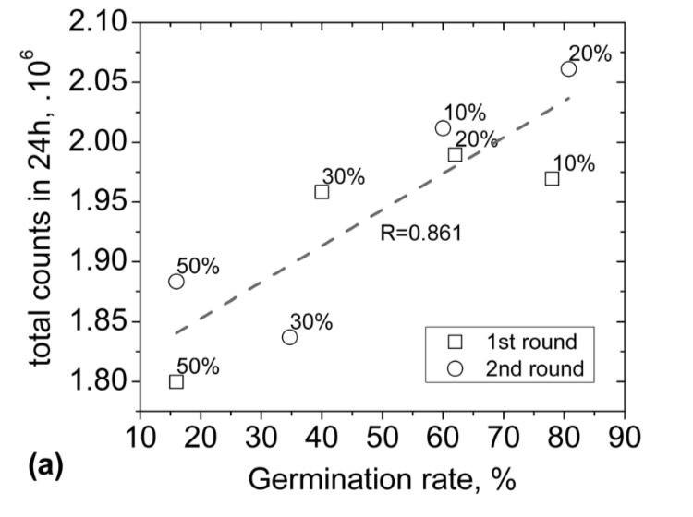
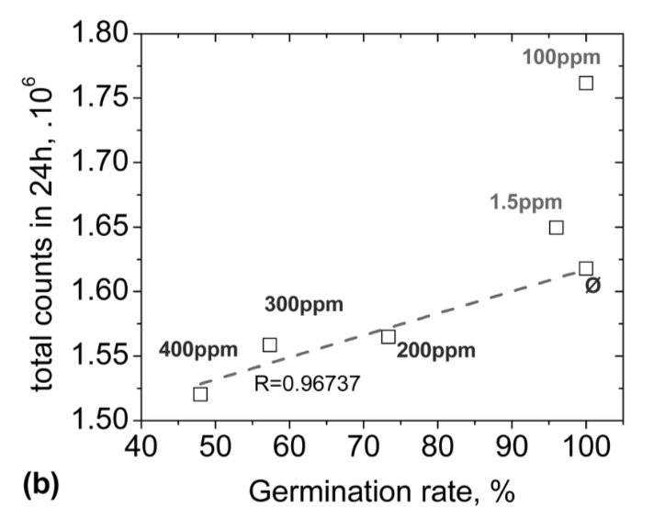
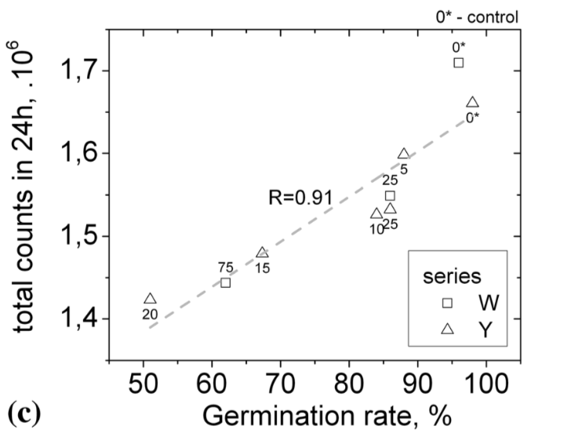
3rd day,
total UPE
leachate
dicromate-K
galvanic ink
50 wheat seedlings in
wastewater sediment

Slide 11
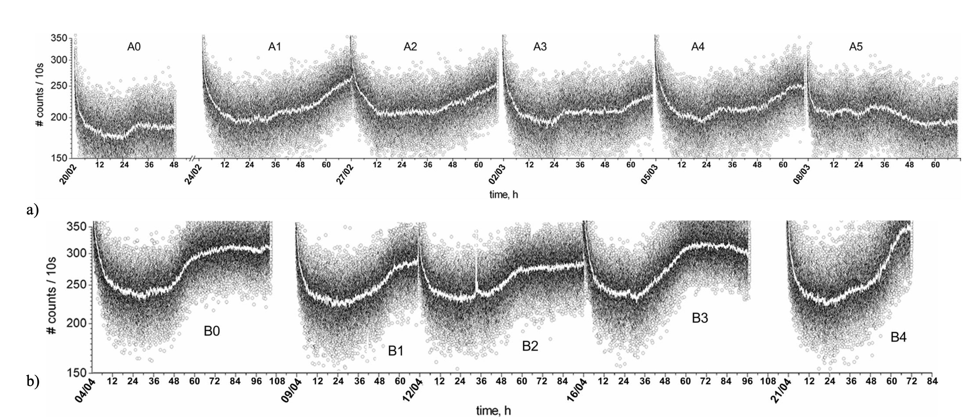
IEEE - IMOC 2007
50 wheat seeds

Slide 12
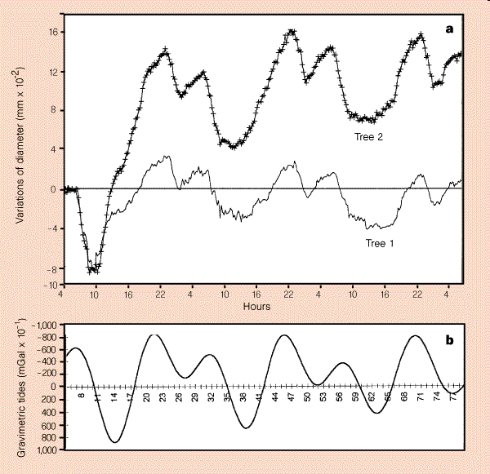
Neuss, 1-6 Aug/2010

Slide 13
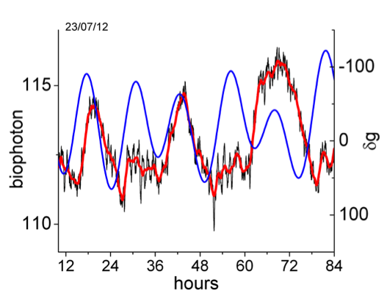
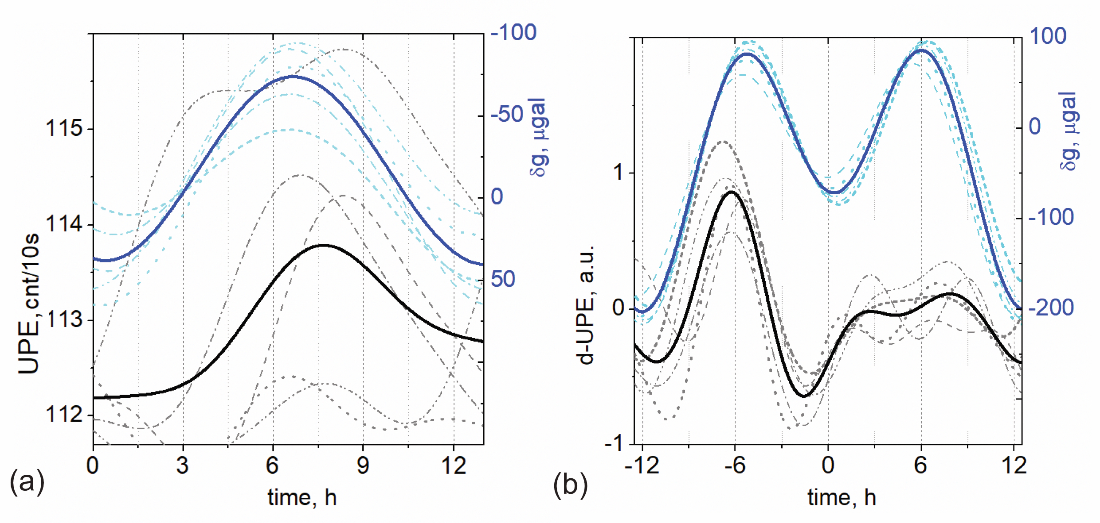
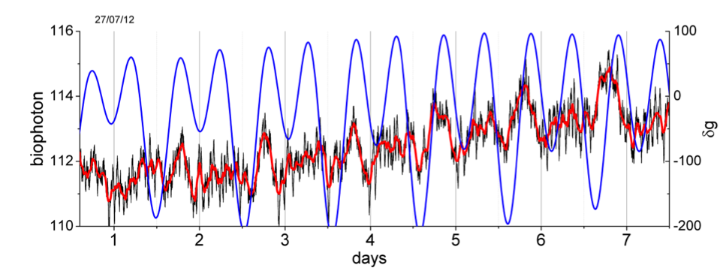
Single seed UPE - Sunflower
after 3 days in dark…

Slide 14
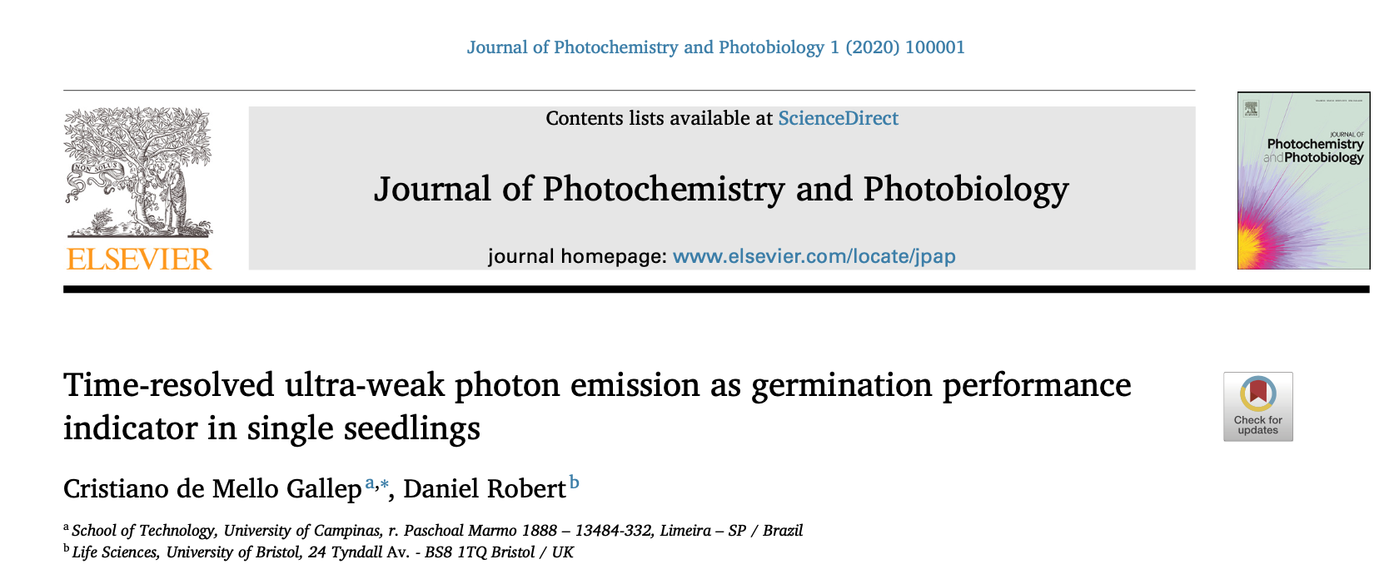
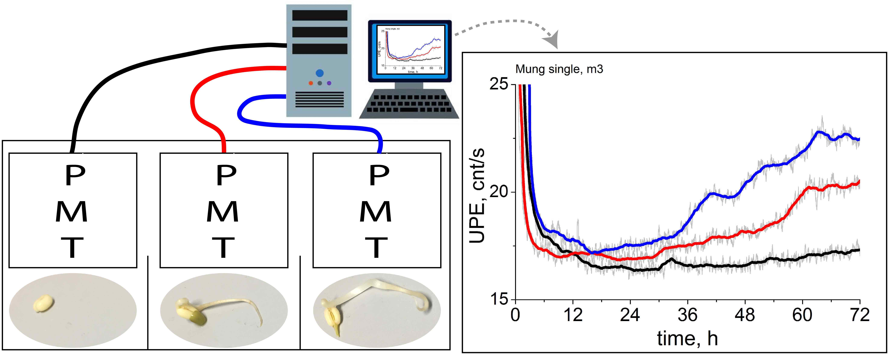
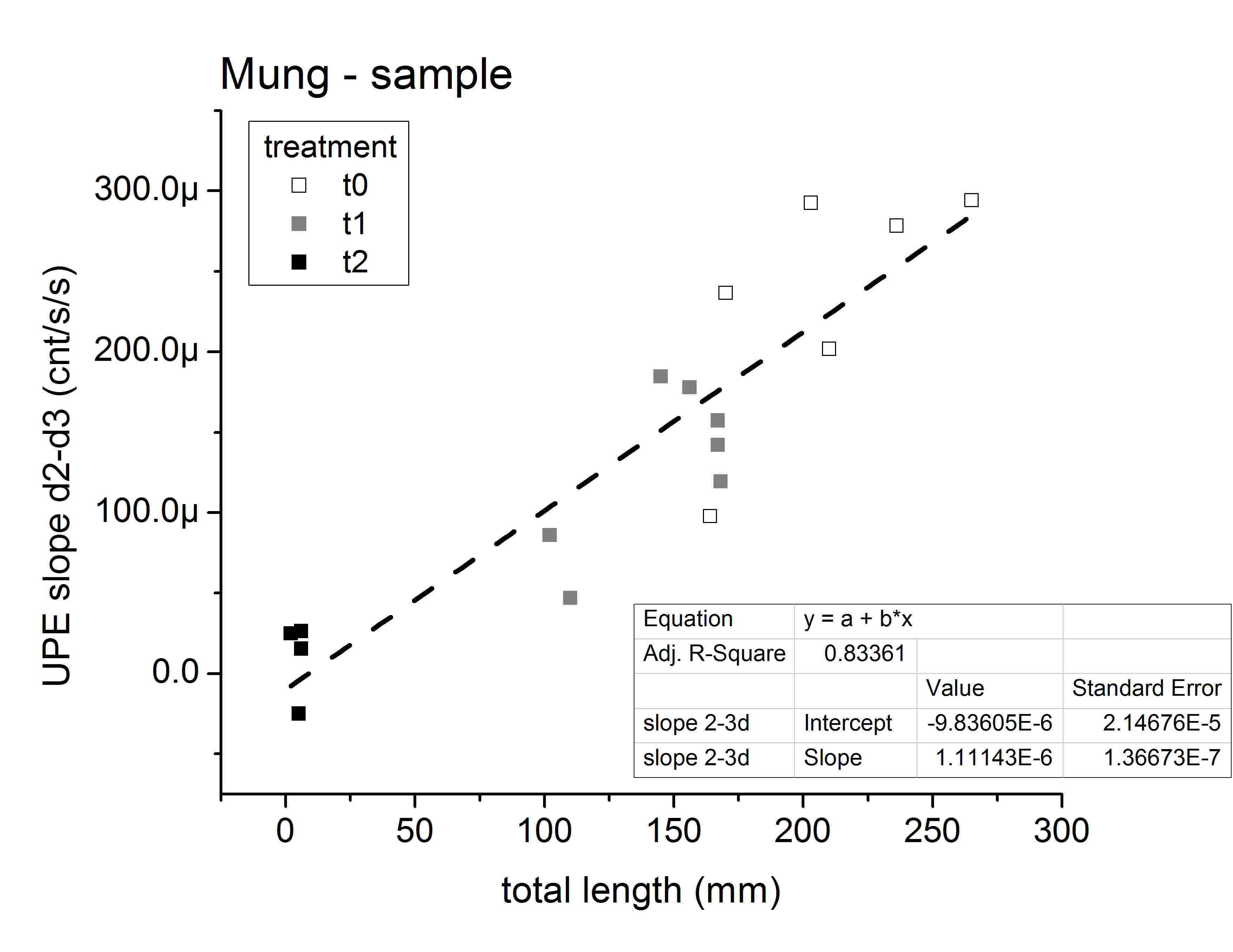
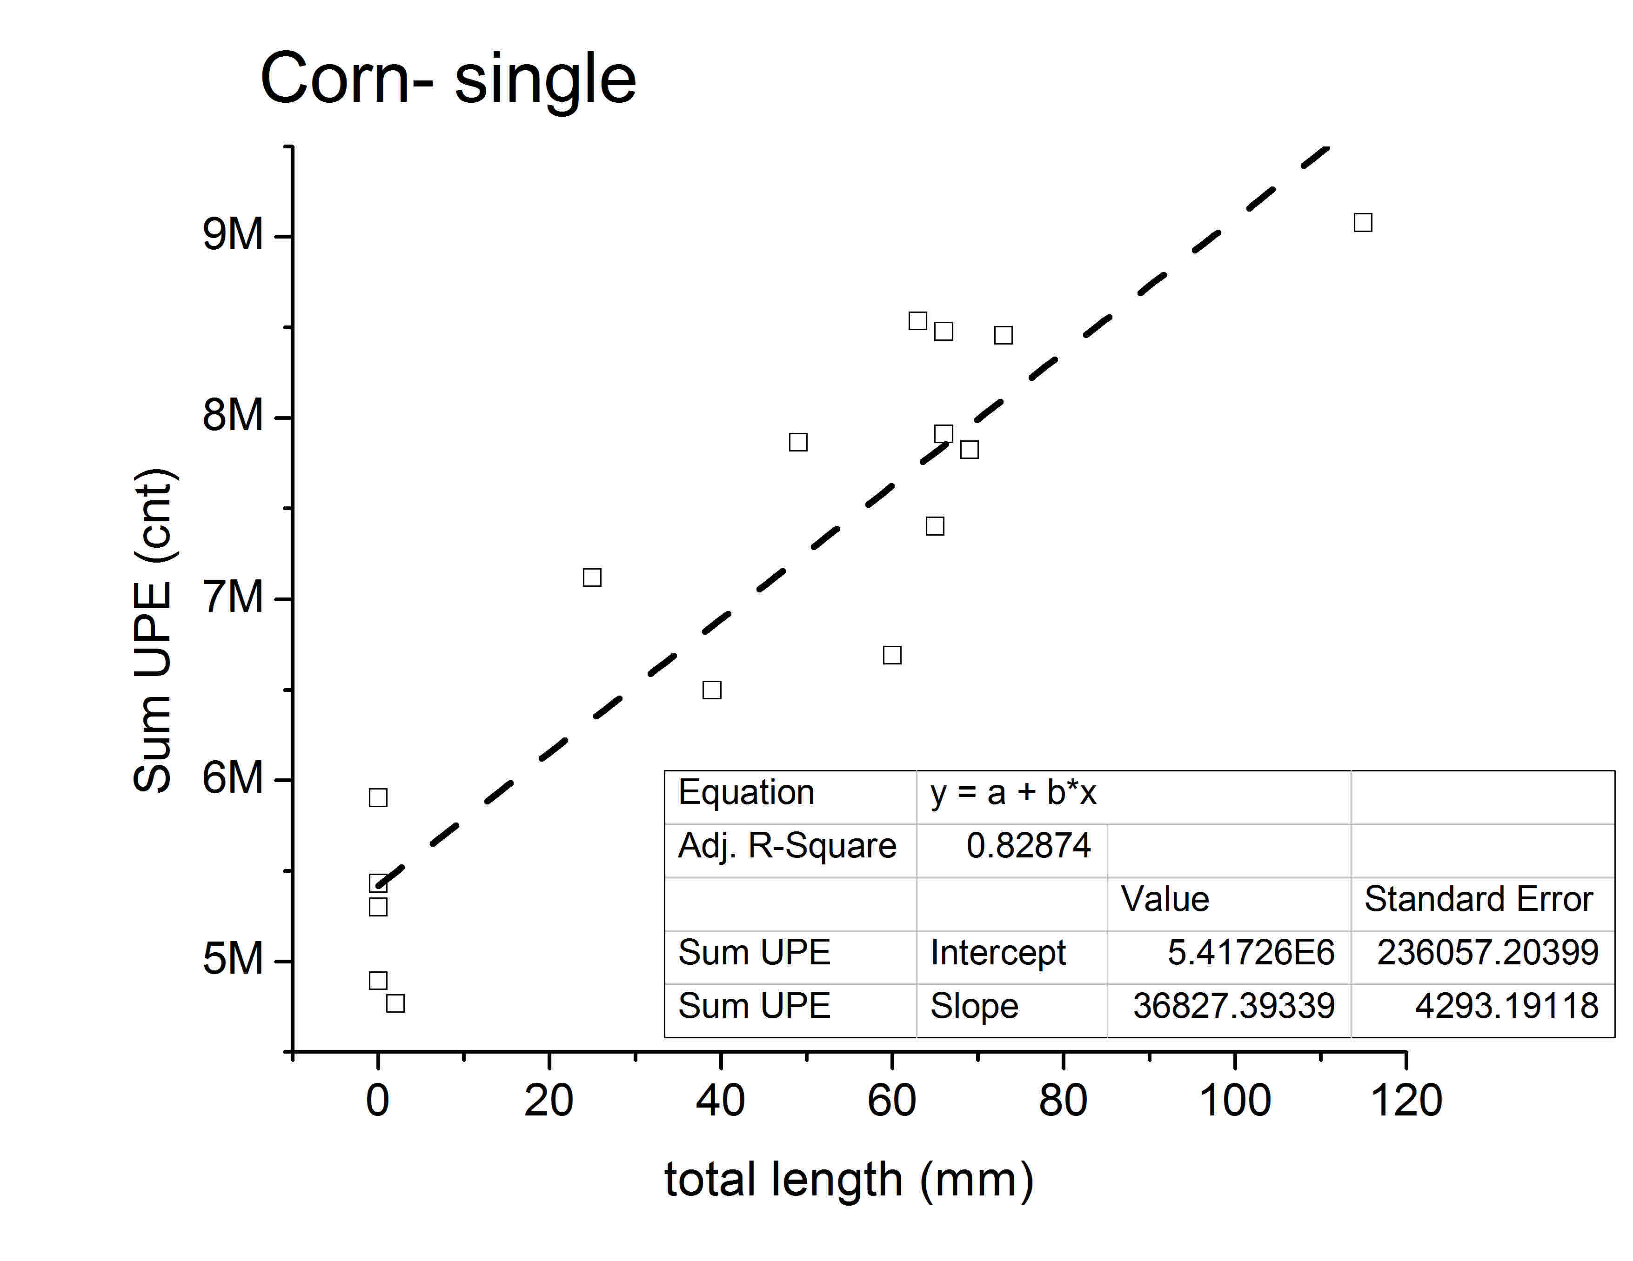
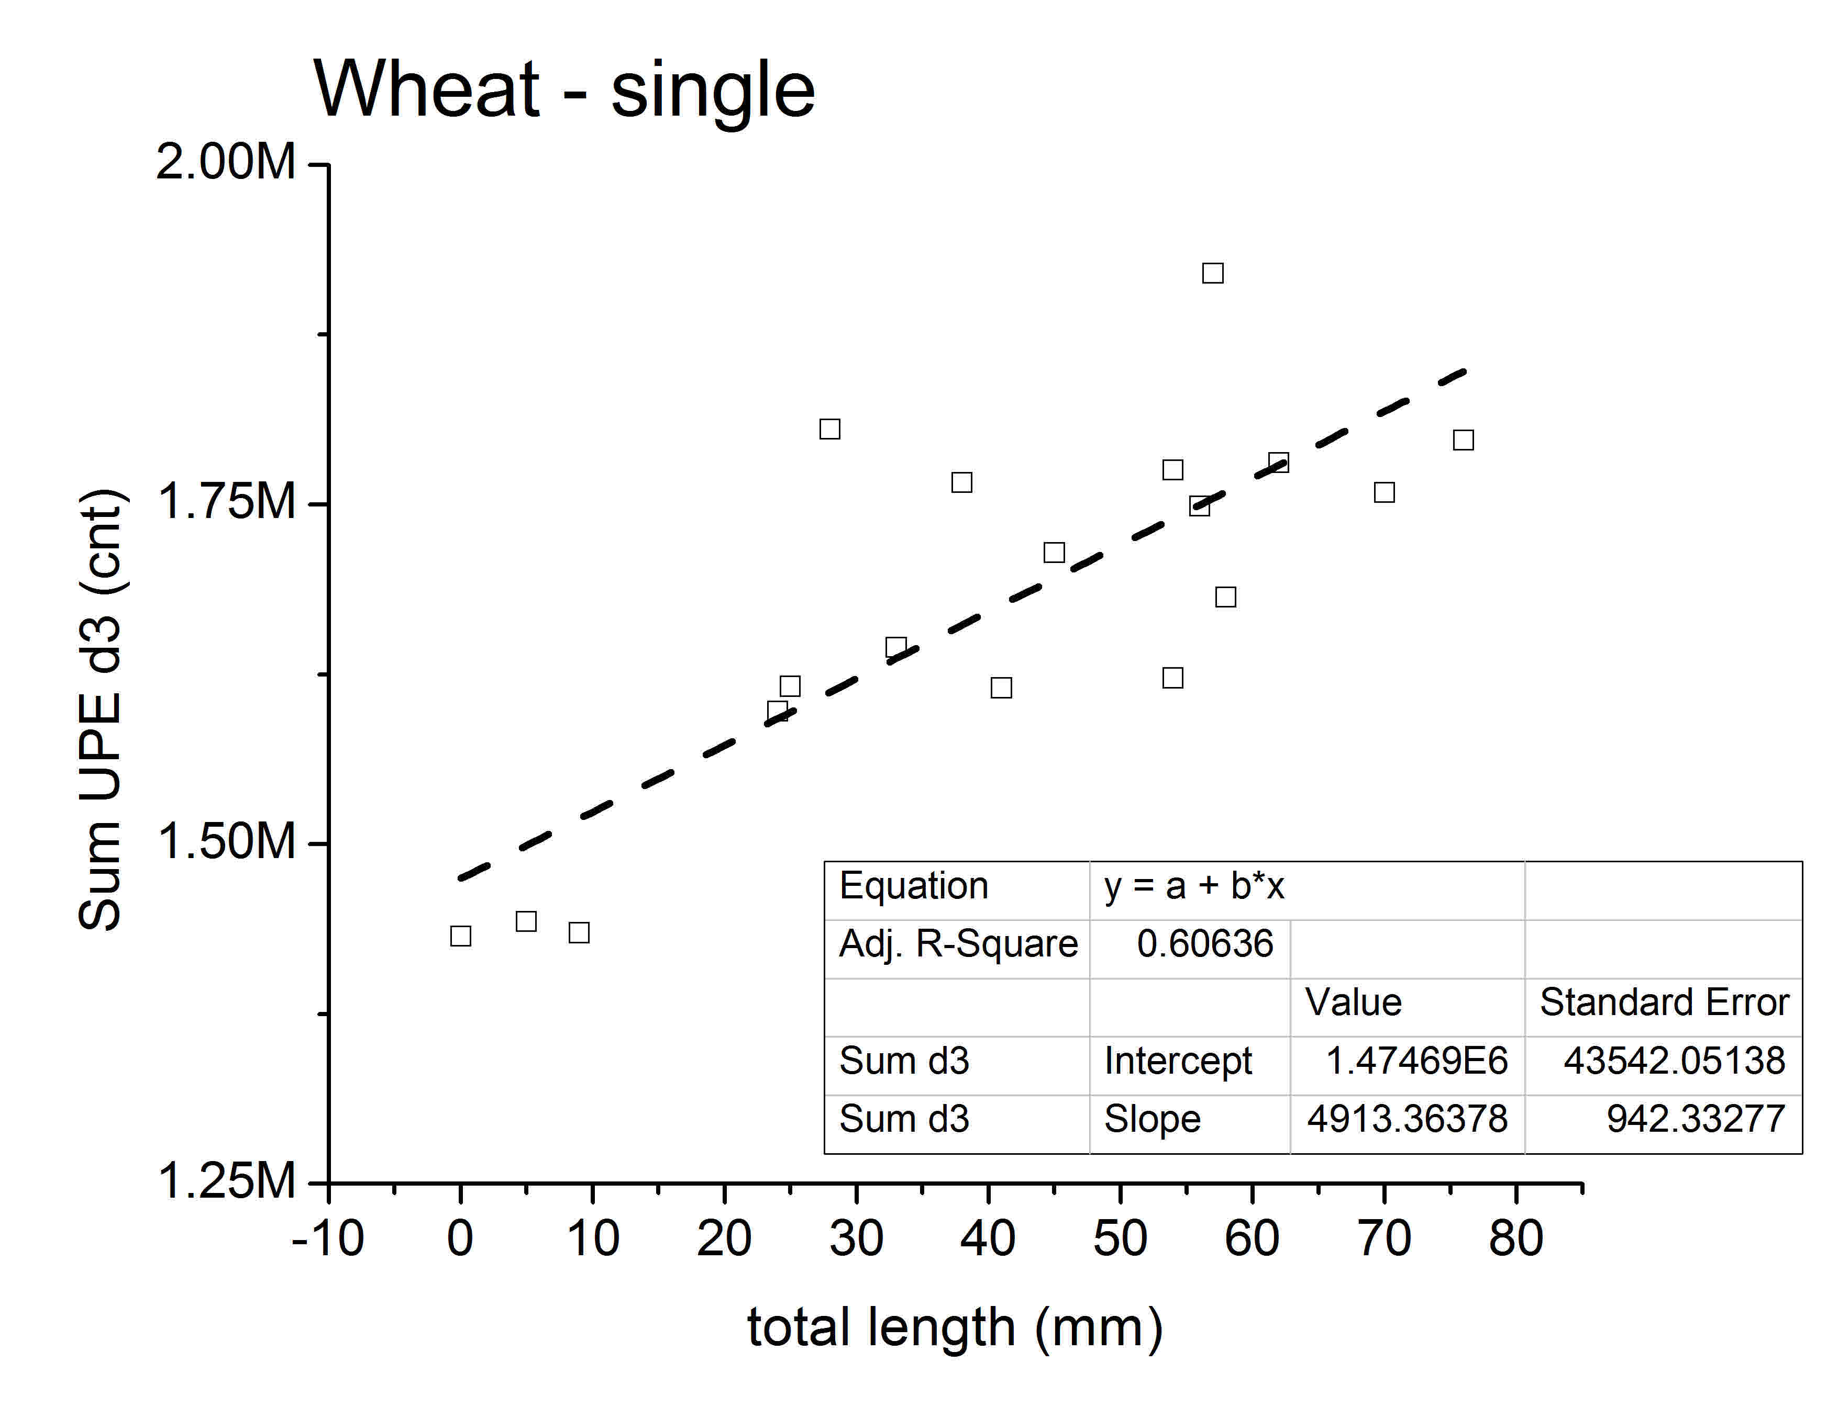
2019
10 beans

Slide 15
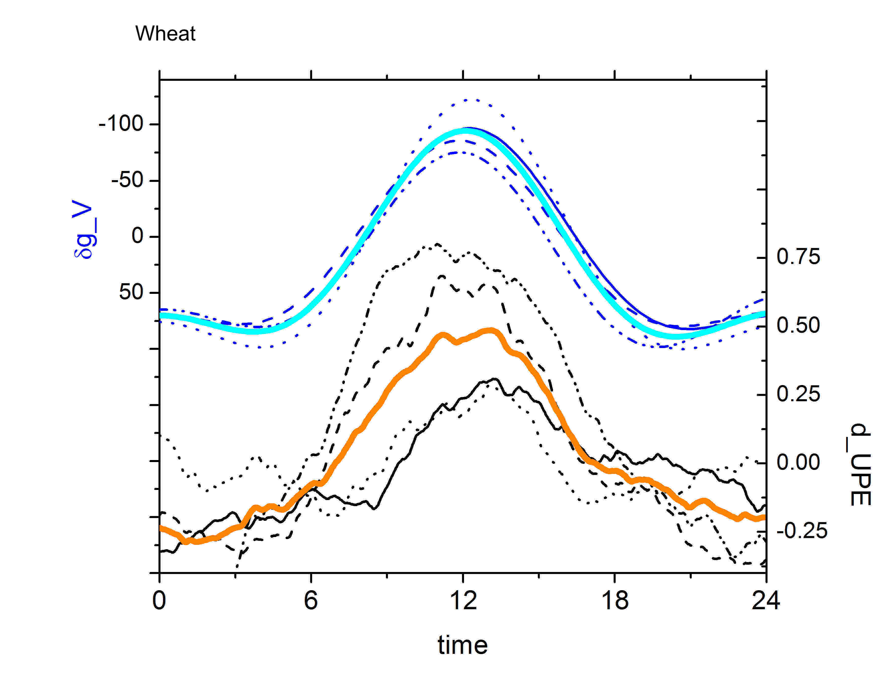
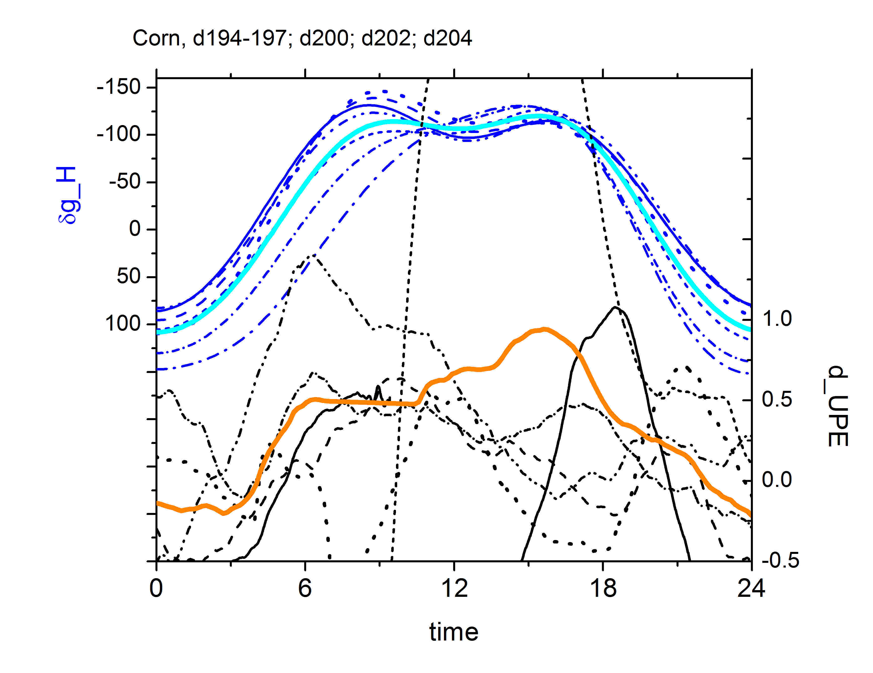
so, what if the gravimetric tide triggers circadian cycles?

Slide 16
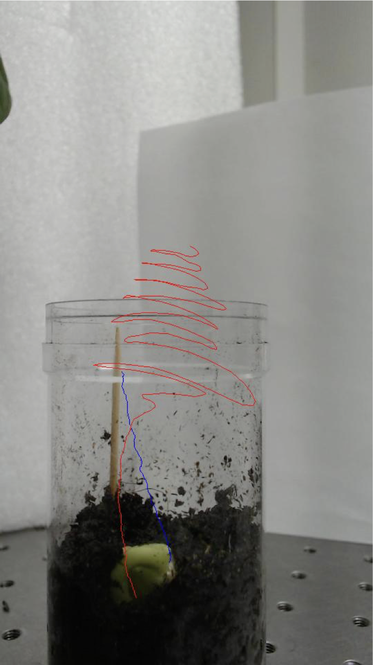
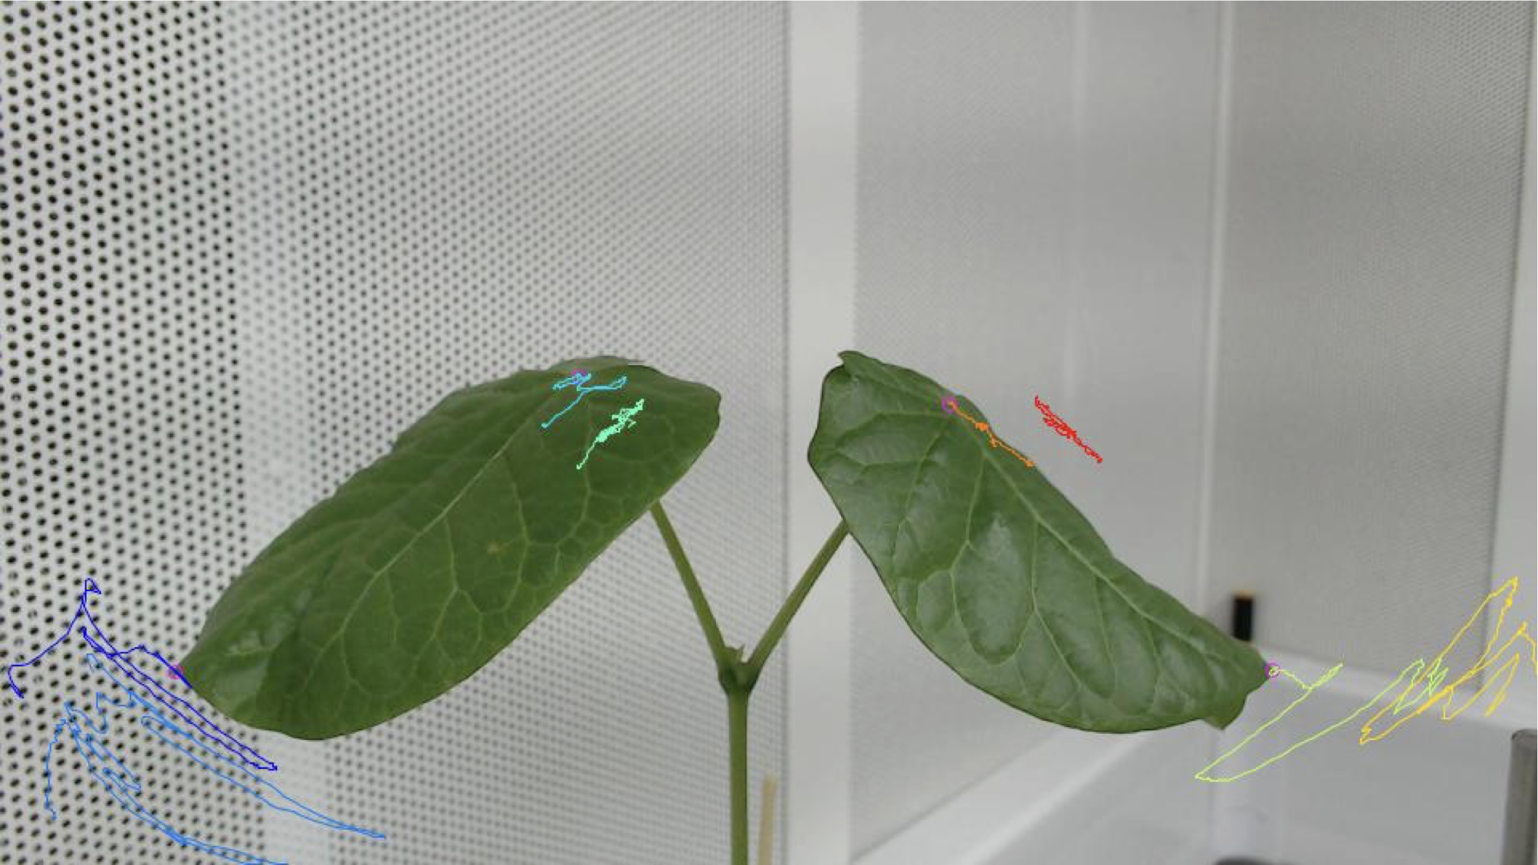
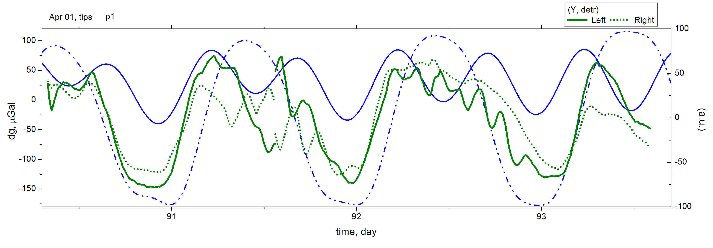
Leaf movements
revisited…
p1
2019
p4
horizontal
vertical

Slide 17
The energy of lunar-solar tides reaches ~10²⁰ J per annum
at the level of global natural energy sources:
heat inflow from the Earth’s interior (~10²¹ J per annum)
tectonic deformations (~10¹⁹−10²⁰ J per annum)
volcanic eruptions (~10¹⁵−10²⁰ J per annum)
radioactive decay of isotopes deep in the Earth (~10²⁰−10²¹ J per annum)
Besides data to be shown, also influence global processes such:
frequency of the occurrence of earthquakes (including weak ones)
spatial distribution of earthquake sources
inertial and resonant phenomena in the Earth’s core and the processes at the core/mantle boundary

Slide 18
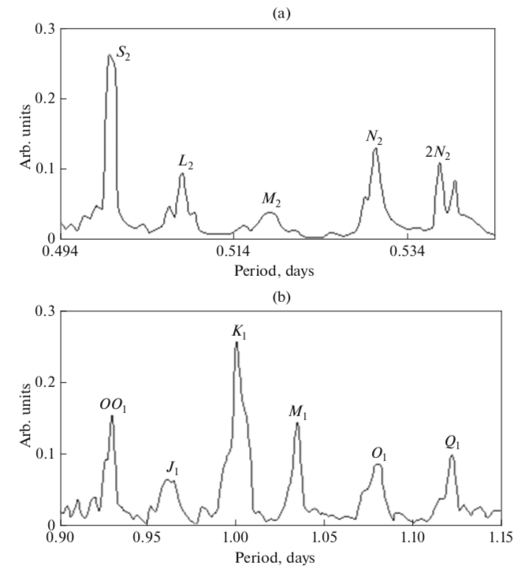
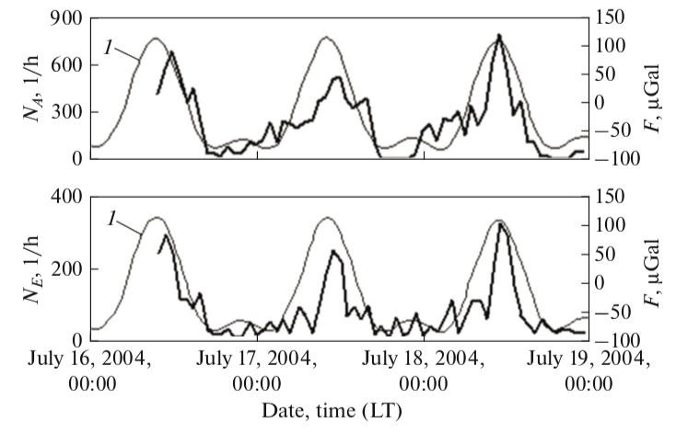
radon volumetric activity
The number of the acts of relaxation (microseismic pulses) N_{A} and electric pulses in the ground N_{E} in the zone controlled by the Kurai fault (Mountainous Altai)
(a) Semidiurnal and (b) near-diurnal intervals of the air pressure (micropulsations) variations spectrum in Moscow.

Slide 19
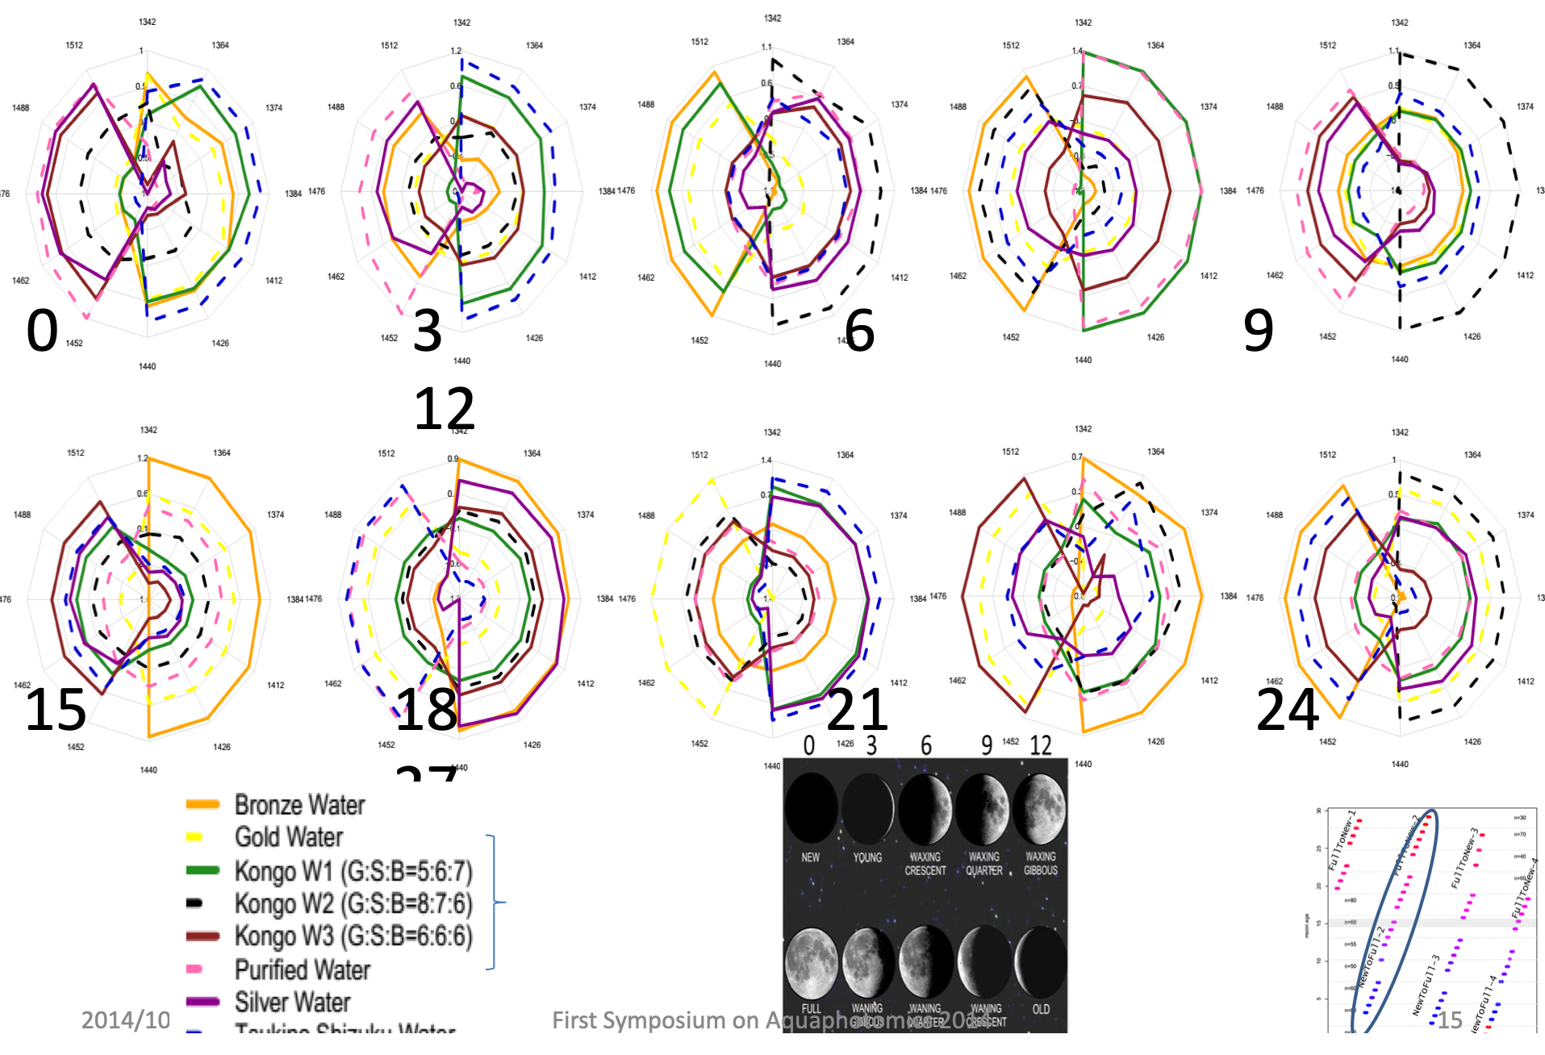
Aquaphotomics
- Roumiana Tsenkova
multi-variant analysis of
FT-NIR spectroscopy
Kobe University

Slide 20
