Slide 1
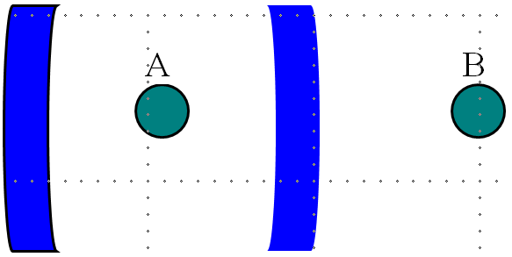
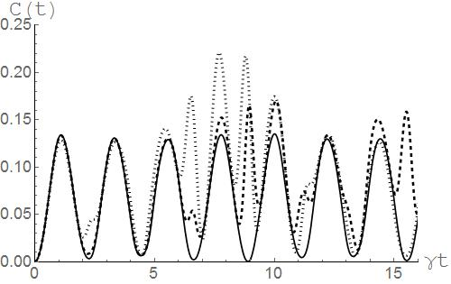
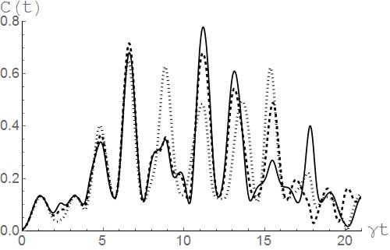
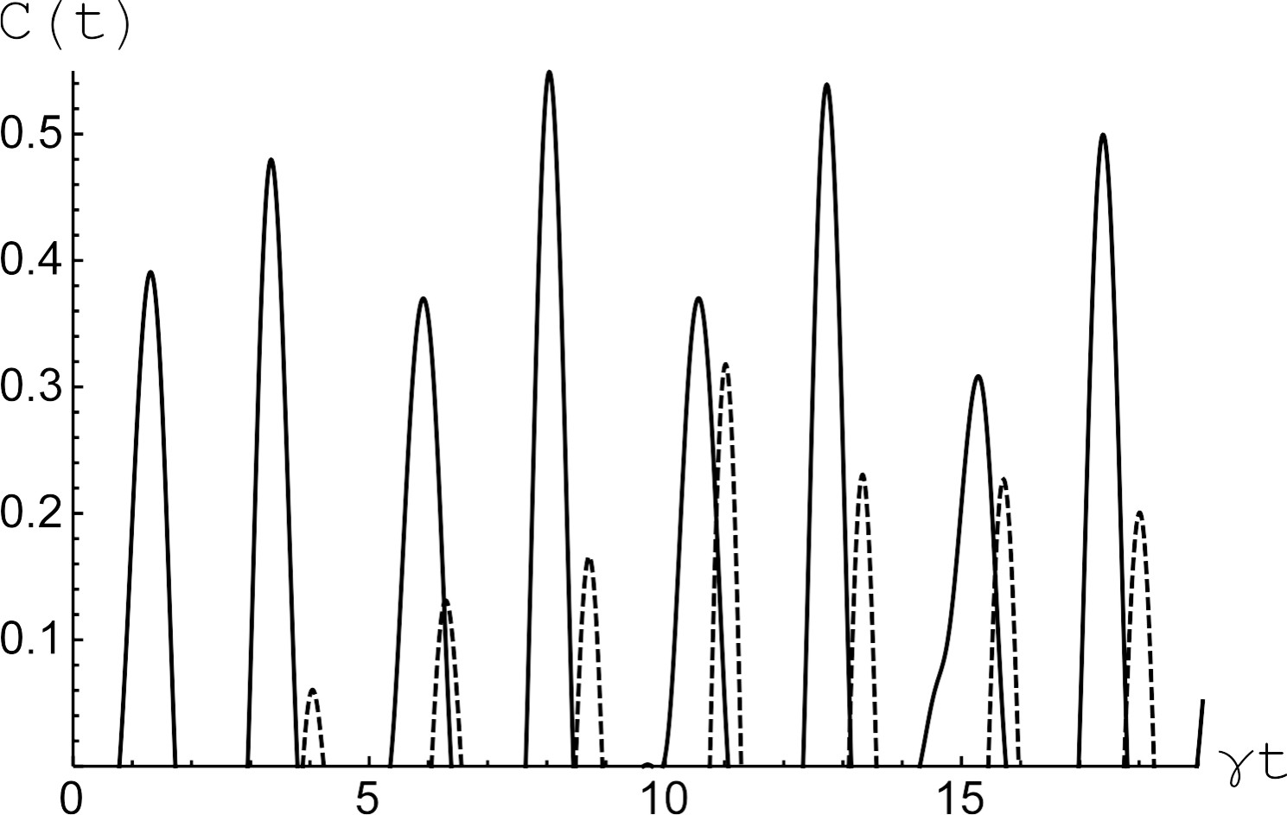
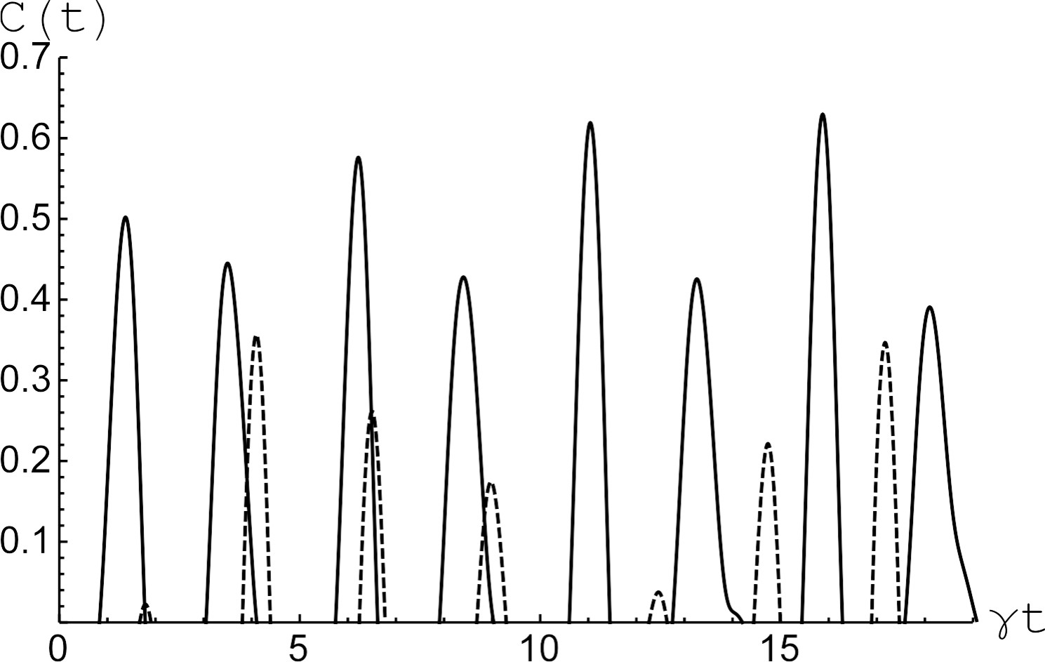
Entanglement between isolated two-level atom and Jaynes-Cummings atom in a cavity with nonlinearity
E. K. Bashkirov, R.K. Zakharov
Samara National Research University
Simulations
Model and negativity calculations
(a) | (b)
Hamiltonian in the interaction picture
Initial separable incoherent atomic states
(1)
or
(2)
Initial thermal cavity field state
Time-dependent density matrix
(a) | (b)
Reduced atomic density matrix for initial atomic states (1) or (2)
Matrix elements for initial atomic state (1)
Conclusion
Concurrence
Here are the eigenvalues of the matrix in decreasing order
with

