Slide 1
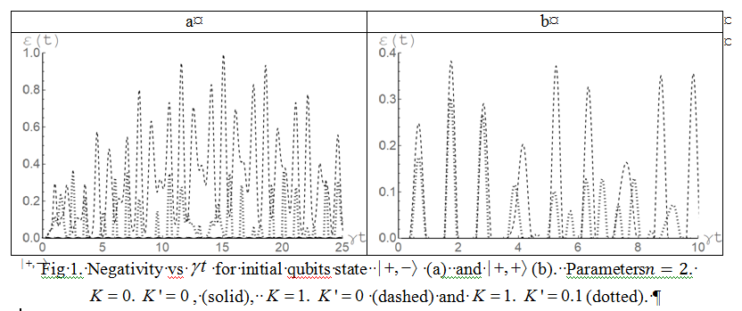
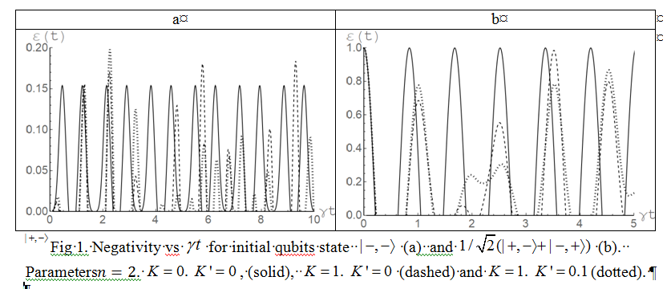
Bashkirov E.K.
Samara National Research University
On the Dynamics of the generalized Tavis-Cummings Model with nonlinearities
.
Model and negativity calculations
Simulations
Hamiltonian in the interaction picture
Initial separable
or Bell’d type entangled atomic state
Fock cavity field state
Time-dependent density matrix
The negativity
Here is the eigenvalues of the partial transpose matrix
Therefore
SAMARA NATIONAL RESEARCH UNIVERSITY
34, Moskovskoye shosse, Samara, 443086, Russia

