Slide 1
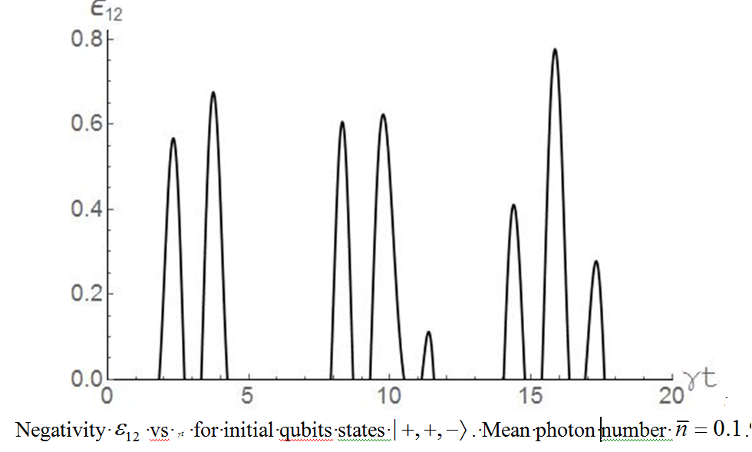
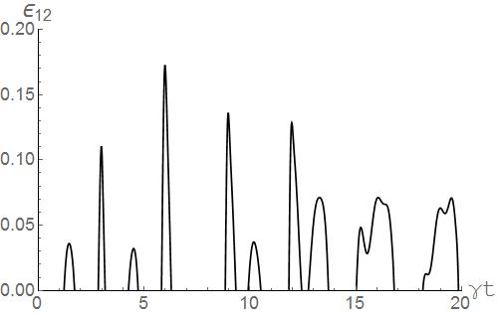

Bashkirov E.K., Bagrov A.R., Vasiliev I.V.
Samara National Research University
Dynamics of three qubits not-resonantly interacting with one-mode cavity field
.
Simulations
Hamiltonian in the interaction picture
Initial separable
or Bell’d type entangled atomic state
.
Thermal cavity field
Time-dependent density matrix
The negativity between 1 and 2 qubits
Here is the eigenvalues of the partial transpose matrix
Therefore
SAMARA NATIONAL RESEARCH UNIVERSITY
34, Moskovskoye shosse, Samara, 443086, Russia

